Slide 1



constructive solutions
High Volume JSW GGBFS (70%)Concrete using Chemical admixture Fosroc Auramix 450
- Presentation and Live Demo

Slide 2
Content
Introduction
Brief about GGBFS
Brief about Chemical admixture
Market expectations on high volume GGBFS
High volume 70% GGBFS trial mix details
Demonstration trials.

Slide 3
Introduction
The supplementary cementitious material (SCM) has been extensively used in the development of high-performance concrete (HPC), which include fly ash, silica fumes, rice husk ashes and ground granulated blast furnace slag (GGBS).
Why high volume replacement of SCM?
  Sustainable development’’ - ‘‘The development that meets the needs of the present without compromising the ability of future generations to meet their own needs’’.
  As you know concrete is the second largest used material after water and it stands at 2 tonnes per capita per year and it would continue to increase with time, need alternative SCM like for sustainable concrete.
  Reduce the emission of CO₂ in atmosphere during manufacturing of cement. There is a general understanding that one tonne of cement production leads to almost one tonne of CO₂ emission. By using 70% GGBFS it shall be reduced to117 kg/m³
  To improvement of the properties of concrete both in fresh and hardened form,
Apart from improvement of the properties of concrete in fresh and hardened form, the use of SCM has also reduced the consumption of cement in concrete, thereby reducing the emissions of CO2 in the atmosphere during manufacturing of cement.
There is growing pressure over the construction industry and concrete technologists to reduce the consumption of cement by incorporating SCM and chemical admixtures in concrete. Such kind of concrete are also regarded as ‘‘sustainable concrete’
GGBS such SCM is a by-product obtained during the manufacture of iron in the blast furnace. It is economically available in large quantities and suitable for use in ready-mix concrete, in the production of large quantities of site-batched concrete and in precast product manufacturing.

Slide 4
GGBFS
Ground Granulated Blast furnace Slag(GGBFS)
  GGBS is a by-product obtained during the manufacture of iron in the blast furnace. It is economically available in large quantities and suitable for use in ready-mix concrete, in the production of large quantities of site-batched concrete and in precast product manufacturing.
Why (GGBFS) ?
  Very high replacement compared to other SCM’s 30% -80%
  Available in large quantities.
  Processed ( factory produced ) expected to be consistent in quality
  Enhances the durability
  Reduces temperature rise in concrete
  Reduces permeability
  Reduces alkali-silica reactivity
  Increases chloride and sulphate resistance.
  By-product obtained during the manufacture of iron in the blast furnace. It is economically available in large quantities and suitable for use in ready-mix concrete, in the production of large quantities of site-batched concrete and in precast product manufacturing.

Slide 5
GGBFS
Strength development of GGBFS

Slide 6

GGBFS
OPC Ordinary Portland Cement (fully hydraulic)
GGBFS Ground Granulated Blast Furnace Slag
PFA Pulverized Fuel Ash (fly ash)
CSF Condensed Silica Fume (micro silica)
Properties OPC GGBFS PFA CSF
SiO₂ % 20 37 60 95
CaO % 63 41 1 1
Al₂O₃ % 6 12 28 2
Fe₂O₃ % 3 2 8 2
Specific surface m²/kg 290 380 400 18000
Bulk density kg/m³ 1400 1200 950 250
Specific gravity 3.15 2.9 2.3 2.2

Slide 7
GGBFS
Ground Granulated Blast furnace Slag(GGBFS) - Limitations .
  The use of high volume GGBS in concrete tends to slow down the early age strength, which limits its use in the fast-track construction and post-tensioned concrete which are subjected to high early loads and Precast Industry which requires early strength.
How to reduce these limitations (GGBFS)?
  By increase the surface of area of GGBFS by grinding finer which helps in gaining the early strength.
  By Reducing the water cementitious ratio
  By using Chemical admixture

Slide 8

Chemical admixture
Why Chemical admixture
Properties of Concrete
  Workability
  Strength
  Durability

Slide 9
Chemical admixture
Chemical admixture
  Chemical admixtures are the ingredients in concrete other than Portland cement, water, and aggregate that are added to the mix immediately before or during mixing to modify and improve the properties of concrete.
Uses of chemical admixture
  To increase workability – Flow concrete
  To increase the workability retention over 3hrs
  To convert the conventional low grade concrete to the SCC.
  To achieve the early strength with out steam curing
  Reduce the stickiness ,ideal for pumping of concrete in high rise building
  To accelerate or retard
  Reduce the bleeding
  Reduce the permeability and increase the durability.

Slide 10
Market Requirements– GGBFS replacement concrete
Use of GGBFS more than current level of 40 -50% i.e. very close to 70 %
  From the point of durability and economy
Early strength similar to 50% replacement of GGBFS on using 70% replacement of GGBFS
  To meet the demand of fast track constructions.
Making conventional grades of concrete from slump concrete to flow concrete with long retentions.
  For the application of tunnel form shuttering ,Mivan shuttering , high rise building and at congested reinforcement junctions.
Compatibility with locally available aggregates and cement.
  Robustness of the mix - Less sensitivity to the variation in the aggregate gradation like Zone I , II and III and moisture.

Slide 11
Demonstration high Volume 70% JSW GGBFS Concrete using Chemical admixture
Fosroc Auramix 450
I’m sure todays demonstration will add value and data to the high volume GGBFS research.

Slide 12
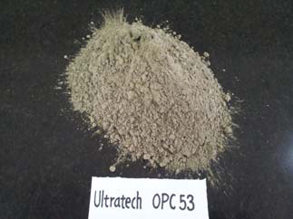
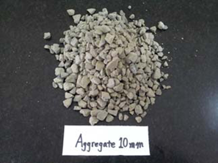
Demonstration high volume (70%) GGBFS mix
Material
  Cement OPC 53 – Ultratech cement Ltd
  GGBFS from JSW cement Ltd
  Admixture : Fosroc Auramix 450
  Aggregates - Granite local source from Bengaluru

Slide 13
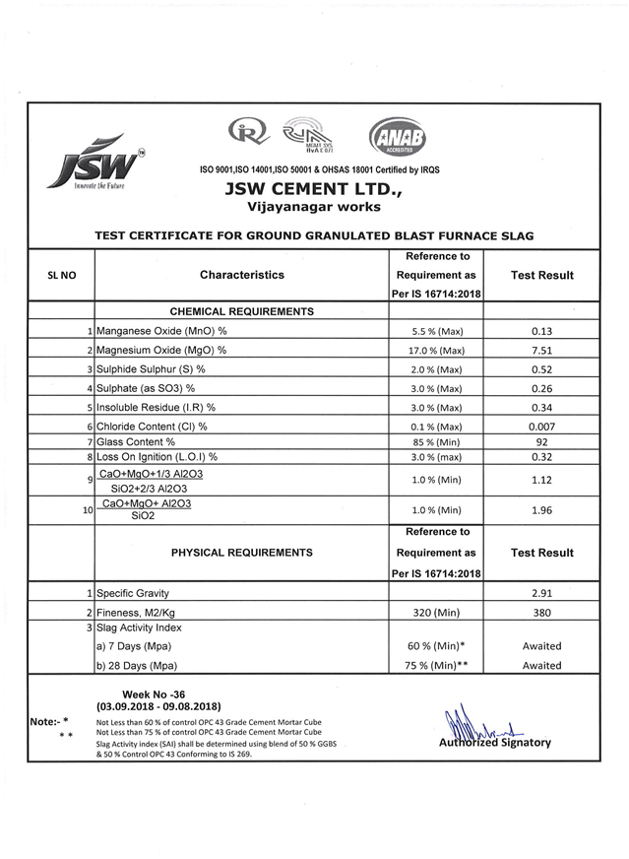
GGBFS
GGBFS from JSW cement Limited
  Fineness of GGBFS has been increased from 350 to 380 m2/kg. to meet the market Objective of Early strength of the concrete mix.

Slide 14
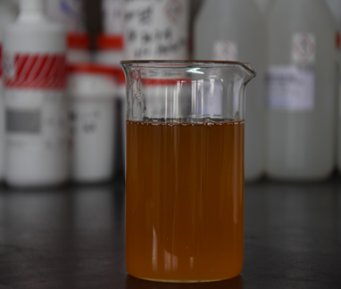
Chemical Admixture
Auramix 450 a new generation, low viscosity , PCE based Superplsticiser
  Very low stickiness ,ideal for high volume SCM replacement and pumping of concrete in high rise building
  Very long workability retention over 4 hrs with out excessive retardation and bleeding.
  Very high water reduction, over 40% suitable for high strength, high performance and high volume SCM concrete.
  Ideal for normal workability vibrated through to self compacting concrete
  Single component, no need to add additional retarder or VMA
  Compatible with high cement replacements
  Compatible with 100% crush Sand
  Highly robust to take care of variation in the aggregate
  gradation like Zone I , II and III and moisture.

Slide 15
PC based admixture
Specific performances are designed by adjusting functional building blocks, molecular weight, side chain length, charge density, graft density
Side chain
Water reduction capability
Viscosity control
Workability retention
Functional building blocks
C
C
C
O
O⁻
O
O⁻
O
O⁻
COOM
+
+
+
Stickiness control
Cement affinity
Cement Surface

Slide 16
Concrete mix proportion
Grade of concrete | M30
Raw materials | Quantities /M³
CEMENT (Ultratech OPC-53) Kg/m³ | 114
GGBFS – JSW cement Ltd Kg/m³ 70% | 266
20 mm - Local source from Bengaluru Kg/m³ ( 16%) | 307
12.5MM -Local source from Bengaluru Kg/m³ (30%) | 572
M.SAND -Local source from Bengaluru Kg/m³ (53%) | 991
WATER | 152
ADMIX. Fosroc Auramix 450 PC based admixture | 0.75%
W/C Ratio | 0.40

Slide 17
Combined Grading – Zone I

Slide 18
Combined Grading – Zone II

Slide 19
Combined Grading – Zone III

Slide 20
Mix Proportions
 | Trial No. 1 Zone-I Sand | Trail No. 2 Zone- II Sand | Trial No.3 Zone - 3 Sand
CEMENT (Ultratech OPC-53) Kg/m³ | 114 | 114 | 114
GGBFS – JSW cement Ltd Kg/m³ 70% | 266 | 266 | 266
20 mm - Local source from Bengaluru Kg/m³ ( 16%) | 307 | 329 | 347
12.5MM - Local Soure from Bengaluru Kg/m³ (30%) | 572 | 613 | 644
M.SAND - Local source from Bengaluru Kg/m³ (53%) | 991 | 928 | 879
WATER Kg/m³ | 152 | 152 | 152
ADMIX. Fosroc Auramix 450 PC based admixture % by weight of cement | 0.75% | 0.75% | 0.75%
W/Cementitios Ratio | 0.40 | 0.40 | 0.40

Slide 21
Trial Results
 | Trial N0.1 Zone - I Sand | Trial .2 Zone – II Sand | Trial .3 Zone -III Sand
Workability
Initial Flow in mm | 640 | 620 | 650
Flow after 60 mins | 620 | 620 | 640
Flow after 120 min | 600 | 620 | 620
Theoretical Density | 2402 | 2402 | 2402
Fresh Wet Density | 2413 | 2427 | 2418
COMPRESSIVE STRENGHT IN MPA
3 days | 16.18 | 16.1 | 15.75
7 day | 29.30 | 31.50 | 29.00
28 days | 39.20 | 40.10 | 39.50

Slide 22
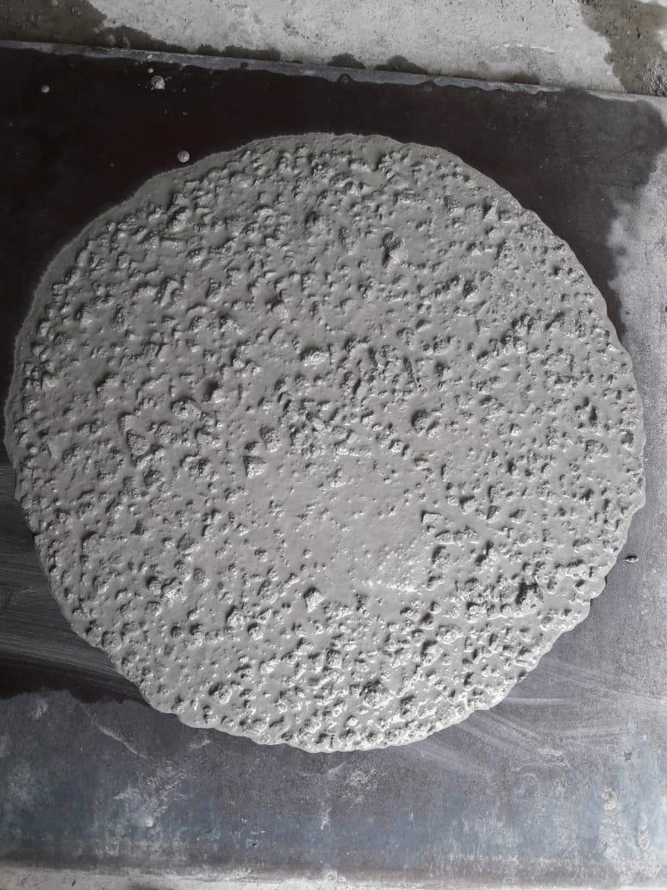
Trial No. I Zone I sand
Results obtained using Admixture Fosroc Auramix 450
Workability
Flow in mm
Time in min | Slump/flow in mm
0 | 640
45 | 620
120 | 600

Slide 23
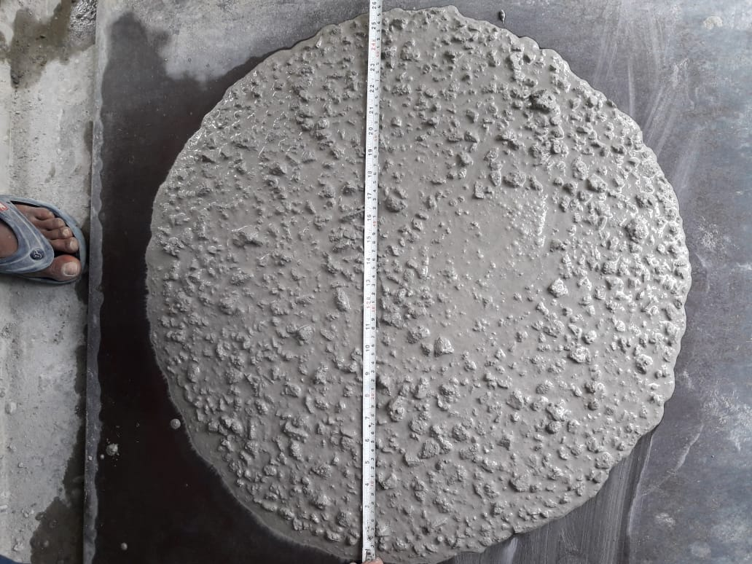
Trial No. II Zone II sand
Results obtained using Admixture Fosroc Auramix 450
Workability
Flow in mm
Time in min | Slump/flow in mm
0 | 620
45 | 620
120 | 620

Slide 24
Trial No. III Zone III sand
Results obtained using Admixture Fosroc Auramix 450
Workability
Flow in mm
Time in min | Slump/flow in mm
0 | 650
45 | 640
120 | 620

Slide 25
Live Demonstration
Trial 1 – Zone 2
Trial 2 – Zone 3
Trial 3 - Zone 1

Slide 26
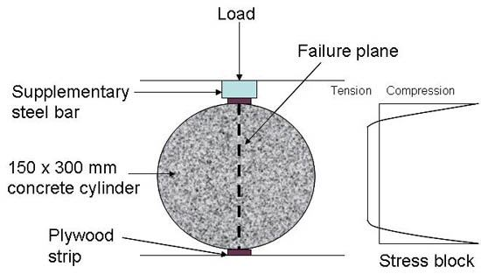
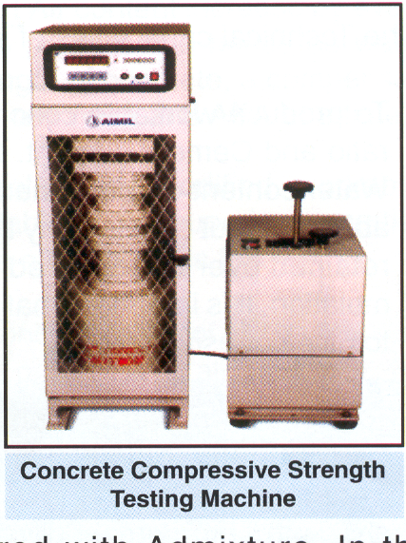
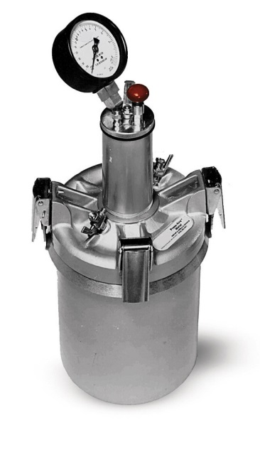
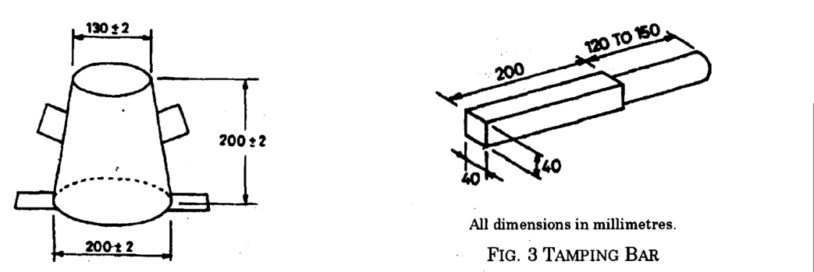
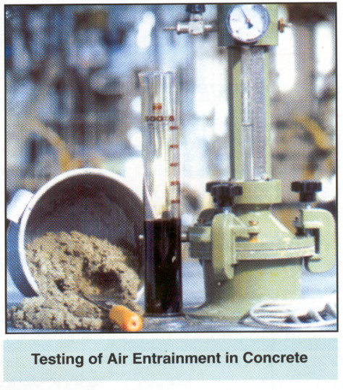
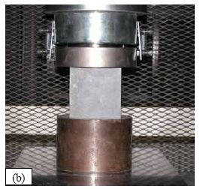

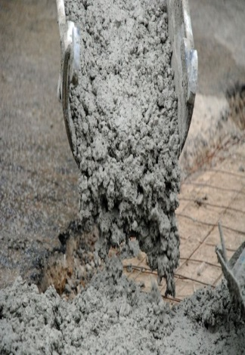
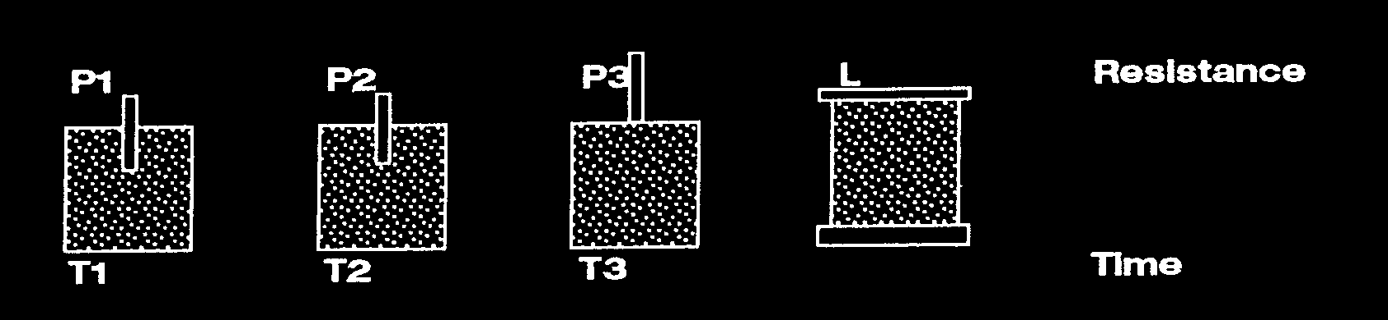
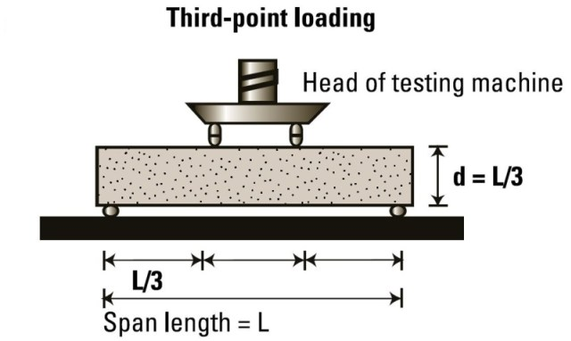
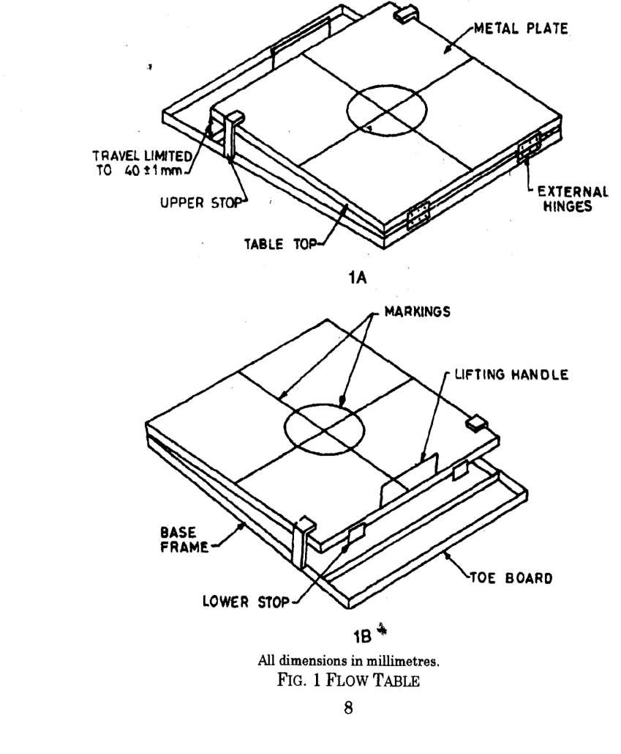
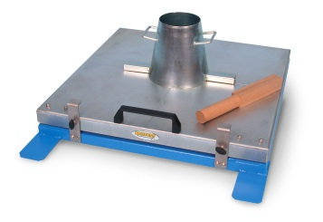
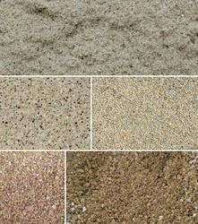
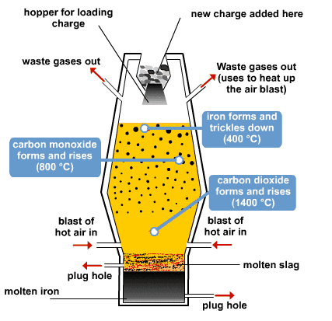
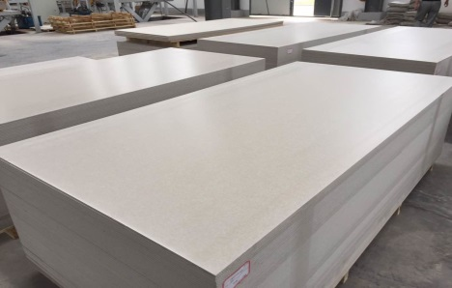
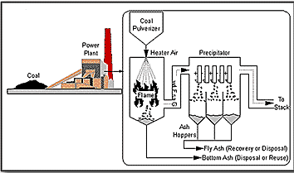



Thank you
Address
Fosroc Chemicals (India) Pvt Ltd
Sapthagiri Palace, No 38
12th Cross CBI Road,
Ganganagar North
Bangalore 560 032
Karnataka State, India
Phone & Fax
Phone : +91 80 4252 1900
Fax : +91 80 23551510
Email: enquiryindia@fosroc.com
Social Media

