Slide 1
Corporate Profile

Slide 2
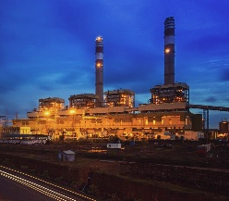
JSW is a $13 billion conglomerate with presence across key sectors
India’s leading integrated steel producer with
18 MTPA steel capacity
Services the entire energy value chain with a total capacity of 4,531MW
Manufacturer of ‘Portland Slag Cement’ and ‘GGBS’ with capacity of 12.8
MTPA
Operates environment friendly seaports & terminals with capacity of
70 MTPA
Coming Soon…

Slide 3
JSW GUIDING PRINCIPLES
Global recognition for Quality& Efficiency while nurturing Nature and Society
Supporting India’s growth in core economic sectors with Speed and Innovation
Transparency
Strive for Excellence
Passion for Learning
VISION
MISSION
CORE VALUES

Slide 4
OUR CONTRIBUTION TO INDIA’S PROGRESS

Slide 6
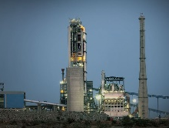
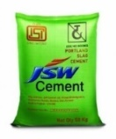
THE JOURNEY OF JSW CEMENT
VISION 2020
To become a 20 MMT company
Vijaynagar capacity inc. 2.4 MTPA
Commissioning of Salboni in June (2.4MTPA) & Dolvi
(Additional 1.2 MTPA)
Shiva Cement acquisition
Launch of new brand campaign: Start Strong. Grow Stronger.
JSW PSC launch - East
Launch of new brand campaign: Banao Pyaar Se
Plan to expand overseas- Fujairah (UAE)
SALES VOLUMES
New plant established at Nandyal marking entry into South India
Concreel HD launch - South India
JSW PSC launch - Karnataka
2009
2012
2014
2016
2017
Future →
TIME

Slide 7
KEY MARKETS FOR JSW CEMENT
Salboni Grinding Unit, WB (2.4 MTPA) in 2017 → Largest in WB
West Bengal
Dolvi Grinding Unit MH (Currently 2.2 MTPA) to further expand to 4.0 MTPA
Proposed Shiva Cement, Orissa (Current 0.15 Expansion by 1.2 MTPA)
Maharashtra
Andhra Pradesh
Goa
Proposed Jajpur Grinding Unit, Orissa (1.2 MTPA)
Vijaynagar Grinding Unit KN (Current 3.2 MTPA)
Nandyal Integrated Unit AP (4.8 MTPA)
Karnataka
Tamil Nadu
Kerala
Andaman & Nicobar
Additional Clinkering unit being set up at Fujairah UAE for 1.0 MTPA

Slide 8
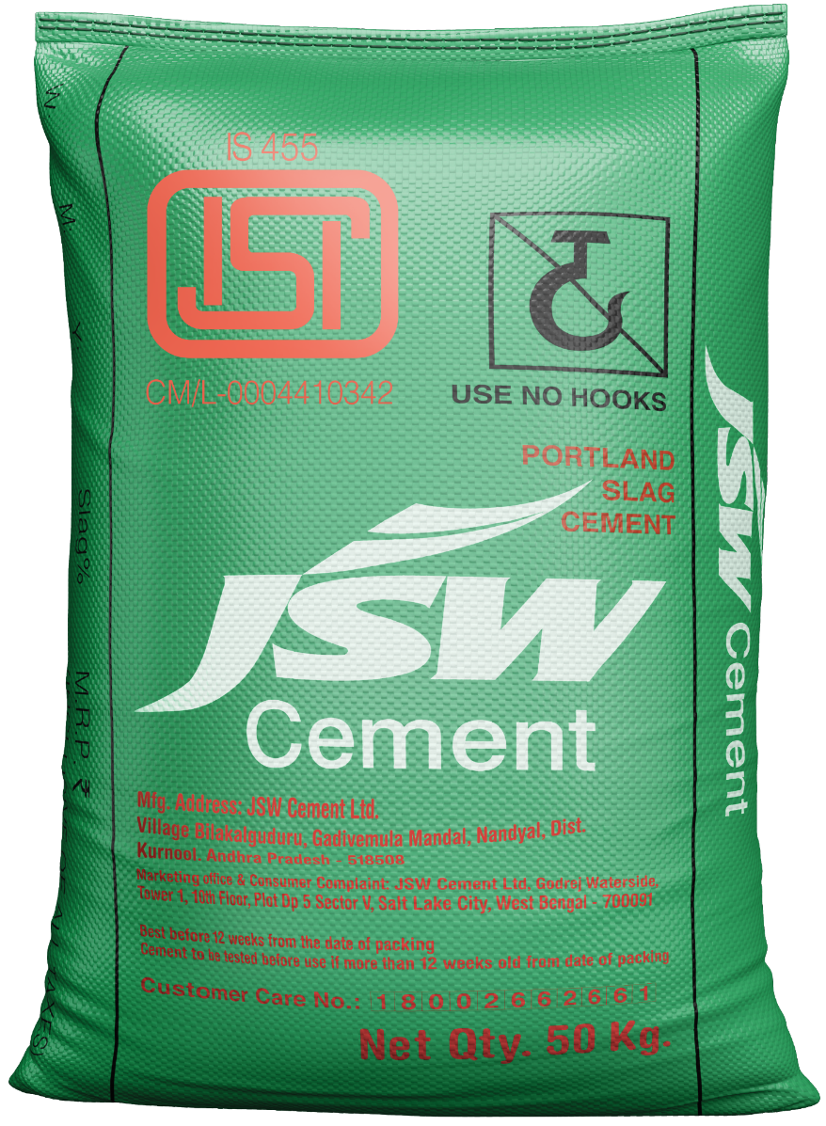
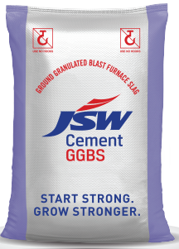
Our Products- Cement & Cementitious

Slide 9
Our Major Product Portfolio
Other Products -
In addition to Portland Slag Cement & Concreel HD, we also offer Ordinary Portland Cement (OPC) in the south to select markets

Slide 10
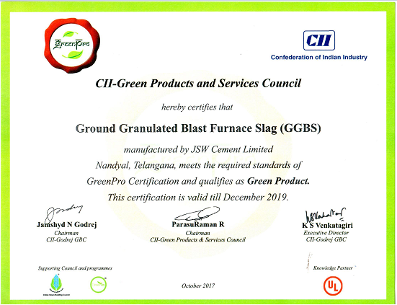
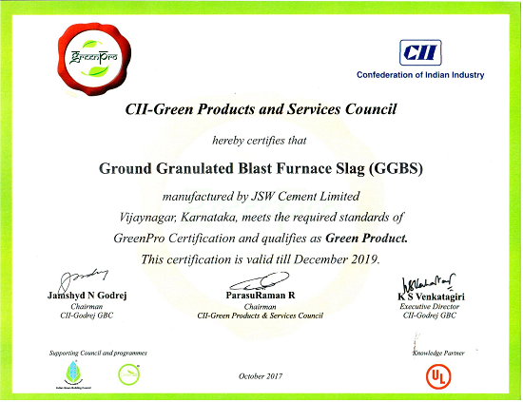
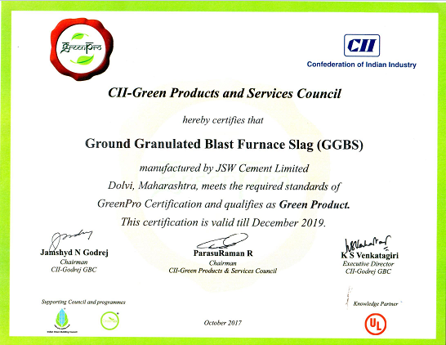
Green Pro Award
PSC Cement & GGBS from all our 3 plants have been awarded the Prestigious CII Green Products & Services Council “CERTIFIED GREEN PRODUCT” certification

Slide 11
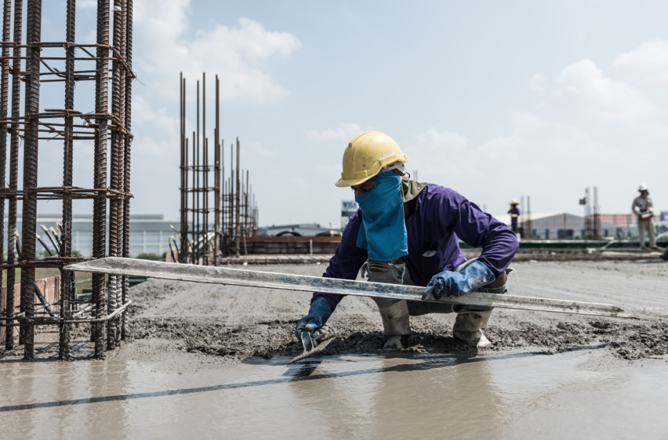
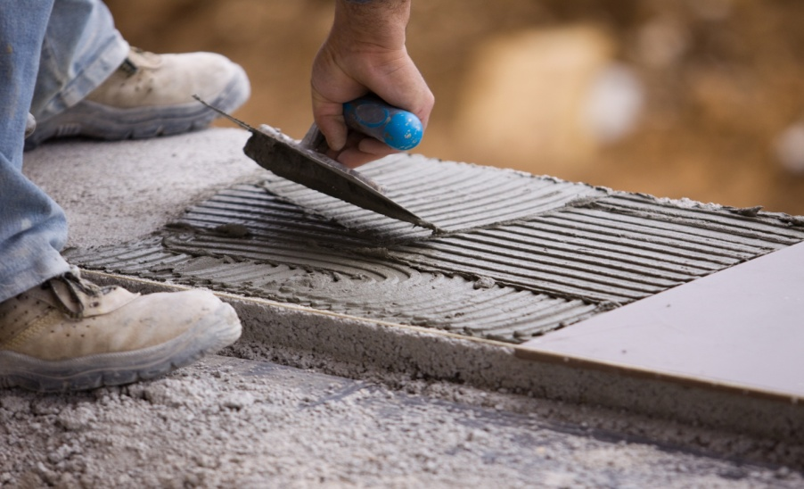
PSC can be used in all applications right from foundation to plastering

Slide 12
JSW Cement Product Attributes

Slide 13
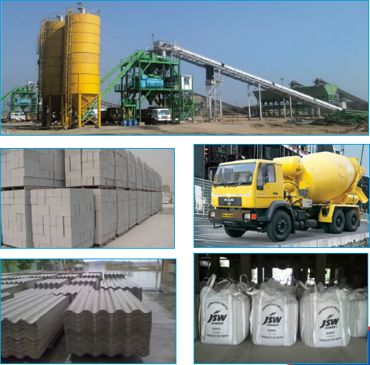
GGBS Consumption areas & applications
Globally, GGBS is a well established and proven Cement Replacement in Concrete mixes and have replaced upto 80% Cement in certain applications.
GGBS is technically a more accepted Supplementary Cementitious Material (SCM) in comparison to other alternatives by virtue of its consistency in quality- GGBS raw material generation is from a high process controlled, Quality Intensive Production of Steel
Over the last few years, JSW GGBS has established its presence in almost all named commercial RMCs and also at onsite batching units for major prestigious projects.
We have also exported GGBS to middle east region for specific projects and continuously seek opportunities to expand the reach of GGBS

Slide 14
Project Specifications/ Codal Provisions on use of GGBS
IS:16714- Ground Granulated Blast Furnace Slag for use in Cement, Mortar & Concrete- Specifications
IRC 15- 2017 Code of Practice for Construction of Jointed Concrete Pavements
IRC SP- 46- 2013 Guidelines for Design & Construction of Fibre Reinforced Concrete Pavements
CII Green Products and Services Council Certifications- “GreenPro”
IRC 112- 2011 Code of Practice for Concrete Road Bridges
IRC 78- 2014 Standard Specifications & Code of Practice for Road Bridges (Sec. VII- Foundations & Sub Str.)
IS:456- Code of Practice- Plain & Reinforced Concrete
IRC SP 70- 2005 Guidelines for the use of High Performance Concrete in Bridges
Metro Rail Projects- Mumbai, Bangalore, Chennai, Pune, Nagpur
IRC 44- 2008 Guidelines for Cement Concrete Mix Design for Pavements (Second Revision)
Indian Railway Standard- Concrete Bridge Code- 2017: General Bridge Construction
Atomic Energy Regulatory Board- Materials of Constructions for Civil Engg. Structures important to safety of Nuclear Facilities
CPWD- Specifications- (Vol I)- 2009
IRC SP- 109- 2015 Guidelines for Design & Construction of Small Diameter Piles for Road Bridges
IRC SP 49- 2014 Guidelines for use of Dry Lean Concrete as Sub Base for Rigid Pavements
RDSO- Ministry of Railways: Guidelines for use of High Performance Concrete in Bridges
Municipal Corporation of Greater Mumbai- Tech. Tender Document

Slide 15
Infrastructure Projects-
Metro Rails, Roads, Bridges & Highways, Ports & Jetties

Slide 16
Buildings-
Residential & Commercial

Slide 17
Ready Mix Concrete & Concrete Product Industries-
Commercial RMC, AAC Blocks, AC Sheet & Precast

Slide 18
START STRONG, GROW STRONGER
THANK YOU !
For any further details, please contact
Trivikram.Shenvi@jsw.in
+91 8793001899

