Slide 1

Constructive Solutions
Welcome
All
The delegates
Mohan Kumar. M
.

Slide 2
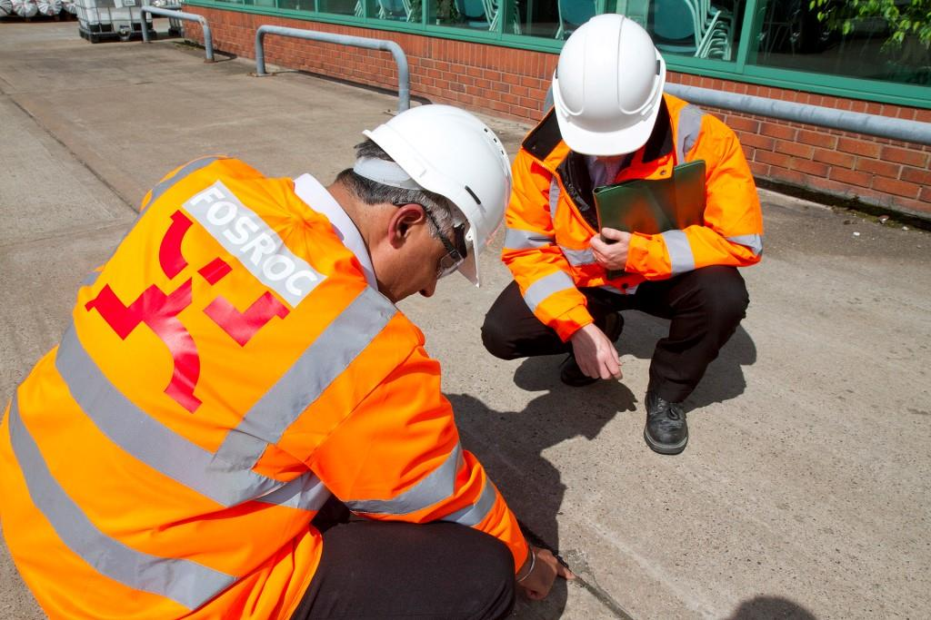
Specialists in
Constructive Solutions
Fosroc is a world leader in the delivery of tailored Constructive Solutions for virtually any type of construction project, combining high quality products, expert technical support, customer service and innovation.
At the cutting edge of chemical technology, Fosroc specialise in sealants, waterproofing, concrete repair, grouts and anchors, concrete admixtures and protective coatings.
With a comprehensive range of products and a highly developed global network, Fosroc offers a high quality solution for virtually any job, whatever the scale.

Slide 3
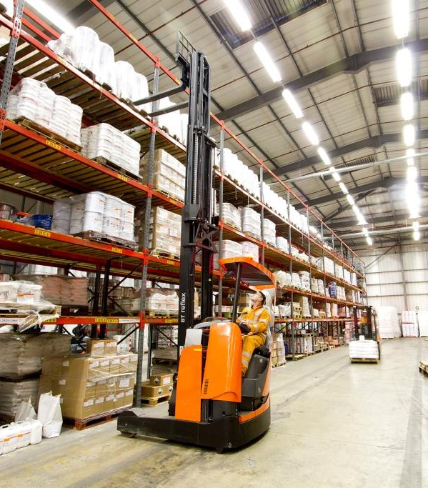
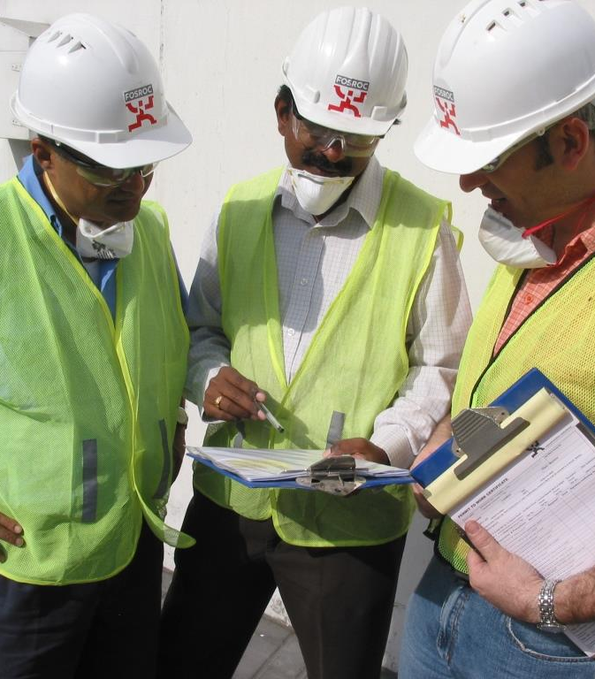
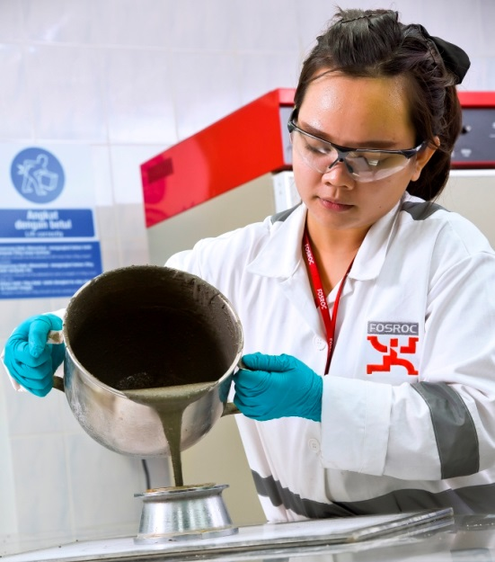
Why Fosroc
Products
Fosroc has an extensive range of products to meet the ever increasing challenges of the construction industry, specializing in bespoke package solutions.
Quality
We operate to strict quality standards to ensure that our customers are constantly provided with the high performance products that they expect from Fosroc
Technology
Fosroc invests significantly in the development of new products and innovative solutions. Fosroc aims to lead the market in application friendly solutions
Knowhow
Fosroc provide support throughout the lifecycle of a construction project with dedicated technical and specification teams that ensure high performance, sustainable and cost saving solutions.

Slide 4
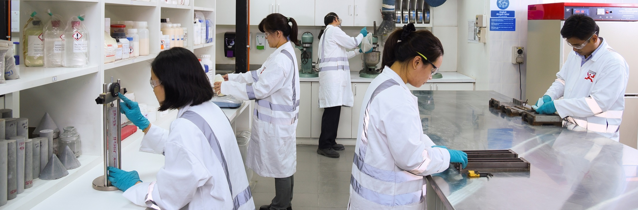
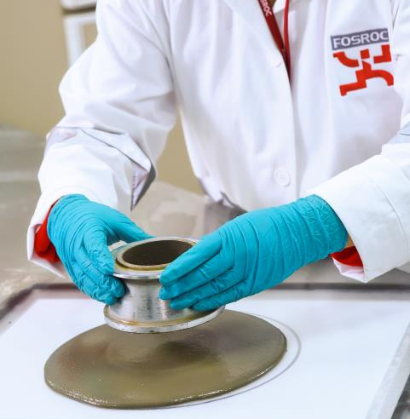



Specialists in Constructive Solutions
With our in-house expertise and specialist technology partners, we’re well positioned to respond to the specific requirements of our clients. By being involved early in the process at the design and specification stage, we can spot opportunities to optimise efficiencies, manage risks and minimise costs across the project. All supported by ongoing training and development to ensure we achieve the world-class quality we’re known for delivering.
Our Accreditations
1
Fully equipped Technology Centre in Bangalore, India and KL, Malaysia
Our superior product standard is reflected through our attention to meeting industry standards and gaining certification via accreditations.
2
Product Application experts in our operating companies
3
Broad product range supported by local and global specialists
4
Innovative tailored solutions that boost the efficiency and durability of a building and infrastructure.

Slide 5
IRL
DNK
UK
ROU
TT
ESP
TUR
KR
CY
IRQ
IRN
CHN
JP
DZA
JO
EGY
SAU
AE
TW
OMN
IND
MM
HK
YEM
TH
VN
NGA
ETH
PH
International Presence
MY
KE
SG
ID
Fosroc Office
AUS
Distributor/Licensee
NZ
Fosroc today:
Fosroc Global Trading serves our Seventy export markets
Operations in 20 countries (18 Manufacturing and two trading companies)
Manufacturing Licensees in 5 countries
Over 1,900 employees worldwide
Notes:
Fosroc Map Version 1

Slide 6
Fosroc India
Fosroc India, one of the first construction chemical company to establish in India. Over 35 years of experience
Commitment to innovation with the Fosroc Technology Centre located in Bangalore, India
State of the art manufacturing facilities at Bangalore, Karnataka, Ankleshwar, Gujarat. Rudrapur, Uttaranchal & fourth facility at Kolkata, West Bengal.
Production capacities .
  Liquid: 1,20,000 MT per annum
  Powder: 1,00,500 MT per annum
  Resin: 3,000 MT per annum
Fit for Purpose Mix Design/Solution by our competent and highly qualified team of Concrete Technologists/Formulators, Managers and Technical Sales staff

Slide 7
Fosroc - India
Regional Concrete Laboratory established in all major metro, for quick service & customer satisfaction.
Additional Service including Holding Tanks/Dispensers
Dedicated Specification Team of experts directly liaising with Consultants/Opinion makers, and offering support towards drawing correct BOQ with materials fit for purpose.
Network of business partners – Applicators, Project Distributors, Retail Distributors, and Key Accounts, for better approach to customers
Trained applicators network for application support.
Training academy for training the small jobbers, contractors and unskilled job workers.

Slide 8
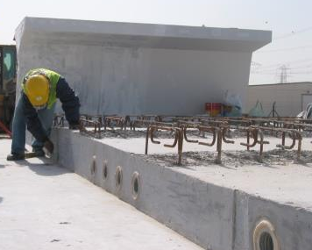
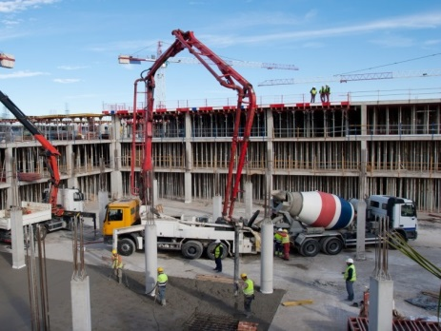
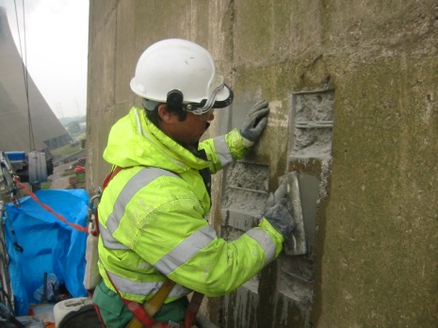
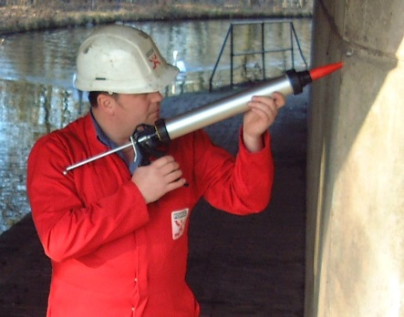
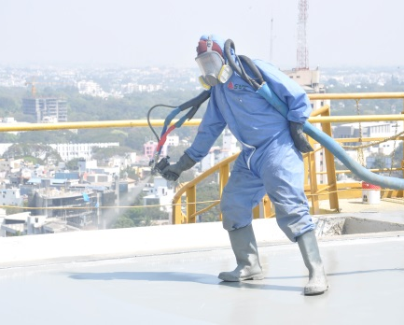
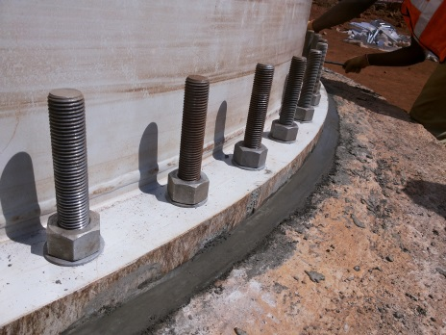

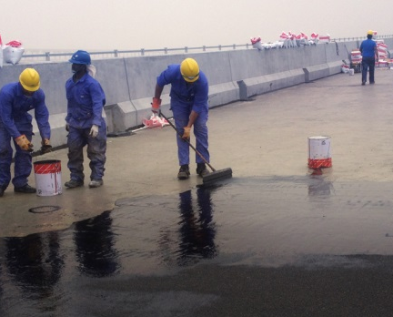
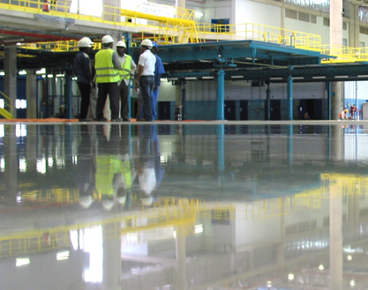
Our Solutions
Adhesives
Admixtures
Concrete Repair
Joint Sealants
Waterproofing
Grouts & Anchors
Cement Additives
Protective Coatings
Industrial Flooring

Slide 9
.
Waterproofing solutions

Slide 10
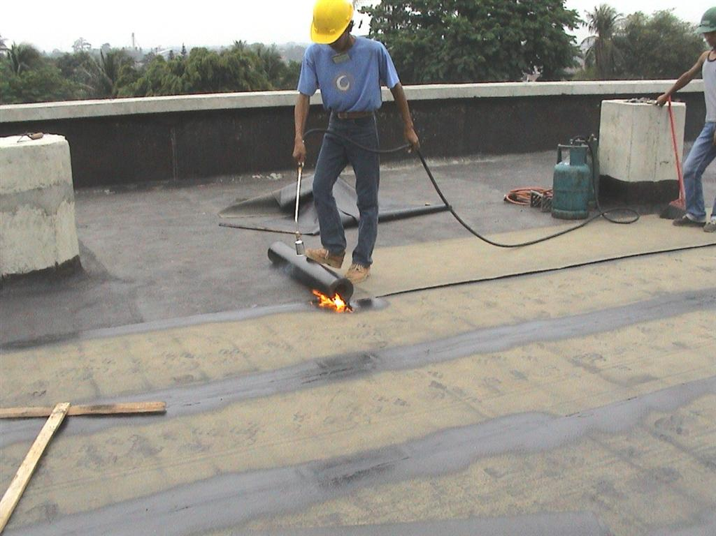

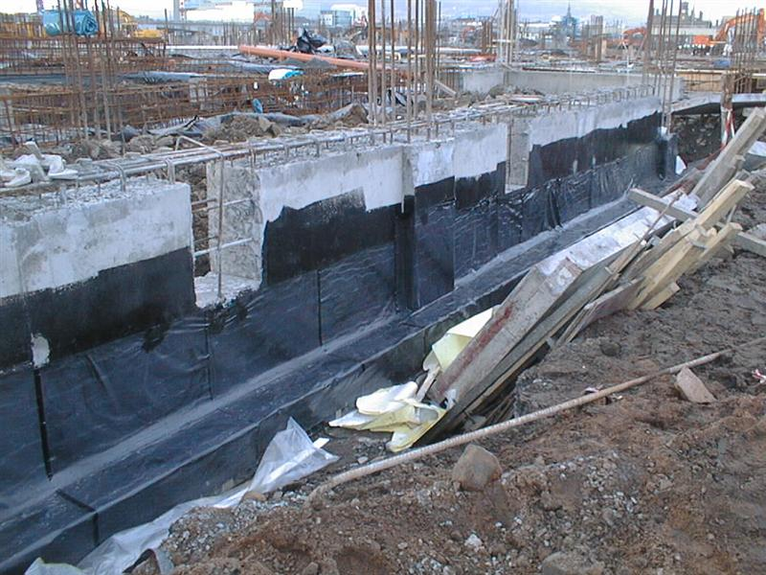
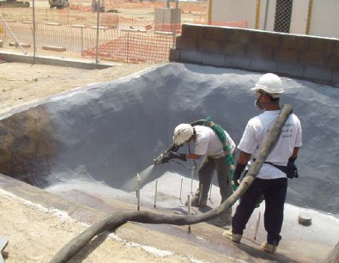
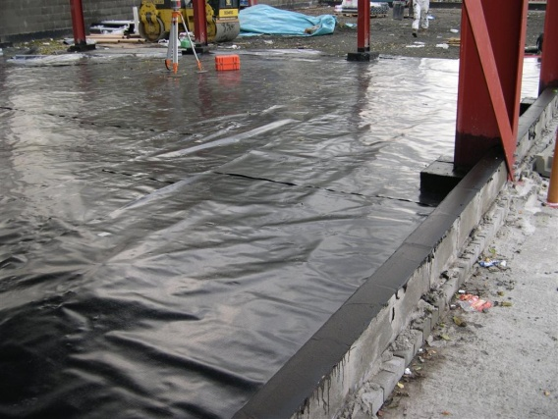
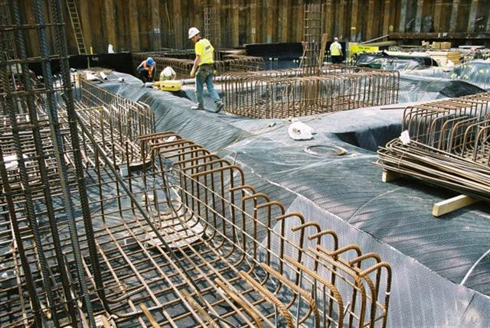
Waterproofing-Generic Systems
Torch-on
Liquid applied
Self adhesive
Spray
Loose laid
Pre-applied

Slide 11
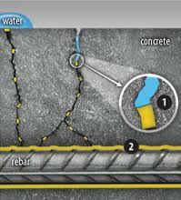
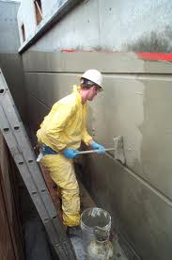
Waterproofing system types

Slide 12
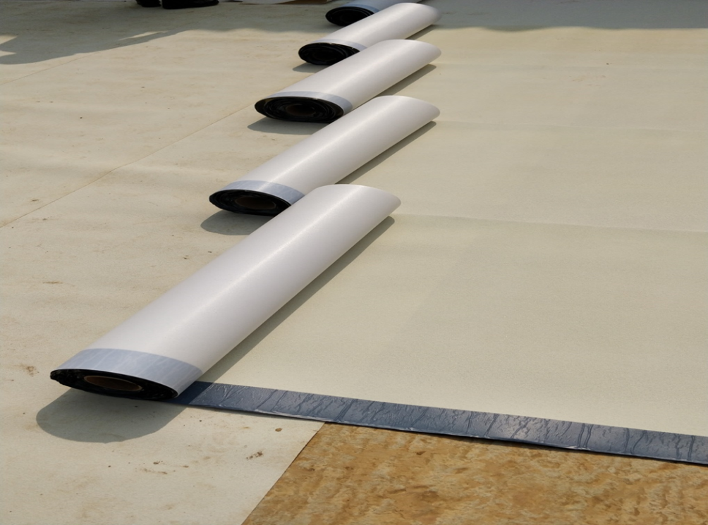
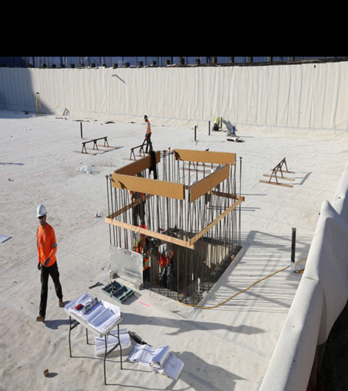
.
FOSROC MEMBRANE HDPE-P and S

Slide 13
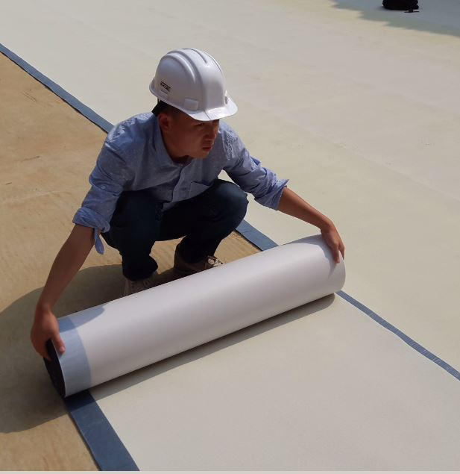
Fosroc membrane HDPE- P
Fosroc membrane HDPE -P
  Unique composite sheet comprised of a thick HDPE film, pressure sensitive adhesive and weather resistant protective layer
  Forms integral bond to poured concrete, preventing both the ingress and lateral migration of water while providing a robust barrier to water and moisture.
  Available in 1.2mm and 1.5 mm thickness along with accessories.
  Supplied as 1MtrX 20 Mtr rolls.

Slide 14

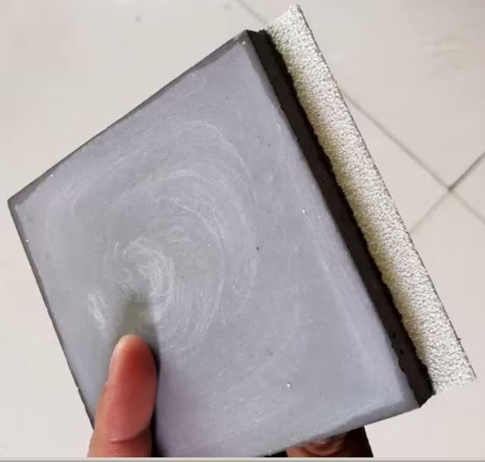
HDPE- P Technology
Fosroc membrane HDPE -P
  Pressure sensitive adhesion bonds to poured concrete.
  PSA(Pressure sensitive adhesive), is a type of adhesive only sensitive to pressure and designed temperature.
  It’s mainly composed of anti-ultraviolet absorber, anti-oxygen TPE(thermoplastic elastomer),
  There is no chemical action during the process of the bonding. Adhesive makes the membrane perfectly bond to the concrete only because of applying pressure and temperature.

Slide 15
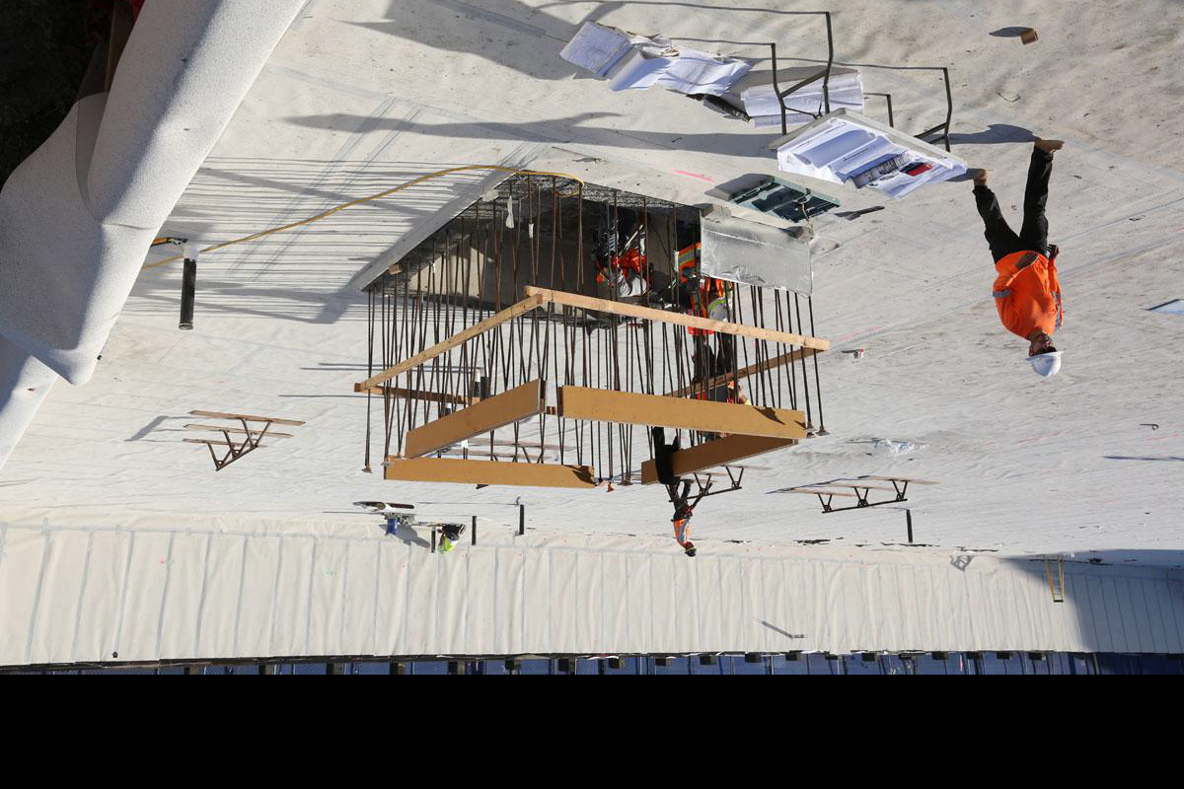
HDPE- P – Salient Features
  Below ground structure waterproofing protection to grades 1, 2 and 3 as defined in BS : 8102-2009.
  .
  Forms a integral bond to poured concrete by pressure sensitive adhesive and remaining in place if settlement of the substrate occurs.
  Simple application - no primers or protection material required.
  Inert product - no risk of a reaction with ponded water prior to concrete being poured.
  .

Slide 16
Technical Properties
S. No. | Parameter | Fosroc Membrane HDPE-P
1 | Membrane Thickness | 1.2 mm and 1.5 mm
MECHANICAL PROPERTIES
2 | Tensile Strength, film (ASTM D 412) | 27 Mpa
3 | Elongation (ASTM D412) | 500 %
4 | Puncture resistance (ASTM E154) | > 1000+/-5%
5 | Peel Adhesion to concrete , (ASTM D903 Modified) | 1500 N/m
6 | Resistance to hydrostatic head, (ASTM D751-06(2011) | >70 m
7 | Low temperature flexibility | < -25ºC, no crack
8 | UV Exposure test ( 45 days) ASTM G 153 | No Change
9 | Dimensional stability (ASTM D 1710- 08) @ 40Deg. | L< 0.13% and W <0.07%
10 | Lap Joint strength (ASTM D1876) | 13.5 N/mm

Slide 17

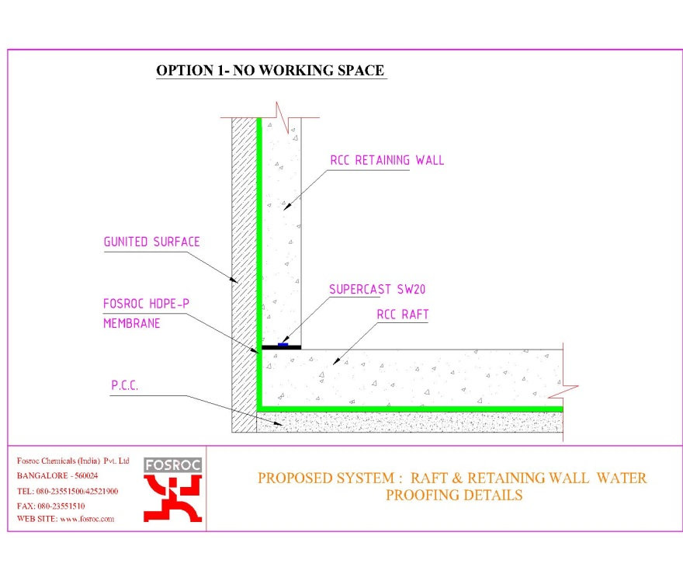
Vertical walls- without working space
  Installation of membrane
  Where Fosroc Membrane HDPE-P is applied to removable formwork; it is recommended that a minimum concrete compressive strength of 10N/mm² is reached before the formwork is stripped.
  Mechanically fasten the membrane vertically using fasteners appropriate to the substrate with sanded face uppermost to receive fresh concrete to which it will adhere.
  Ensure the underside of the succeeding sheet is clean, dry and free from contamination before attempting to overlap. Roll firmly to ensure a watertight seal.

Slide 18
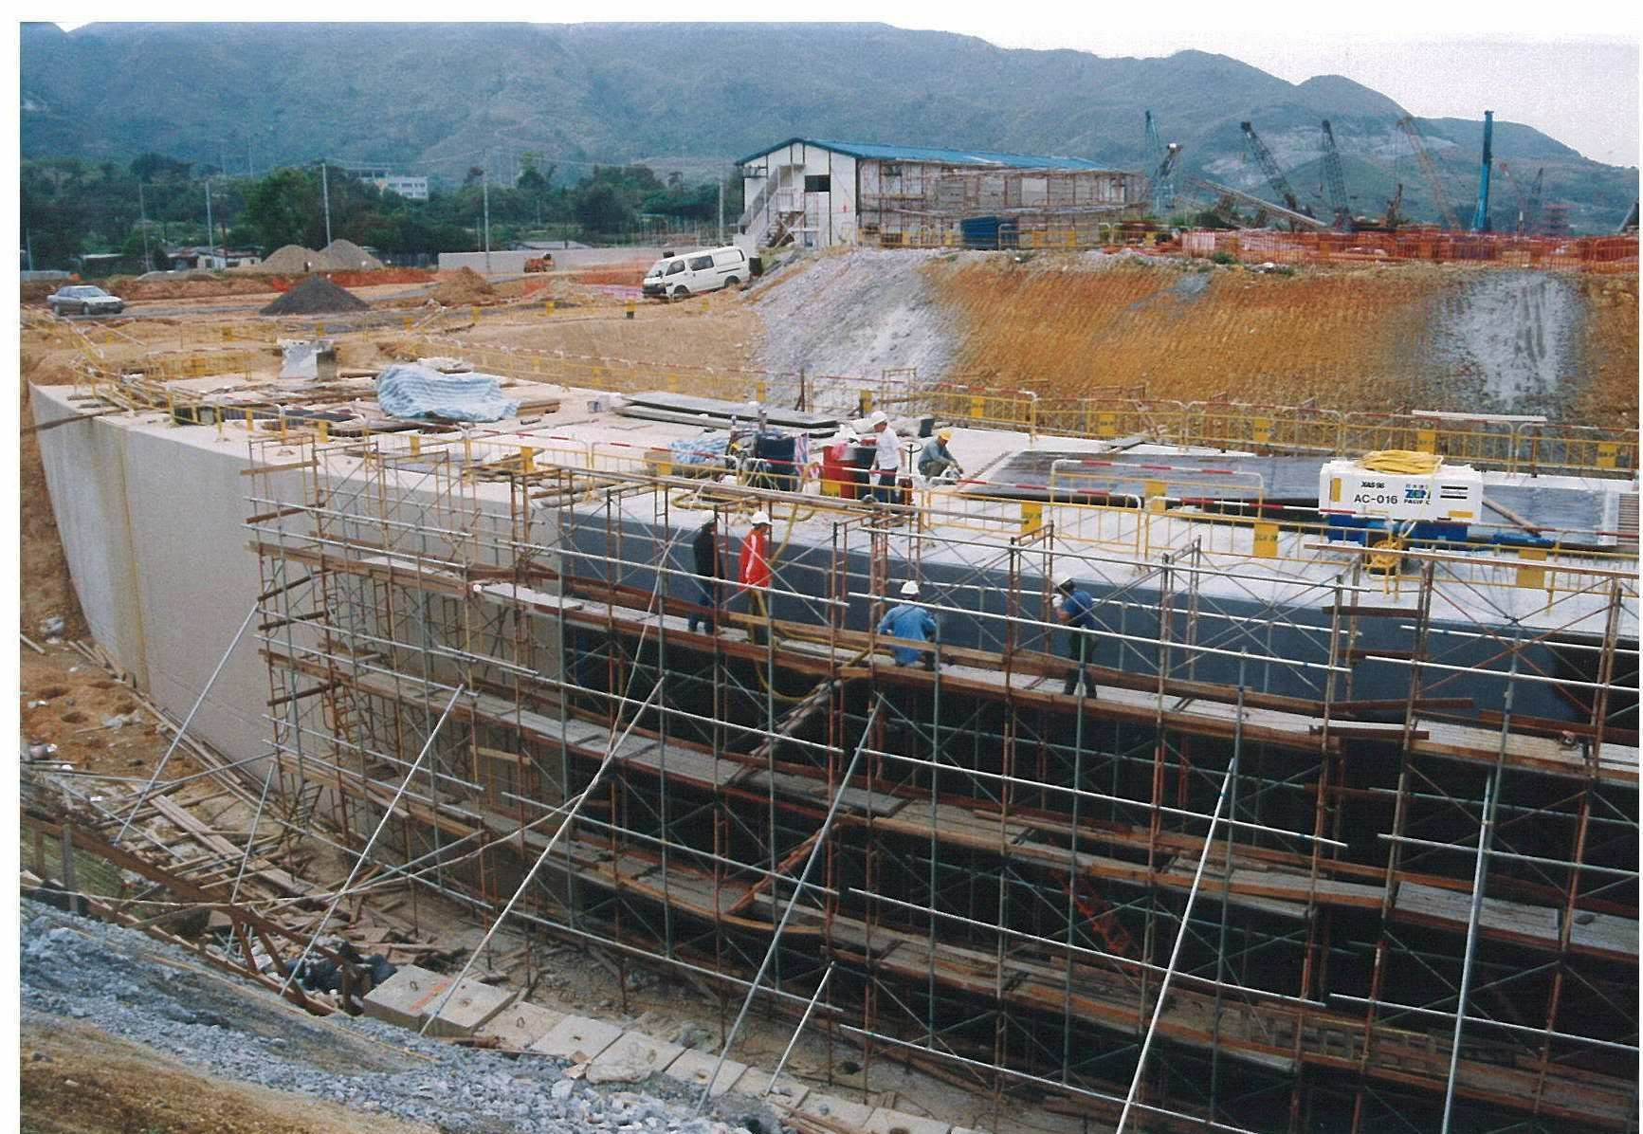
Vertical application – With Working space
HDPE-S Post Applied Self Adhesive membrane for retaining walls with working space.
No Primer required.
Simple application
No protection required.

Slide 19
Technical Properties- HDPE-S
S. No. | Parameter | Fosroc Membrane HDPE-S
1 | Membrane Thickness | 1.2 mm and 1.5 mm
MECHANICAL PROPERTIES
2 | Tensile Strength, film (ASTM D 412) | 17 Mpa
3 | Elongation (ASTM D412) | 500 %
4 | Puncture resistance (ASTM E154) | > 900 N
5 | Peel Adhesion to concrete , (ASTM D903 Modified) | 3000 N/m
6 | Resistance to hydrostatic head, (ASTM D751-06(2011) | >70 m
7 | Low temperature flexibility | < -25ºC, no crack
8 | UV Exposure test ( 45 days) ASTM G 153 | No Change
9 | Dimensional stability (ASTM D 1710- 08) @ 40Deg. | L< 0.13% and W <0.07%
10 | Lap Joint strength (ASTM D1876) | 13.5 N.mm2

Slide 20
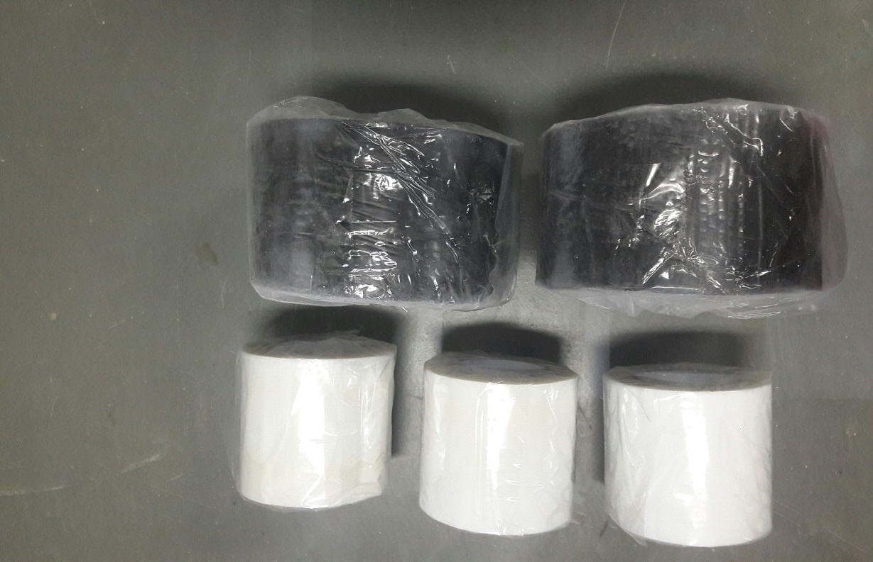
Fosroc membrane HDPE - Accessories
  HDPE- Sealed Tape- Double-side tape used for end side laps, cut edges and overlapping of different material. ( 100 mmX10 mtr)
  Sanded Tape – Self adhesive tape with sand used for sealing of the needle hole , repairing , overlapping ( 100 mm X 20 Mtr)
Double sided tape
Sanded tape

Slide 21
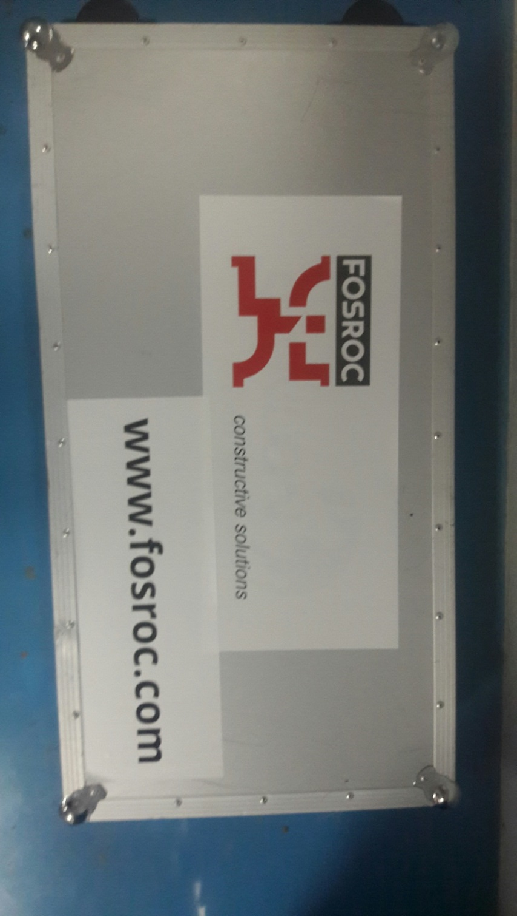
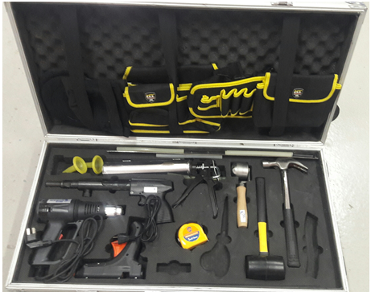
Application methods
Equipment's and Tools
Tool Box

Slide 22
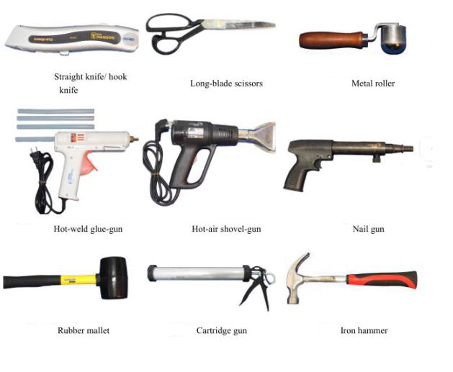
Application Method
Tools required

Slide 23
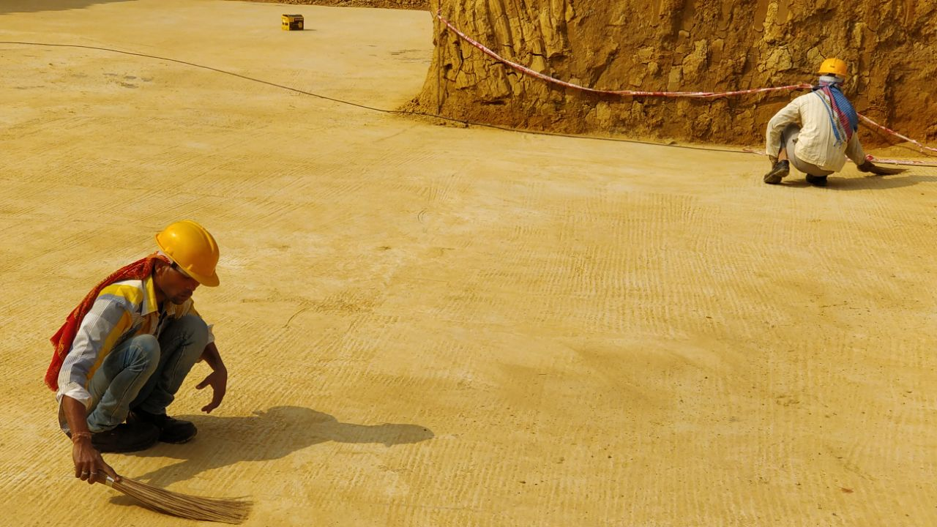
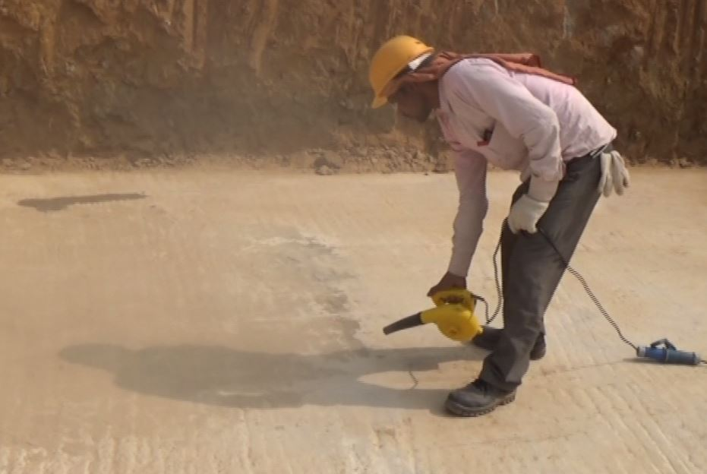
Horizontal application
  Surface preparation
  Clean all concrete surfaces free of laitance, dust, dirt, cavities, projecting nibs etc.
  Make sure that the surface is smooth, it does not need to be dry but it must not have any standing water.
  All surfaces must be free of loose aggregates and sharp protrusions

Slide 24
Horizontal application
  Installation of membrane .
  The FOSROC Membrane HDPE-P shall be applied with sanded face uppermost to receive fresh concrete to which it will adhere.
  Laps between sheets shall be rolled to ensure good adhesion of the selvedge.
  Roll ends or cut edges shall be sealed using double sided adhesive sealed tape
  Penetrations through the membrane i.e. pipe entries, pile cap shall be made watertight using Fosroc Membrane HDPE-P with the accessories.

Slide 25
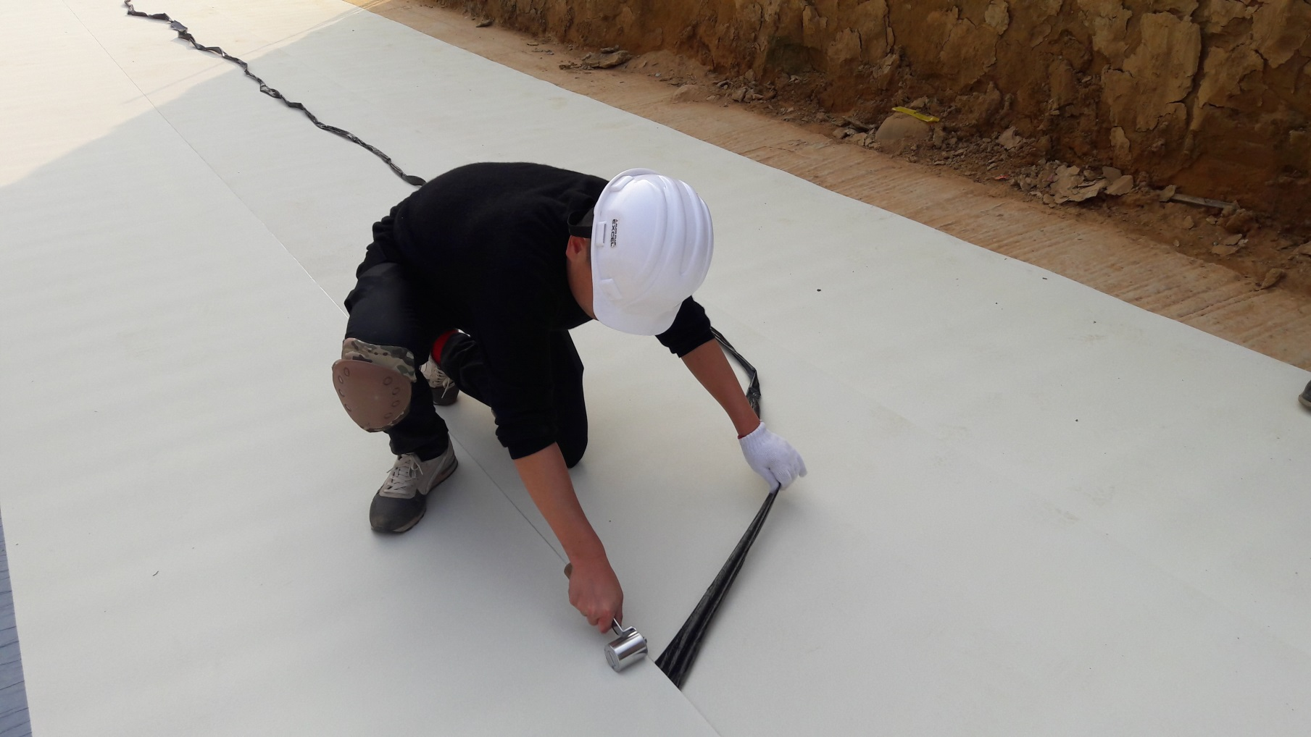
Horizontal application
  Rolling of laps, cut edges and end laps using steel rollers . Must apply sufficient pressure.

Slide 26
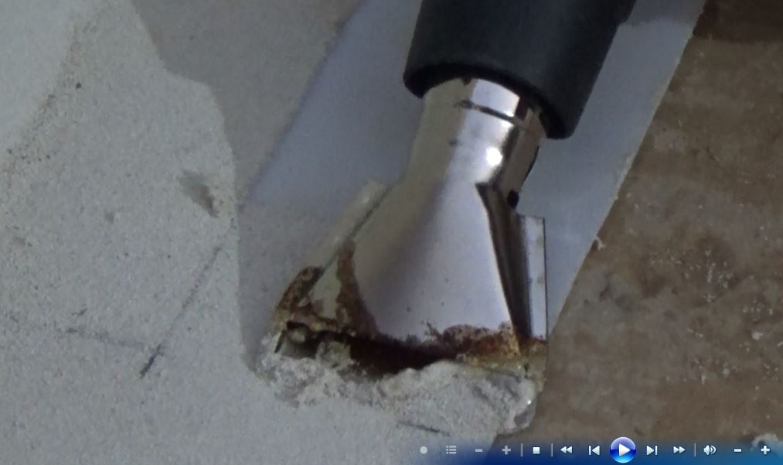
Horizontal application
  Joining of Roll ends , Cut edge etc
    Step 1. Removal of sanded surface

Slide 27
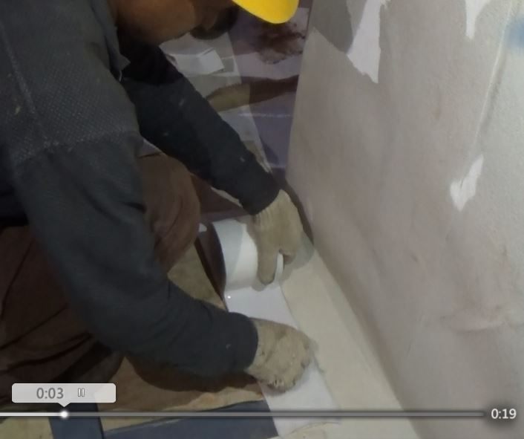
Horizontal application
  Joining of Roll ends , Cut edge etc
    Step 2. Pasting of Double sided tape

Slide 28
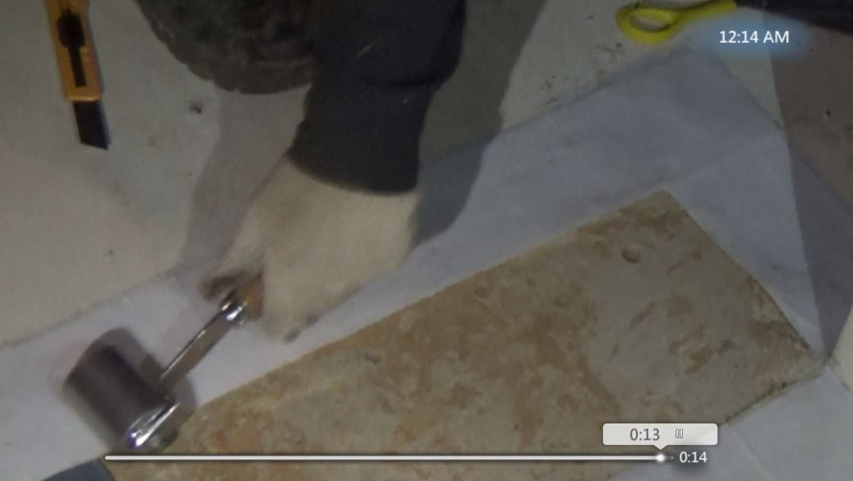
Horizontal application
  Joining of Roll ends , Cut edge etc
    Step 3. Rolling of double sided tape

Slide 29
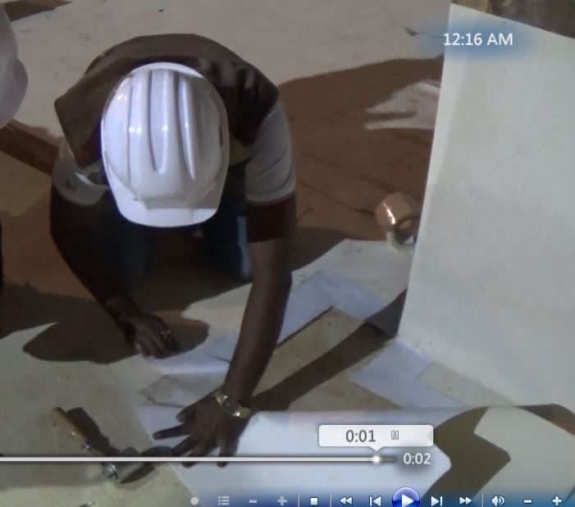
Horizontal application
  Joining of Roll ends , Cut edge etc
    Step 4. Removing double sided tape film

Slide 30
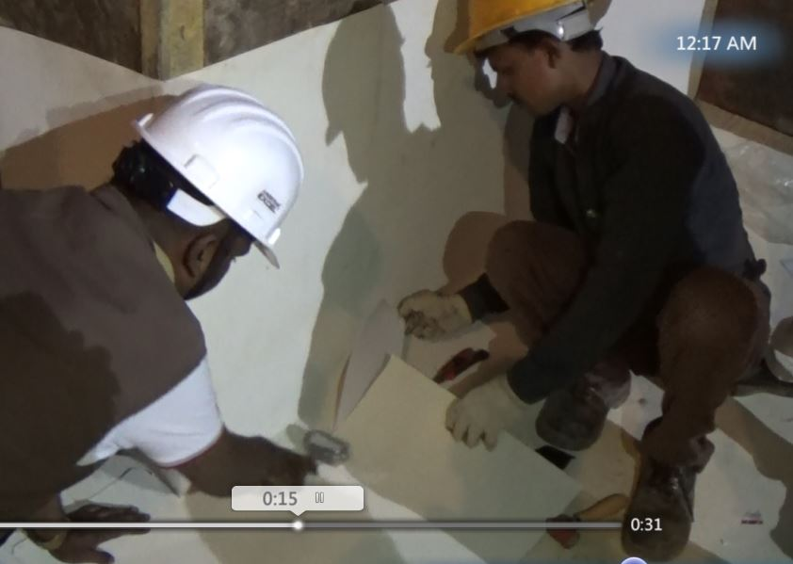
Horizontal application
  Joining of Roll ends , Cut edge etc
    Step 5. Rolling of HDPE –P membrane on Double sided tape

Slide 31
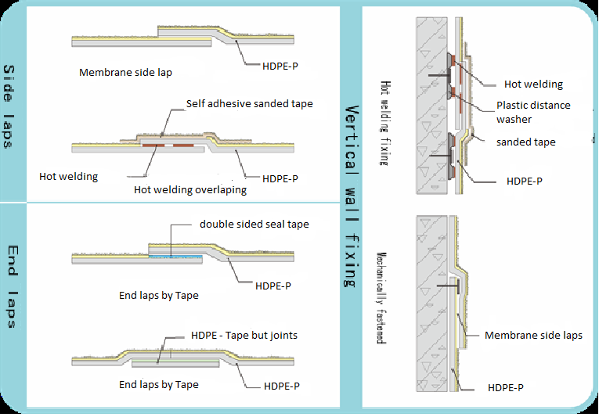
HDPE- P- Joining details
Double sided tape
Sanded tape

Slide 32
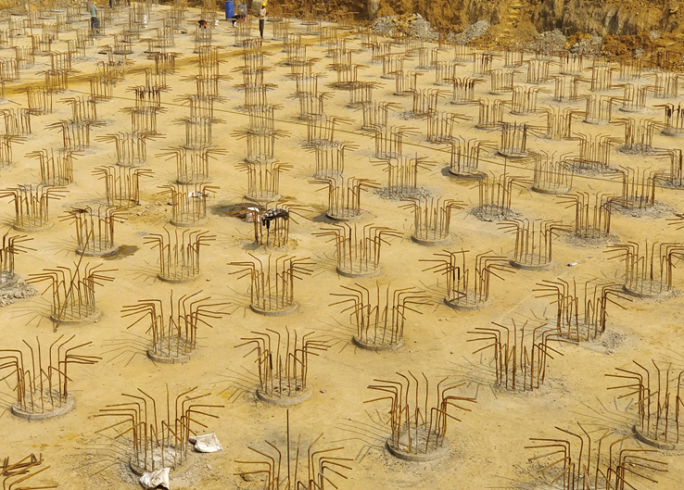
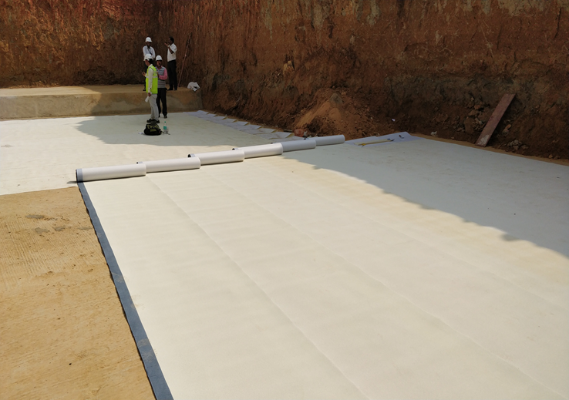
Membrane HDPE-P- Job reference
Basement waterproofing- Airport authority of India- Agarthala, SCG Consultants Chennai – 24000 Sq mtr.

Slide 33
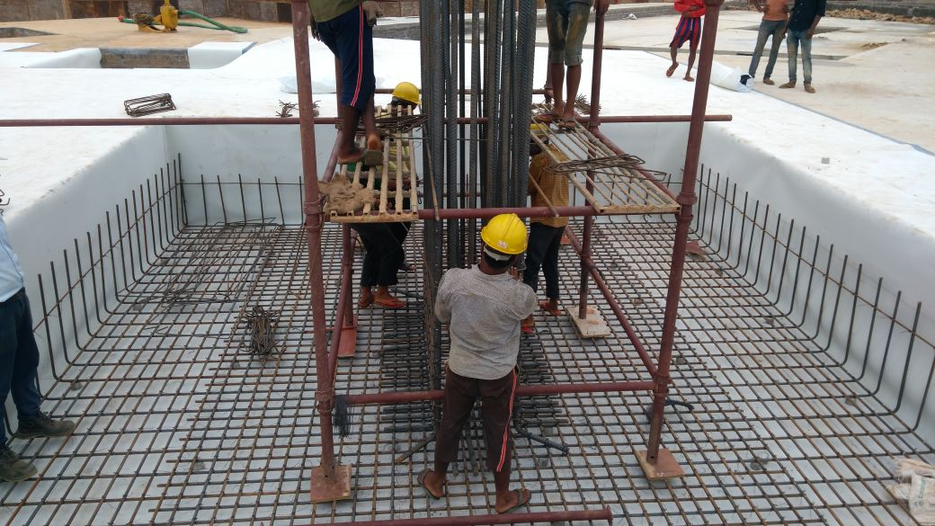
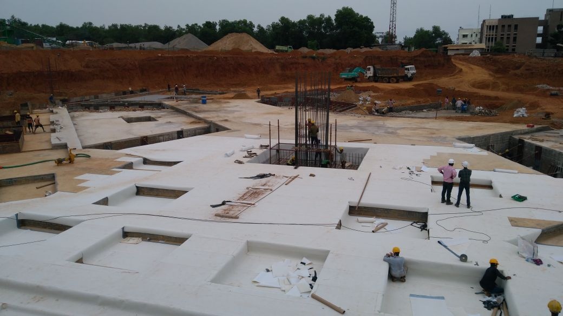
Membrane HDPE-P- Job reference
Basement waterproofing-St. Xavier University Bhubaneshwar- 6000 sq mtr

Slide 34

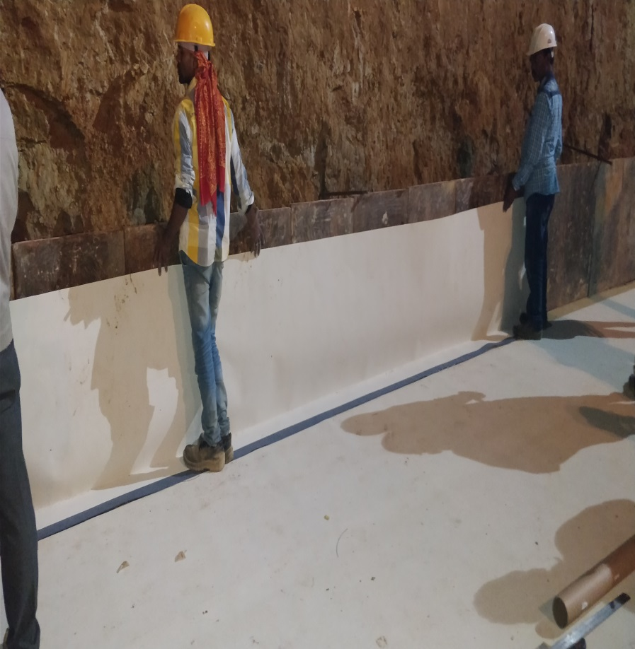
Membrane HDPE-P- Job reference
Ambiance valley Goa Basement 2000 sq mtr

Slide 35
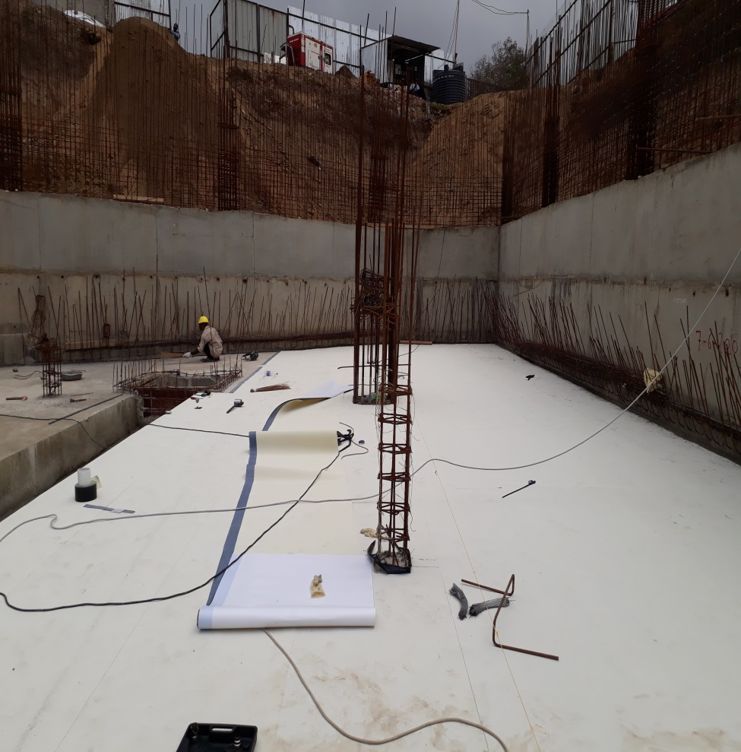
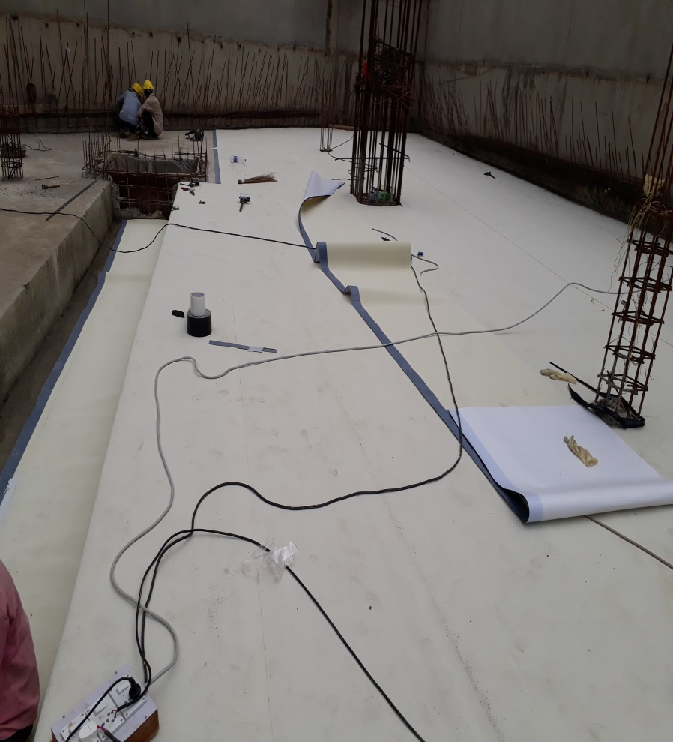
Membrane HDPE-P- Job reference
Surat Rajahans builders corporate office 2000 sq mtr

Slide 36
Fosroc.
Fosroc corporate Video

Slide 37

Thank you
Constructive Solutions

