Slide 1
Springer: Your Publisher of Choice
Swati Meherishi
Executive Editor, Applied Sciences and Engineering
September 22, 2018

Slide 2

A little about me…
Swati Meherishi
Part of the Physical Sciences and Engineering Publishing Team at Springer With a focus on Engineering and Applied Sciences Publishing Some of my main journal projects: Indian National Academy of Engineering Letters Indian Geotechnical Journal Journal of the Indian Institute of Science Journal of Packaging Technology and Reserach Transportation in Developing Economies
Notes:
[This slide used for providing the audience with a background of the speaker.]

Slide 3
A little more about me…
~12 years of experience publishing engineering content in the US and in India
~ 30 journal portfolio at Springer
~300 books signed in 4 years at Springer
600+ book authors spread over 5 continents
Degrees in Physics and Philosophy from St Stephen's College, Delhi
Notes:
[More speaker background if required or wanted. Add images applicable to your research field as appropriate]

Slide 4
Market Definition, Size and Growth

Slide 5
How many publishers, journals and books are there?
Journals:
28,000 English-language journals
2,000+ journals publishers
2.3 million journal articles per year
Books:
50,000 new English-language academic/scholarly books per year
1,000+ academic/scholarly book publishers

Slide 6
Introduction to
Springer Nature
Notes:
In section one I’d like to talk to you about scientific publishing in general. Why do you need to publish your work? Why is it necessary that you publish in English? The publish or perish mentality. The time it can take to get a manuscript published. And the peer review process and what’s involved.

Slide 7








Who is Springer Nature?
In May 2015
Notes:
Last year, Springer and Macmillan Science and Education merged to become one company—Springer Nature.
Our company publishes many of the top brands in academics, including Springer, Nature, BioMed Central, Macmillan, and Palgrave.

Slide 8
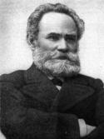

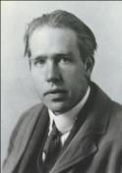
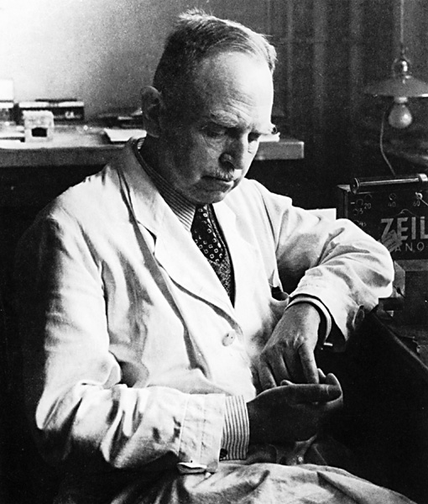
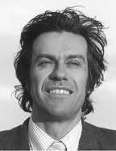
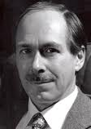

Springer Nature overview
175 years in academic publishing
13,000 employees in over 50 countries worldwide
3000 journals and 12,000 books annually
Largest open access publisher (600 journals)
SpringerLink & Nature.com have over 250 million downloads/year
Most Nobel laureates have published in Springer Nature journals
J.P. Pavlov
Medicine
Albert Einstein
Physics
Niels Bohr
Physics
Otto Hahn Chemistry
Pierre-Gilles de Gennes
Physics
Gerard ‘t Hooft
Physics
Kurt Wüthrich
Chemistry
1904
1921
1922
1944
1991
1999
2002
Notes:
We are a very old company, having over 170 years of experience in academic publishing.
We are also a very large company, with employees based globally to best serve researchers worldwide.
We are one of the largest publishers, with over 3000 journals and 12,000 books published every year.
We are also the largest open access publisher, with about 600 journals.
Our online platforms have over 250 million downloads every year. That is a lot of researches who will be able to find your content when you publish with us!
Lastly, most Nobel laureates have published in Springer Nature journals because they recognize the quality in our publications.

Slide 9
The Springer Nature journal portfolio
3,000 journals publishing more than 340,000 articles per year
Number of 2016 articles by business model
More than 3,000 journals:
    2,800 journals in the Research division, thereof 1,800 hybrid, 600 full OA, and 400 subscription journals
    200 journals in the Professional division (incl. more B2B type publications)
More than 344,000 articles p.a.:
    55% in hybrid, 25% in subscription and 20% in OA journals
10 out of the Top 25 primary research journals by Impact Factor are Nature-branded journals
344k articles

Slide 10











All publishing fields
Notes:
But we don’t only publish in the natural sciences. We publish broadly across all disciplines to ensure that researchers across the world have a platform to share their findings and their ideas with others in their field.

Slide 11
Overall market positioning by JCR data
Springer Nature holds a 16% title, 15% article and 12% citation share
Top 10 rankings by JCR data ...
by number of titles by number of articles by number of cites
  Source: JCR 2015; excluded are non-English language and review journals; for the key publishers: active journals only

Slide 12
Fully open access journals: key players
Springer Nature is the clear market leader
Sources: Publisher web sites, CrossRef; excludes articles in hybrid journals; Springer Nature: ORG excl. Nature Communications 2012-14; Copernicus numbers for 2016 estimated

Slide 13
Leading eBook Publishers: Total Number of eBooks
Springer Nature also leads in eBooks!
Total Number of English-Language eBooks (Aug 17)
English-Language eBooks published in 2016
Data from publisher websites; Taylor & Francis: numbers from CRCNetBase and T&F eBooks sites

Slide 14









Spectrum of publications
Springer Nature
Articles
Reviews
Briefs & Pivots
Databases
Theses
Proceedings & Lecture Notes
Books
Handbooks
Major Reference Works
Notes:
We also publish a wide spectrum of academic literature to best suit the needs of our authors and readers.
So not matter your discipline or the type of work you want to publish, you will be able to do so with Springer Nature.

Slide 15
The Golden Rules of STM Publishing in Today’s Environment

Slide 16
The Golden Rules of STM Publishing in Today’s Environment
1. Your content has to be online
All new articles (300,000/yr)
Backfiles
(7 million articles)
All new books (~14,000/yr)
Book Archive
(100,000 books)
2. Your content has to be “findable”
SEO
A&I services
Library portals
Book search programs / eRetail
Social Media
Push marketing

Slide 17
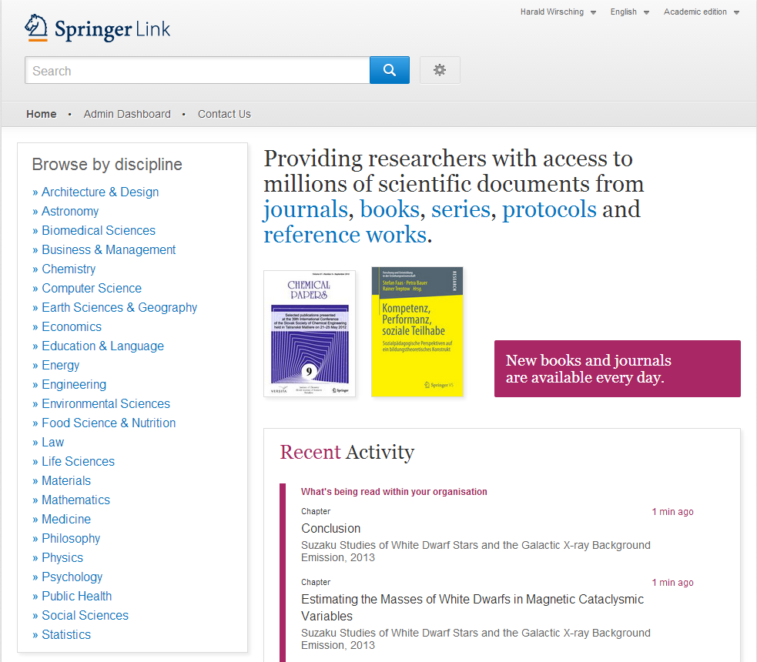
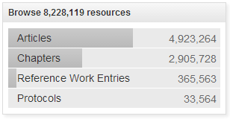

Slide 18
Content growth on SpringerLink
Documents
Book Archives
Journal Archives

Slide 19









Discovery Tools for Scientific Information
Information Task
Main Discovery Tools
Background research:
First stop for researchers and students when researching new area or learning new subject
1. Google
Focused research:
Literature review for establishing research base or writing a research article
2. A&I databases
Bibliographic search:
Finding a reference, usually part of another information task
Keeping up-to-date:
Browsing current literature to stay up-to-date in a field
3. Library Portals
SpringerLink acts as a repository for Springer published research, usually not starting point of a scientific information task
Notes:
19

Slide 20







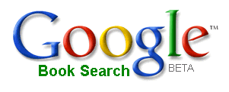






Findability and visibility of content are key
How Springer leverages business opportunities
Search Engine
Optimization
Abstract & Indexing
Services
Library portals
Book search programs /
eRetail
Social Media

Slide 21
Springer’s Role in Serving Authors

Slide 22
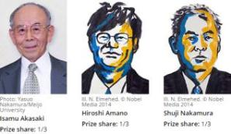
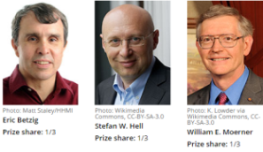


All ten of the 2014 Nobel laureates in medicine, physics, chemistry and economics are Springer authors and editors!
Physics
Chemistry
Physiology and Medicine
Economics

Slide 23
Strong focus on author services, satisfaction already on a high level
Journal author satisfaction
Book author satisfaction
Average: 1.5
Average: 1.6

Slide 24
The journal’s brand is the key criteria for journal selection
Source: Springer Author satisfaction Survey; 5-point rating: 1=very important to 5=not important at all

Slide 25
Thank You!

