Slide 1
Innovative World of Concrete (IWC)
An International Conference on
“INNOVATIONS IN CONCRETE
– To Meet Housing and Infrastructure Challenges"
19th to 22nd September 2018 at NIMHANS Convention Centre, Bangalore
“Rheology of Ultra High Performance Self Compacting Concrete - UHPSCC”
Presenting Authors
Santhosh k- Department of Civil Engineering, AIET Moodbidri
Manoj V - Department of Civil Engineering, SVCE Bangalore
Co-Authors
Bharathi Ganesh - Department of Civil Engineering, NMIT Bangalore
Ramesh M N - Managing Director, Talrak Construction Chemicals Pvt. Ltd
SHARADA BAI H- Retd. Professor, UVCE, Bangalore University

Slide 2
Overview
Introduction
What Research says?
Why UHPC?
Materials Used,Methodology
Mix Design
Test On Fresh Properties
Compressive Strength
Conclusion And References
Notes:
This presentation will discuss various types of high-performance concrete. The discussion will begin with an overview of high-performance concrete and the drive behind the technology. Next, specific types of high-performance concrete will be discussed, namely high-durability, high-early-strength, and high-strength concrete. We will then review the differences in construction procedures necessary for handling high-performance concrete. The presentation will conclude with brief mentions of self-consolidating concrete and ultra-high-performance concrete.

Slide 3
Introduction
During past three decades, the concrete technology is evolving at greater speed with drastic improvement in its strength, durability and other structural properties.
The researchers Richard and Cheyrezy have introduced a new type of concrete called Ultra High Performance Concrete/Self Compacting Concrete (UHPC/UHPSCC) to cater to the higher strength requirement of RCC structures with more storeys with emphasis on durability and performance.
The compressive strength of UHPC is greater than 100MPa and tensile strength is greater than 5MPa.

Slide 4
Concrete of Ultra-high performance and strength can be achieved with the right combination of supplementary cementitious materials like silica fumes, GGBS and Metakaolin along with quartz powder as a portion of fine aggregates.
PC based hyper plasticizer is used to optimise water-binder ratio. These approaches in order with optimum packing density is employed in the mix design process.

Slide 5
Merits of Using UHPC
It has very high compressive, flexural and split tensile strength
Due to the very high durability property, life of the structure is improved.
It has a better ductile property, so it can be used in the pre cast concrete structures.
Cross section of the structural element can be noticeably reduced.
Mix is designed based on Optimized Packing Density approach, hence improves the homogeneity of concrete.
Hence, reduces the capillary suction, reduces the pore size and therefore reduces danger of concrete cancer, improving durability.
Presence of micro fibres reduces the micro cracks due to shrinkage and hence improves the tensile strength and ductility of concrete.

Slide 6
What Literatures Say
The mineral admixtures namely GGBS, Micro Silica, Metakaolin, Fly Ash etc. are extensively used as Supplementary Cementitious Materials(SCM).
The mineral admixtures used are finer than the Cement, expected to fill the voids between cement particles and hence improve the packing, enhance workability, strength and durability of UHPC.
Literature highlights the use of Micro Silica and GGBS as the most commonly used mineral admixtures in UHPC.
The Particle Packing Density approach is adopted and mix proportions is arrived to obtain high strength and durable concrete called UHPC.
The studies report that strength of around 150MPa is achieved under normal curing and strength up to 200MPa is achieved with heat curing.

Slide 8
The Materials, Mix Design and Methodology
Properties of UHPSCC are controlled by
The Materials as Ingredients of Concrete
Physical, Chemical and Morphological Properties
Achieving good workability and Compressive strength of the UHPC/SCC.
Materials making UHPSCC
Cement and Cementitious Materials like metakaolin, micro silica etc.,
M-Sand and Quartz sand as Fine Aggregates
And Coarse Aggregates(Optional)
Mild Steel fibres & Hyper plasticizer

Slide 9
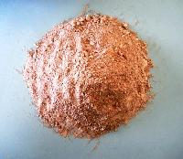
The Materials, Mix Design and Methodology
Materials
Cementitious Material
Two mineral admixtures namely metakaolin (5%)and micro silica (10%)are used along with cement as cementitious materials.
mineral admixtures react chemically with hydrating cement to form a modified paste
Cement : The 53 Grade OPC with Specific Gravity of 3.15(Tested as per IS:12269-1987)
Metakaolin
Produced by heating kaolin to a temperature of 650‐900°C (1200 to 1650°F) Kaolin is a very fine alumino-siliceous mineral.
specific gravity of 2.59
surface area of 8000 to 25000 m²/kg
average particle size is less than 2.5µm

Slide 10
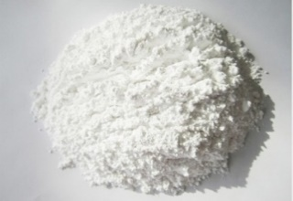
Micro Silica
A waste product of silicon metal or ferrosilicon alloy industries, consisting of mainly silicon dioxide (SiO_{2).}
sizes of the individual particle are approximately equal to 1/100th of the average size of cement particles.
Specific surface of micro silica is about 15000 to 30000 m²/kg
bulk density of 130 to 600 kg/m³
Average particle size of micro silica is less than 1µm
Chemical Composition | Material | SiO₂ | Fe₂O₃ | Al₂O₃ | CaO | MgO | others
Percentage of Content | Cement | 22.25% | 4.56% | 5.8% | 62.67% | 0.7% | 4.02%
 | Metakaoline | 52% | 1.7% | 42% | 0.5% | 0.3% | 3.51%
 | Micro Silica | 93.58% | 0.25% | 0.20% | 0.38% | 0.49% | 5.11%

Slide 11
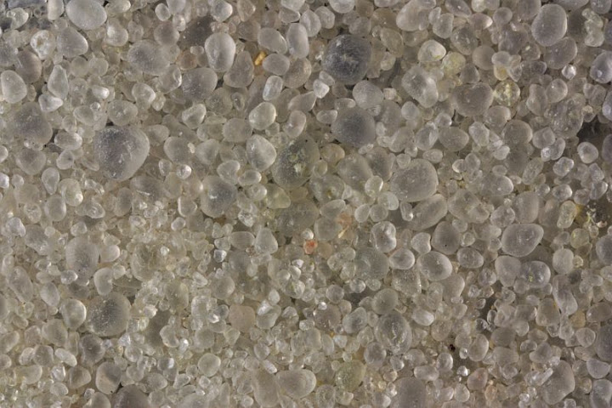
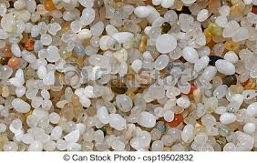
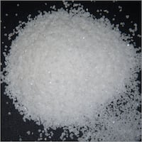
Fine Aggregates
M-Sand (95%) with Specific Gravity of 2.67 and Quartz Sand (5%) with Specific Gravity of 2.66 are used as a Fine Aggregates
Quartz Sand
Quartz Sand is made up of a lattice of silica (SiO₂) tetrahedral, hardness of the quartz sand is 7 as per Mohr’s Scale of mineral hardness.
There are 3 different sizes of quartz sand are used
60mesh, 100mesh and 200mesh.

Slide 12
Chemical Admixtures
P C based New Generation Hyper Plasticizer
Optimized Particle Packing Approach
The packing density is the ratio of volume of solids to the total bulk volume.
To achieve the optimized particle packing density, particles are selected in such a way that, smaller sized particles fill up the voids between the larger particles and so on.

Slide 13
Methodology
UHPFRC
Assessment of Characteristics of Materials used for UHPSCC
Mix Design from Reference Mix - Validate & Redesign suitably
Rheology
Varied Dosage of Admixture
Hardened UHPFRC
Early Compressive Strength Tensile Strength, Flexural Strength, Modulus of Elasticity
Slump Flow, V Funnel, and L - Box -As Per EFNARC 2005

Slide 15
Mix Design
Table 2 Reference Mix from R. Yu, P. Spiesz, H.J.H. Brouwers 2014
Reference Mix |  | Modified Mix used as Design Mix – Total Cementitious Content is 805 kg/m³
Materials | UHPC Mix | Materials | Mix1 (Mix without Coarse Aggregates) | Mix2 (Mix with Coarse Aggregates)
CEM 52.5 R | 612.4 kg | Cement | 1 | 1
Limestone | 262.5 kg | Micro Silica Fume | 0.1 | 0.1
Quartz | 0 | High Reactivity Metakaolin | 0.05 | 0.05
Micro sand | 218.7 kg | M-Sand | 1.62 | 0.85
sand 0-2 | 1054.7 kg | Coarse Aggregate | --- | 0.77
micro- silica | 43.7 kg | Quartz Sand | 0.32 | 0.32
Water | 202.1 lt | Steel Fibres | 0.00575 | 0.00575
super plasticizer | 45.9 lt | Super Plasticizer | 0.65%-1.3% | 0.55%-1.2%
water/cement ratio | 0.33 | Water/Binder ratio | 0.3,0.26,0.22 | 0.3,0.26,0.22

Slide 16
Notes:
High-performance concretes are made with carefully selected high-quality ingredients and optimized mixture designs; these are batched, mixed, placed, compacted and cured to the highest industry standards. Typically, they will have low water-cementing materials ratios of 0.20 to 0.45. High-range water reducers are usually used to make these concretes fluid and workable at lower w/cm. High-performance concrete almost always has greater durability than normal concrete. This greater durability may be accompanied by normal strength or it may be partnered with high strength. Note that strength is not always the primary required property. For bridge decks, a normal strength concrete with very high durability and very low permeability is considered high performance concrete. This table lists materials often used in high-performance concrete and their selection criteria.

Slide 17
The M-Sand is sieved into different size particles, such as retaining on 2.36mm, 0.6mm, 0.15mm sieves and particle passing through 0.15mm sieves.
Quartz sand of sizes 0.25mm (60 meshes), 0.15mm (100mesh) and 0.75mm (200mesh) are used to fill the requirements of very fine particles.
The typical example of sieve analysis of materials mixed in different combinations and the final fractions obtained.
Particles of size > 2.36mm - 20 %
Particles of size > 0.6mm – 30%
Size Fraction of > 0.15mm – 40%
Quantity of particles with size < 0.15mm - 10%.
Notes:
High-performance concretes are made with carefully selected high-quality ingredients and optimized mixture designs; these are batched, mixed, placed, compacted and cured to the highest industry standards. Typically, they will have low water-cementing materials ratios of 0.20 to 0.45. High-range water reducers are usually used to make these concretes fluid and workable at lower w/cm. High-performance concrete almost always has greater durability than normal concrete. This greater durability may be accompanied by normal strength or it may be partnered with high strength. Note that strength is not always the primary required property. For bridge decks, a normal strength concrete with very high durability and very low permeability is considered high performance concrete. This table lists materials often used in high-performance concrete and their selection criteria.

Slide 18
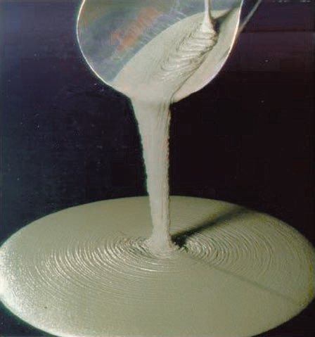
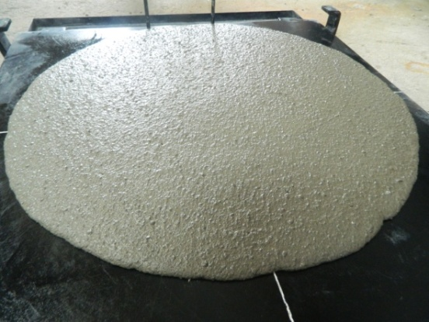
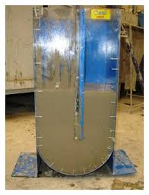
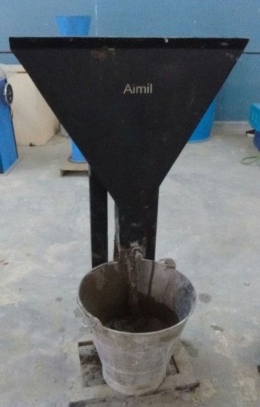
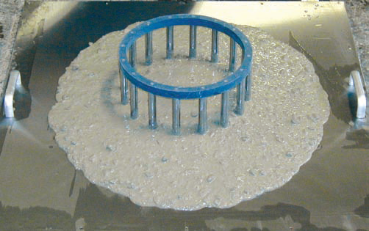
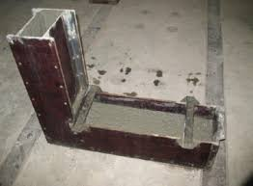
Self-Consolidating Concrete
Rheology of SCC is Rheology of UHPC
Notes:
Since SCC is characterized by special fresh concrete properties, many new tests have been developed to measure flowability, viscosity, blocking tendency, self-leveling, and stability of the mixture. The slump flow test (ASTM C1611) is performed to measure filling ability and stability. The test is performed similarly to the conventional slump test (ASTM C143). However, instead of measuring the slumping distance vertically, the mean diameter of the resulting concrete patty is measured horizontally. This number is recorded as the slump flow. The J-Ring test (ASTM C1621) measures passing ability. The J-Ring consists of a ring of reinforcing bar such that it will fit around the base of a standard slump cone, as shown here. The slump flow with and without the J-Ring is measured, and the difference calculated. ASTM C1610 evaluates static stability of a concrete mixture by quantifying aggregate segregation. A column is filled with concrete and allowed to sit after placement. The column is then separated into three pieces. Each section is removed individually and the concrete from that section is washed over a 4.75 mm (No. 4) sieve and the retained aggregate weighed. A non-segregating mixture will have a consistent aggregate mass distribution in each section. A segregating mixture will have higher concentrations of aggregate in the lower sections. An earlier assessment of the segregation resistance is ASTM C1712. A 45 g hollow cylinder device is placed on top of an inverted slump mold containing SCC. The distance the weight sinks in 30 seconds correlates to the static segregation resistance of the mixture. If the penetration depth is less than 10 mm, the mixture is considered segregation resistant. A penetration value above 25 mm signals a mixture that is probably prone to segregation.

Slide 19
Paste content
The Paste content is the summation of amount of paste required to fill the voids in the concrete mass and 10% paste extra to coat the aggregate
Paste Contents
w/b | Paste Content in %
 | Mix 1 | Mix 2
0.3 | 49.5 | 51.7
0.26 | 46.4 | 48
0.22 | 43.2 | 44.7

Slide 20
Properties in Fresh State
Specifications of Rheology for Self-Compacting Concrete as per EFNARC 2005
Method / Test | Units | Specifications
 |  | Minimum | Maximum
Slump Flow | mm | 650 | 800
T₅₀cm Slump Flow | Sec | 2 | 5
J-Ring | mm | 0 | 10
V-Funnel | Sec | 6 | 12
Time increase, V-funnel at T₅minutes | sec | 0 | 3
L-Box | Blocking ratio h2/ h1 | 0.8 | 1
U-Box | (h2 -h1) mm | 0 | 30
Fill-Box | % | 90 | 100
GTM Screen Stability Test | % | 0 | 15
Orimet | sec | 0 | 5

Slide 21
Mix Design
Rheological Properties of the Mixes
Mix | admixture dosage % |  | Slump Spread |  | J ring | L- Box | V- funnel |  | U box
 |  |  | Horizontal (mm) | T₅₀ cm (sec) | T₅₀ cm (sec) | Blocking ratio (H₂/H₁) | (Tr) Flow (sec) | Flow at T₅ min (sec) | Diff in height (mm)
Mix without CA – Mix1 | 0.65 | 0.3 | 780 | 4 | 4 | 0.95 | 8 | 11 | 0
 | 0.85 | 0.26 | 710 | 4 | 6 | 0.9 | 10 | 13 | 1
 | 1.3 | 0.22 | 660 | 5 | 8 | 0.85 | 12 | 15 | 1
Mix with CA- Mix2 | 0.7 | 0.3 | 760 | 4 | 5 | 0.9 | 9 | 10 | 1
 | 0.95 | 0.26 | 680 | 5 | 8 | 0.85 | 11 | 13 | 1
 | 1.4 | 0.22 | 650 | 5 | 10 | 0.85 | 12 | 15 | 1
Specification |  |  | 650-800 mm | 05 sec. | 10 sec. | 0.8-1 | 6-12 sec. | ≤ Tr+3 | Max 30

Slide 22
Rheology of SCC
Variation of Slump Flow With The Water Binder Ratio
Comparison of V Funnel Time of Different Mixes at Different w/c Ratio

Slide 23
Rheology of SCC
Variation of Slump Flow With The Water Binder Ratio
Comparison of V Funnel Time of Different Mixes at Different w/c Ratio

Slide 24
Rheology of SCC
Comparison of J ring T50 with Water Binder Ratio
Comparison of L Box Blocking Ratio with Water Binder Ratio

Slide 25
Rheology of SCC
Comparison of J ring T50 with Water Binder Ratio
Comparison of L Box Blocking Ratio with Water Binder Ratio

Slide 26
Properties in Hardened State
Compressive Strength Test
The compressive strength of mixes of UHPC specimens is evaluated as per IS516:1959(reaffirmed in 2004).
Water Binder Ratio |  | 0.3 | 0.26 | 0.22
Mix without CA – Mix1 | Paste Content % | 49.5 | 46.4 | 43.2
 | 28 Day Compressive Strength in MPa | 106 | 112 | 120
Mix with CA- Mix2 | Paste Content % | 51.7 | 48 | 44.7
 | 28 Day Compressive Strength in MPa | 90 | 97 | 105

Slide 27
Properties in Hardened State
Compressive Strength Test

Slide 28
Discussion & Conclusions
From the experimental results, it is observed that even at a very low water binder ratio, the targeted rheological properties of fresh SCC can be achieved by adjusting the dosage of admixture.
The properties of UHPSCC in wet state are recorded for each dosage of admixture and analysed.
The paste volume of the mixes is one of the criteria, which controls the flow behaviour of mixes.
It may be concluded that flow properties of UHPSCC mixes can be improved with increased paste volume of the mixes.
The mixes without coarse aggregates have shown better flowability properties in comparison with the mixes with coarse aggregates.
The reduced flow may be attributed to the increased shear resistance of the mix in the presence of coarse aggregates as well as reduction in the volume of paste.

Slide 29
Discussion & Conclusions
The 28day strength of 90MPa and 106MPa could be achieved for a cementitious content of 805 kg/m³ for the mix with and without coarse aggregates respectively at a w/b ratio of 0.30.
Similarly, the strength attained at 28 days curing was 97MPa and 112MPA at a w/b ratio of 0.26 and 105MPa and 120MPa at a lower w/b ratio of 0.22 for the mixes with and without coarse aggregates respectively.
Hence it is concluded that a sensitive factor to be borne in mind while designing the UHPSCC mix is the coarse aggregate content when optimised rheological performance is desired. The UHPC/UHPSCC mixes without coarse aggregate not only enhance the rheological performance but also satisfied the strength requirement.

Slide 30
Sandwich Elements - SESBE
Little Metropole Modern Art Museum, France
Jean Bouin Stadium, Paris, France

Slide 32
References
[1] A.R. Lubbers. 2003. “Bond Performance between Ultra-High Performance Concrete and Pre-stressing Strands”. Faculty of Fritz, College of Engineering and Technology of Ohio University. pp. 155-165.
[2] Assail. 2007. “Mechanical Properties and Durability of Polymer Modified RPC Exposed to Oil Products”. Ph.D. Thesis, University of Technology, Baghdad, Iraq. p.180.
[3] Behloul, M., Chanvillard, G., Casanova, P., and Orange, G. (2002). “Fire resistance of ductile ultra high performance concrete.” Proc., 1st FIBCongress, FIB Int., Osaka, Japan, Dipl.-Ing., Institute for Structural Concrete and Building Materials, University of Leipzig 421–430.
[4] E.Fehling; K. Bunje; T. Leutbecher 2004 “Design relevant properties of hardened Ultra High Performance Concrete”. “Proceeding of the International Symposium on ultra high performance Concrete Kassel, Germany”, Sep. 13-15, 2004. Pp.377-390.
[5] Jianxin Ma and Jorg Dietz, “Ultra High performance self Compacting concrete” Lacer No7.2002
[6] M. Orgass and Y. Klug. 2004. “Steel Fibre Reinforced Ultra-High Strength Concrete”.MFPA Leipzig GmbH, Lacer No. 9. pp. 12-20.

Slide 33
References
[7] S. Shihada and M. Arafa 2010 “Effects of Silica Fume, Ultrafine and Mixing Sequences on Properties of Ultra High Performance’’ Concrete Asian Journal of Materials Science 2 (3): 137-146.
[8] Srinivas Allena and Craig M Newton, Shrinkage of Fiber Reinforced Ultra High Strength Concrete: (Journal of material in Civil Engineering (ASCE), 24(5), 612-614 (May 2012).
[9] Sudarshan N M, DR. T Chandrashekhar Rao, Mechanical Properties Assessment of Ultra High Performance Fibre Reinforced Concrete (UHPFRC), International Journal for Research in Applied Science & Engineering Technology (IJRASET) (Journal of material in Civil Engineering Volume 3, Issue VI, ISSN 2321-9653 ,( June 2015).
[10] Sundararaman S, S Azhagarsamy, Performance of Ultra High Performance Concrete Containing Mineral Admixtures, SSRG International journal of Civil Engineering Vol: 2, Issue 10, Octobre 2015.
[11] Fib Symposium 2017, Presentation on ‘UHPC for Innovative Structural and Architectural Solutions’.

