Slide 1






Performance specifications for cementitious grouts used in post-tensioned concrete systems
  Manu K. MOHAN, M. S. Student
  Radhakrishna G. PILLAI, Associate Professor
  Manu SANTHANAM, Professor
  Ravindra GETTU, Professor
Indian Institute of Technology Madras
Chennai, INDIA
Ministry of Human Resource Development and
Ministry of Housing and Urban Affairs
Government of India
  ICI-IWC 2018
  NIMHANS convention center, Bangalore, India
September 19-22, 2018

Slide 2
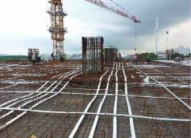

Grouted, post-tensioned (PT) systems are commonly used in large concrete structures
High-rise buildings
Long-span segmental bridges
Strands are embedded in plastic ducts and the interstitial spaces are supposed to be filled with grout
Nuclear vaults
Silos
Source : https://www.google.co.in and FDOT report (2003)

Slide 3
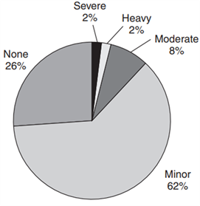
Premature corrosion has been observed in many YOUNG bridges
Mandovi, 12
Ynys-y-Gwas, 33
Malle, 13
Bickton Meadows, 15
Niles Channel, 16
Mid Bay,15
447 bridges in UK
Ban during 1992 – 1996
(Woodward, 1988)

Slide 4
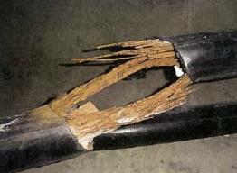
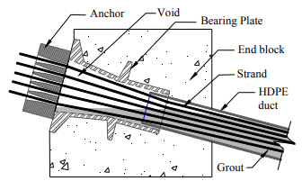
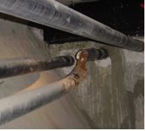
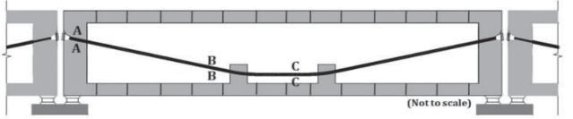
Premature corrosion has been observed in many YOUNG bridges
Varina-Enon, Virginia
At 17 years
Anchorage zone in a PT girder
FDOT 2003

Slide 5
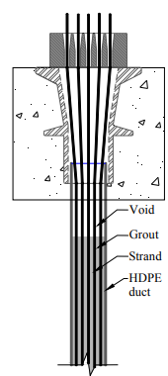
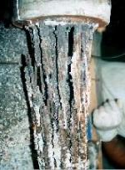

Premature corrosion has been observed in many YOUNG bridges
Sunshine Skyway, Florida
At 8 years
Anchorage zone in PT column
FDOT 2001

Slide 6
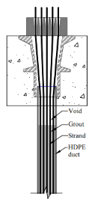
Why such premature corrosion?
Voids in ducts → exposed strands
A metro rail bridge
Anchorage zone in PT column
Anchorage zone in a PT girder

Slide 7
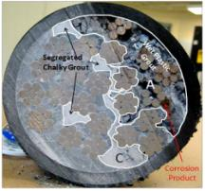
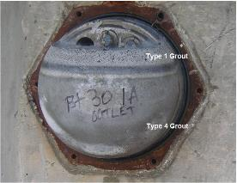
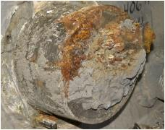
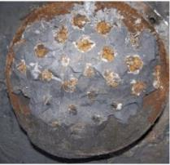
Why such premature corrosion?
Chloride ingress → Corrosion of strands
Chlorides

Slide 8
Why such premature corrosion?
Carbonation of ‘top’ grout → Localized corrosion
CO₂

Slide 9
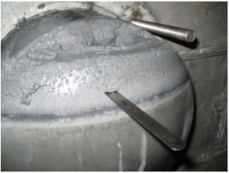

Are the new grouts good enough?
- Formation of soft grout should be avoided
Inadequate specs. → Voids → Premature corrosion

Slide 10
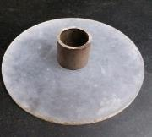
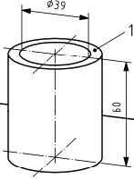
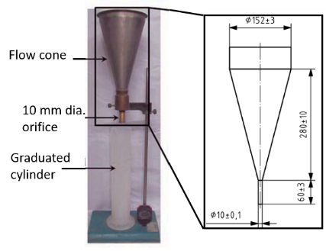
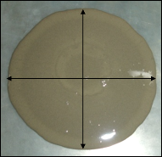
Methods to assess the fluidity and its retention of PT grouts
Flow cone test
Spread test
Cylinder
Smooth plate
Flow cone (EN445:2007)
Grout spread
(EN445:2007)

Slide 11
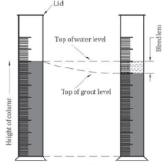
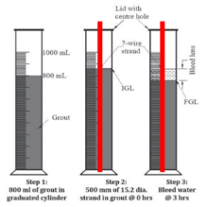
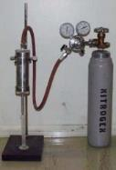
Methods to assess the bleed resistance of PT grouts
Standard bleed (SB) test
Wick-induced bleed (WB) test
Pressure-induced bleed (PB) test
Inclined tube bleed (IT) test
Standard bleed (SB) test
Wick-induced
bleed (WB) test
Pressure-induced
Bleed (PB) test
Inclined-tube test
PCG = Plain cement grout
SBG = Site batched grout
PPG = Pre-packed grout (commercial)
TF = Tendon Fill

Slide 12

Fluidity (Efflux time, T₀) of commercial grouts
TF
Good quality PT grouts may get disqualified by the current efflux time test and viceversa !
We have to use other tests to qualify/disqualify PT grouts
PCG = Plain cement grout
SBG = Site batched grout
PPG = Pre-packed grout (commercial)
TF = Tendon Fill
Kamalakannan et al 2018

Slide 13

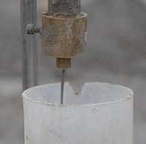
Recommended specifications for fluidity and its retention
Flow cones with smaller orifice diameters
Thixotropic grouts with very low w/c
2 mm orifice
Property | EN 447 (2007) & ISO 14824 (2012) | fib Bulletin No. 20 (2002) | PTI M55 (2003) | Recommended
Efflux time, T₀ (s) | T₀ ≤ 25 (EN 445 Flow cone) | T₀ ≤ 25 | 5 ≤ T₀ ≤ 30 (ASTM C939 Marsh cone) | T₀ ≤ 25 (EN 445 Flow cone)
Efflux time 30 min. after mixing, T₃₀ (s) | 1.2 T₀ ≥ T₃₀ ≥ 0.8 T₀ and T₃₀ ≤ 25 | Not mentioned | Not mentioned | 1.2 T₀ ≥ T₃₀ ≥ 0.8 T₀ and T₃₀ ≤ 25
Efflux time 180 min. after mixing, T₁₈₀ (s) | Not mentioned | Not mentioned | Not mentioned | 1.4 T₀ ≥ T₁₈₀ ≥ 0.6 T₀ and T₁₈₀ ≤ 25
Notes:
Depending on the pre-shear (past shear histories applied on the grout), the fluidity will change as it’s a thixotropic material.
The green colour indicates the recommended specification.

Slide 14
Mixture proportion of the grouts studied
Material | Quantity (kg/m³)
 | PPG1 | PPG2 | PPG3 | PPG4 | PPG5 | PPG6 | PPG7 | PPG8 | PPG9
OPC | 1473 | 1120 | 1088 | 1119 | 951 | 951 | 951 | 951 | 951
Fly ash-1 (Class F) | 0 | 320 | 512 | 0 | 317 | 317 | 317 | 317 | 317
Fly ash-2 (Class F) | 0 | 0 | 0 | 480 | 317 | 317 | 317 | 317 | 317
Silica fume | 164 | 160 | 0 | 0 | 0 | 0 | 0 | 0 | 0
Water | 458 | 432 | 432 | 432 | 428 | 428 | 428 | 428 | 428
HRWR | 1.80 | 1.44 | 1.44 | 1.43 | 1.43 | 1.53 | 1.43 | 1.43 | 1.43
Viscosity modifier | 0 | 0 | 0.80 | 0.79 | 0.50 | 0 | 0.80 | 0.63 | 0.63
Nano clay | 0 | 0 | 0 | 0 | 0 | 1.58 | 0 | 0 | 0
SRA | 0 | 0 | 0 | 0 | 0 | 0 | 0 | 0 | 31.7
water/binder | 0.28 | 0.27 | 0.27 | 0.27 | 0.27 | 0.27 | 0.27 | 0.27 | 0.27

Slide 15
Fluidity and its retention
PPG = Pre-packaged grout
Grout | T₀ | T₃₀ | T₁₈₀
PPG 1 | 12 | 13 | 19
PPG 2 | 14 | 15 | 24
PPG 3 | 18 | 19 | 25
PPG 4 | 29 | 30 | 37
PPG 5 | 24 | 26 | 27
PPG 6 | 15 | 18 | 28
×
×
×
Acceptance criteria
1.2 T₀ ≥ T₃₀ ≥ 0.8 T₀ and T₃₀ ≤ 25
1.4 T₀ ≥ T₁₈₀ ≥ 0.6 T₀ and T₁₈₀ ≤ 25
PPGs 1, 2, and 3 met the requirements
Grouts with low efflux time need not have required fluidity retention (e.g., PPG6)

Slide 16
Recommended specifications for fluidity (Spread, S)
Rarely used, though a simple test
Property | EN 447 (2007) & ISO 14824 (2012) | fib Bulletin No. 20 (2002) | PTI M55 (2003) | Recommended
Grout spread, S₀ (mm) | S₀ ≥ 140 | S₀ ≤ 25 | 5 ≤ S₀ ≤ 30 (ASTM C939 Marsh cone) | S₀ ≤ 25 (EN 445 Flow cone)
Grout spread 30 min. after mixing, S₃₀ (mm) | 1.2 S₀ ≥ S₃₀ ≥ 0.8 S₀ and S₃₀ ≥ 140 | Not mentioned | Not mentioned | 1.2 S₀ ≥ S₃₀ ≥ 0.8 S₀ and S₃₀ ≤ 25
Grout spread 180 min. after mixing, S₁₈₀ (mm) | Not mentioned | Not mentioned | Not mentioned | 1.4 S₀ ≥ S₁₈₀ ≥ 0.6 S₀ and S₁₈₀ ≥ 120

Slide 17
Fluidity and its retention (Spread, S)
Grout | S₀ | S₃₀ | S₁₈₀
PBG 1 | 167 | 161 | 141
PBG 2 | 158 | 153 | 136
PBG 3 | 151 | 146 | 122
PBG 4 | 117 | 114 | 86
PBG 5 | 128 | 121 | 90
PBG 6 | 160 | 151 | 130
×
×
Acceptance criteria
1.2 S₀ ≥ S₃₀ ≥ 0.8 S₀ and S₃₀ ≥ 140
1.6 S₀ ≥ S₁₈₀ ≥ 0.6 S₀ and S₁₈₀ ≥ 120
PPGs 1, 2, 3, and 6 met the requirements

Slide 18


Recommended specifications for bleed resistance
Property | EN 447 (2007) & ISO 14824 (2012) | fib Bulletin No. 20 (2002) | PTI M55 (2003) | Recommended
Bleed (%)
Standard | Not mentioned | Not mentioned | ≤ 0.1 | ≤ 0.1
Wick-induced | ≤ 0.3 | ≤ 0.3 | ≤ 0.3 | ≤ 0.0
Standard bleed and wick-induced bleed tests must be done
Standard bleed test
Wick-induced bleed test

Slide 19
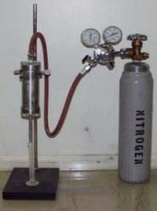
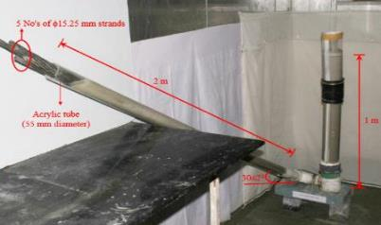
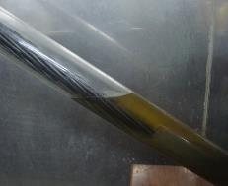
Recommended specifications for bleed resistance
Property | EN 447 (2007) & ISO 14824 (2012) | fib Bulletin No. 20 (2002) | PTI M55 (2003) | Recommended
Bleed (%)
Pressure-induced (at 350 kPa) | Not mentioned | Not mentioned | ≤ 0.1 | ≤ 0.1
Inclined tube test | ≤ 0.3 | ≤ 0.3 | ≤ 0.3 | ≤ 0.3

Slide 20
Bleed resistance of existing PPGs and other indigenous grouts
Upper limit = 0.3 %
(EN 447:2007)
PT grouts used in today’s construction industry do not meet the recommended specifications
Kamalakannan et al. 2018, Ashok 2015, Ramya, 2015

Slide 21
Bleed resistance of the grouts
×
×
PPG3 and PPG5 has very low bleed and can be used for PT columns

Slide 22
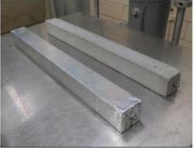
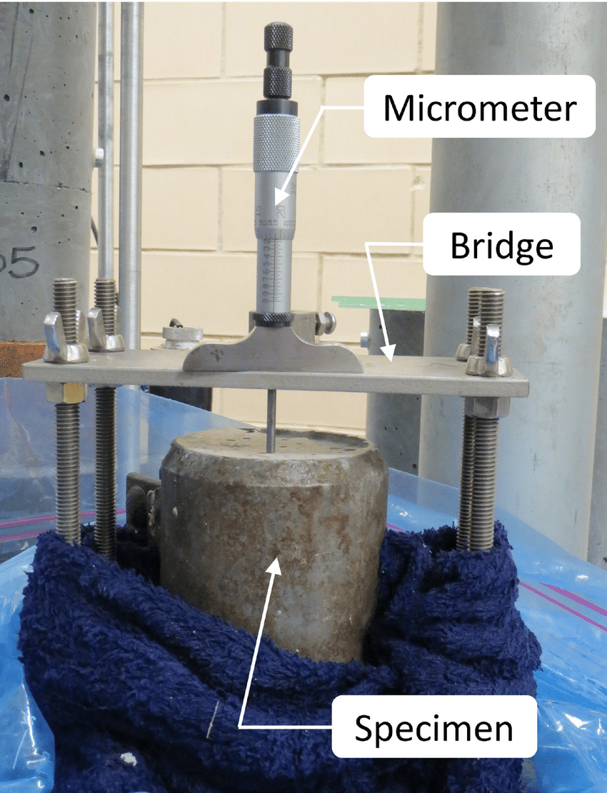
Recommended specifications for dimensional stability
Compressive strength is not a screening test
Good dimensional stability
  Total and autogenous shrinkage
ASTM C157 specimens for measuring the shrinkage
ASTM C1090 test for measuring expansion
Property | EN 447 (2007) & ISO 14824 (2012) | fib Bulletin No. 20 (2002) | PTI M55 (2003) | Recommended
Compressive strength (MPa)
7-day | ≥ 27 | ≥ 27 | ≥ 21 | ≥ 21
28-day | ≥ 30 | Not mentioned | ≥ 35 | ≥ 35
Hardened volume change (%)
Expansion | Not mentioned | Not mentioned | ≤ 0.1 at 24 hours ≤ 0.2 after 28 days | ≤ 0.1 at 24 hours ≤ 0.2 after 28 days
Shrinkage | Not mentioned | Not mentioned | Not mentioned | ≤ 0.2 after 28 days

Slide 23
Cube compressive strength and shrinkage for the grouts
Total shrinkage
Autogenous shrinkage
PPG4 has highest compressive strength; PPG6 has lowest
Shrinkage strains were reduced with the use of SRA

Slide 24
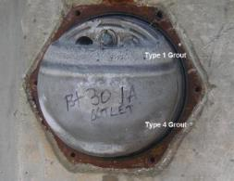
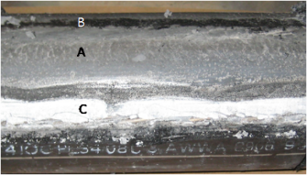
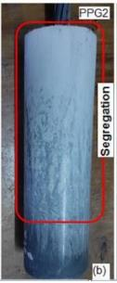
Visual observations on grout cylinders/tendons can also be used as performance tests
Frothy material floats or forms at the top surface of grout
Segregation in the field tendons
Segregation in
the lab specimens
Ashok Gorantla 2016, http://www.fhwa.dot.gov/publications/research/infrastructure/structures/bridge/13028/

Slide 25
Modified performance specifications for PT grouts
Parameter |  | Acceptance criteria | Test method | Standard
Fresh state (very crucial) | Efflux time, T₀ (s) | T₀ ≤ 25 | Flow Cone test as per EN 445:2007 | EN 447:2007
 | Efflux time 30 minutes after mixing, T₃₀ (s) | 1.2 T₀ ≥ T₃₀ ≥ 0.8 T₀ and T₃₀ ≤ 25
 | Efflux time 180 minutes after mixing, T₁₈₀ (s) | 1.4 T₀ ≥ T₁₈₀ ≥ 0.6 T₀ and T₁₈₀ ≤ 28
 | Gout spread, S₀ (mm) | ≥ 140 | Grout spread test as per EN 445:2007
 | Grout spread 30 minutes after mixing, S₃₀ (mm) | 1.2 S₀ ≥ S₃₀ ≥ 0.8 S₀ and S₃₀ ≥ 140
 | Grout spread 180 minutes after mixing, S₁₈₀ (mm) | 1.4 S₀ ≥ S₁₈₀ ≥ 0.6 S₀ and S₁₈₀ ≥ 120
 | Bleed (%) |  | Standard, wick bleed and inclined tube test as per EN 445:2007 Pressure-induced bleed test as per ASTM C1741 | EN 447:2007 and PTI M55.1-12
 | Standard | -
 | Wick-induced | ≤ 0.3
 | Pressure-induced (at 350 kPa) | ≤ 0.1
 | Inclined tube | ≤ 0.3
 | Setting time (hrs.) |  | Setting time test as per ASTM C953 | EN 447:2007 and PTI M55.1-12
 | Initial | ≥ 3
 | Final | ≤ 24

Slide 26
Modified performance specifications for PT grouts
Parameter |  | Acceptance criteria | Test method | Standard
Desired | Compressive strength (N/mm²) |  | ASTM C942 with the moulds complying to ASTM C 109 | EN 447:2007 and PTI M55.1-12
 | 3 day | ≤ 10
 | 7 day | ≤ 27
 | 28 day | ≤ 30
Very Crucial | Hardened volume change (%) |  | ASTM C1090 for expansion and ASTM C157 or ASTM C1698 for shrinkage | PTI M55.1-12
 | Expansion | ≤ 0.1 at 24 hours & ≤ 0.2 after 28 days
 | Shrinkage | ≤ 0.2 after 28 days
Crucial | Deleterious ions (% of binder) |  | Ion Chromatography or Chemical analysis | EN 447:2007 and PTI M55.1-12
 | Chloride (Cl²⁻) | ≤ 0.08
 | Sulphates (SO₄²⁻) | ≤ 4.00
 | Sulphides (S²⁻) | ≤ 0.01
A set of stringent specifications must be used to achieve good quality PT grout

Slide 27
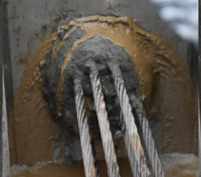
Avoid the filling of duct with water before grouting
Chances are very less that the grout will entirely displace the water
Strands may get corroded and left as it is
  There may be significant delays between the placing of strands in the duct and the prestressing
✗
Increasing gradient
Vent
water flow
water flow
Inlet
water filled duct prior to grouting
Signs of strand corrosion in a duct that was filled with water
Ashok Gorantla 2016

Slide 28
Grout must be pumped from the lowest points to get complete filling of the duct
Vents
Increasing gradient
Duct
Vent
Vent
Grout flow
Min.
1 m
Grout flow
Grout flow
Grout flow
Dead end anchorage
Inlet
Stressing anchorage
Inlet

Slide 29
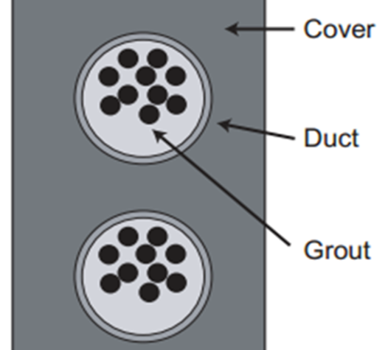

Grout flowing out of the other end does not mean that the tendon is filled with grout
A simplified schematic of typical tendon profile (Not to scale)

Slide 30
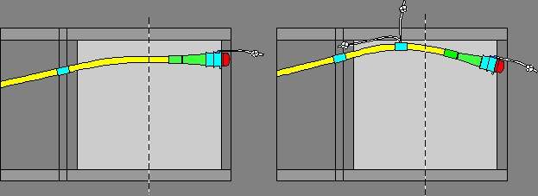
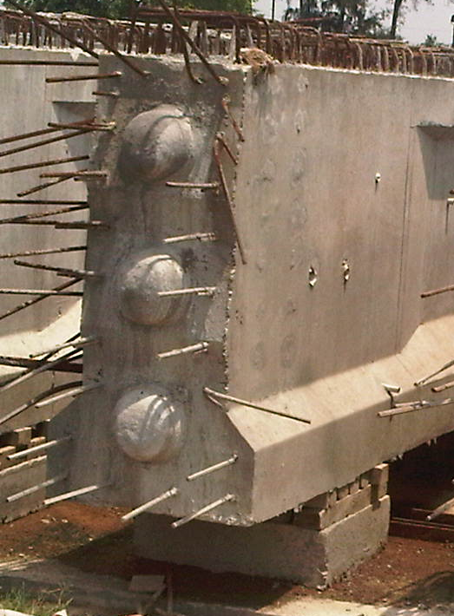
Void formation can be avoided by keeping anchors “face-down” and appropriate vents
✗
✓

Slide 31
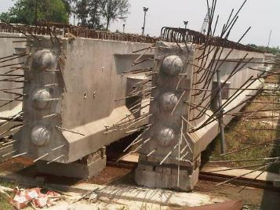
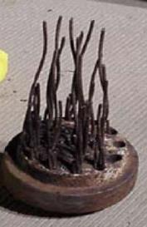
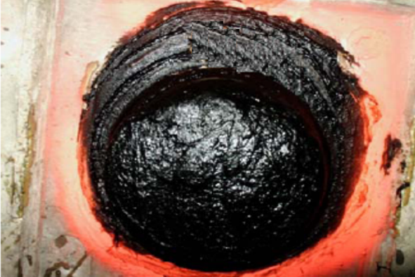
Cementitious cover/cap can attract humidity and moisture and cause corrosion near the ends
✗
~ 13 years!
PT systems with ends covered with cementitious materials
Severe corrosion at the anchorages
✓
Crack-resistant bituminous coating is better than cementitious coating
http://www.fhwa.dot.gov/bridge/pt/pt.pdf

Slide 32
Conclusions
Efflux time alone should not be used to disqualify a thixotropic grout
Bleed resistance is very important to avoid void formation inside the ducts
Retention of flow/bleed resistance are important to check
A set of stringent performance specifications can significantly improve the quality of the PT grouting and life of PT bridges.
PT grouts developed in this study meets all the critical specifications and the grouts have a good balance between the fluidity and the bleed resistance.
The grouting practices are also very important
Future work
  Specifications with smaller orifices and their correlation with bleed

Slide 33


Tendons are the backbone of pre- and post-tensioned concrete structures
We must do whatever we can to prevent corrosion of these expensive and important systems
– an extra care at the beginning in achieving this is really worth in the long term.
Thank You
pillai@iitm.ac.in

Slide 34
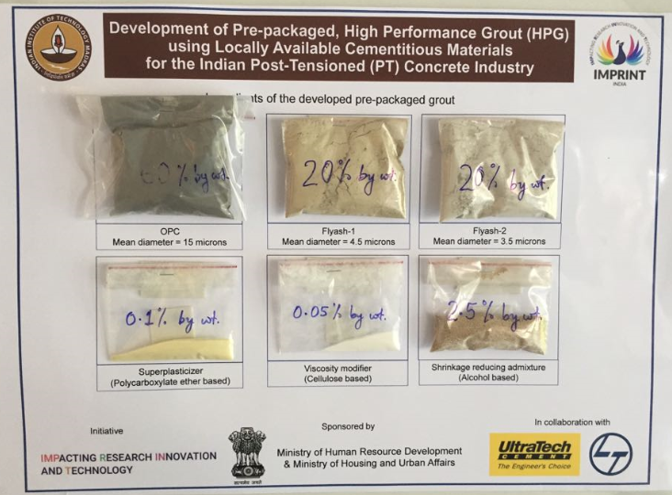
Visit our stall
Thank You
(pillai@iitm.ac.in)

Slide 35
Thank you

Slide 36
Performance specifications for flowable cementitious grouts for post-tensioned concrete systems
  Manu K. Mohan, M. S. Student
  Radhakrishna G. Pillai, Associate Professor
  Manu Santhanam, Professor
  Ravindra Gettu, Professor
Indian Institute of Technology Madras
Chennai, INDIA
  Innovative world of Concrete (ICI-IWC 2018)
  NIHAMS convention center, Bangalore, India
September 21, 2018

Slide 37
Specifications for PT grouts from various standards were reviewed
Property |  | EN 447 (2007) & ISO 14824 (2012) | fib Bulletin No. 20 (2002) | PTI M55 (2003) | MORTH (2005) | IRS (1997) | IS 1343 (2012)
Fresh | Efflux time, T₀ (s) | T₀ ≤ 25 (EN 445 Flow cone) | T₀ ≤ 25 | 5 ≤ T₀ ≤ 30 (ASTM C939 Marsh cone) | - | - | -
 | Efflux time 30 minutes after mixing, T₃₀ (s) | 1.2 T₀ ≥ T₃₀ ≥ 0.8 T₀ and T₃₀ ≤ 25 | - | - | - | - | -
 | Grout spread, S₀ (mm) | S₀ ≥ 140 | - | - | - | - | -
 | Grout spread 30 minutes after mixing, S₃₀ (mm) | 1.2 S₀ ≥ S₃₀ ≥ 0.8 S₀ and S₃₀ ≥ 140 | - | - | - | - | -
 | Bleed (%)
 | Standard | - | - | ≤ 0.0 | - | - | -
 | Wick-induced | ≤ 0.3 | ≤ 0.3 | ≤ 0.0 | ≤ 0.3 | - | -
 | Pressure-induced (at 350 kPa) | - | - | ≤ 0.0 | - | - | -
 | Inclined tube test | ≤ 0.3 | ≤ 0.3 | ≤ 0.3 | - | - | -
 | Setting time (hours)
 | Initial (T_{i}) | T_{i} ≥ 3 | T_{i} > 3 | 3 ≤ T_{i} ≤ 12 | 3 ≤ T_{i} ≤ 12 | - | -
 | Final (T_{f}) | T_{f} ≤ 24 | T_{f} < 24 | - | T_{f} ≤ 24 | - | -

Slide 38
Specifications for PT grouts from various standards were reviewed
Property |  | EN 447 (2007) & ISO 14824 (2012) | fib Bulletin No. 20 (2002) | PTI M55 (2003) | MORTH (2005) | IRS (1997) | IS 1343 (2012)
Hardened | Compressive strength (MPa)
 | 7-day | ≥ 27 | ≥ 27 | ≥ 21 | ≥ 28 | ≥ 17 | -
 | 28-day | ≥ 30 | - | ≥ 35 | ≥ 30 | - | ≥ 27
Dimensional stability | Hardened volume change
 | Expansion | - | - | ≤ 0.1 at 24 hours ≤ 0.2 after 28 days | - | - | -
 | Shrinkage | - | - | - | - | - | -
Durability | Deleterious materials (%)
 | Chloride (Cl⁻) | ≤ 0.10 | ≤ 4.10 | ≤ 0.08 | ≤ 0.1 | - | ≤ 0.1
 | Sulphate (SO₃²⁻) | ≤ 4.50 | ≤ 4.50 | - | ≤ 4 | - | -
 | Sulphide (S²⁻) | ≤ 0.01 | ≤ 0.01 | - | ≤ 0.01 | - | -
Most of the existing specifications are inadequate/not complete for developing a good quality PT grout

Slide 39

Limitations of the of the PT grout specifications
- Fluidity
Fluidity is measured using flow cones of different orifice diameters
  Flow cones of small orifices should be used
  Not suitable for thixotropic grouts with very low w/c ratio
  Grout spread gives a good indication of the fluidity and must be used
  Non-uniform pre-shear changes the fluidity
Retention of fluidity is measured for 30 minutes only
  Grouting operations can last for couple of hours after mixing
  Fluidity retention should be checked up to 3 hours

Slide 40
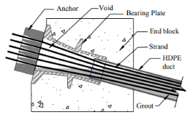
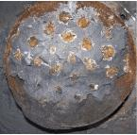
Reasons for tendon corrosion and corrosion propagation are..
Chloride induced corrosion
  Chloride ions reach strands because of the incomplete fillings, voids, exposed strands
Carbonation induced corrosion
  Due to bad quality end caps and presence
  of voids
  Reduces the pH of the grout pore solution
Propagation due to the galvanic coupling
  Corroded region couples with passive region
Unwanted voids (formed due to bleed water) are the root cause for moisture/chloride ingress leading to strand corrosion in PT structures

Slide 41
Effects of SCMs, superplasticizers and VMAs on the flow properties of grouts – a summary
Grout composition | Research findings | Reference
20 - 30 % fly ash SNF based SP | Plastic viscosity, yield stress, and bleed reduces | Khayat et al. 2008, Krishnamoorthy et al. 2002
5 - 20 % Silica fume SNF based SP & Cellulose based VMA | Fluidity decreases drastically Bleed can be reduced | Hope et al. 1988 Khayat et al. 1999 Sonebi et al. 2010
20 – 50 % GGBS & SMF based SP | Fluidity increases Bleed can be reduced | Bras et al. 2013
6 – 20 % Metakaolin PCE based SP & Polysaccharide VMA | Increased flow time, compressive strength and yield stress. Bleed reduces | Sonebi et al. 2013

Slide 42
Test methods and the effect of temperature and humidity – a review
Grout composition | Research findings | Reference
OPC with special admixture | Admixture to control bleed Devised test methods Wick-induced bleed test Pressure induced bleed test | Schupack 1971,1974
5 - 20 % Silica fume, GGBS and SNF superplasticizer | Simple field test to assess the flow and washout loss | Khayat, 1998
10 – 20 % silica fume SNF superplasticizer | Grout fluidity increase with increase in temperature and humidity | Diedrichs, 1989

Slide 43
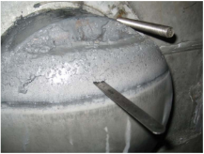
Effect of inert fillers – a review
Grout composition | Research findings | Reference
Portland cement & PCE based superplasticizer | Indirect relationship of yield stress and bleed resistance, effect of chemical admixtures on the rheological parameters | Roussel, 2009 Nugyen, 2011
Portland cement, Limestone filler upto 45%, PCE based SP | Formation of soft grout | Hamilton et al. 2014
Soft grout layer at the top
Pre-packaged, highly flowable and bleed resistant grouts are not available in India and many parts of the world

Slide 44
The following materials were identified for designing the grouts
1
Binders
  OPC 53 Grade
  Class F Fly ash – 621 m2/kg
  Class F Fly ash – 536 m2/kg
  Silica fume
Chemical additives
  PCE-based superplasticizer
  Cellulose-based VMA
  Nanoclay

Slide 45
Physical properties of the binders
Property | OPC | Fly ash-1 | Fly ash-2 | Silica fume
Water demand for normal consistency of cement paste (%) | 30 | - | - | -
Initial setting time (minutes) | 175 | - | - | -
Final setting time (hours) | 275 | - | - | -
Specific surface area (m²/kg) | 310 | 628 | 536 | 15000
Specific gravity | 3.15 | 2.3 | 2.4 | 2.2
Mean diameter (µm) | 15 | 4.5 | 3.5 | 0.41

Slide 46
Chemical composition of the binders
Chemical composition | Quantity (% by mass)
 | Cement | Fly ash 1 | Fly ash 2 | Silica fume
SiO₂ | 20.88 | 59.32 | 60.56 | 96.8
Al₂O₃ | 5.54 | 29.95 | 32.67 | -
Fe₂O₃ | 4.71 | 4.32 | 4.44 | -
CaO | 61.70 | 1.28 | 1.41 | 0.4
MgO | 1.06 | 0.61 | 0.23 | -
(Na₂O)_{e} | 0.20 | 0.16 | 0.12 | -
LOI | 2.27 | - | - | -
Determined using XRF

Slide 47
Physical properties of admixtures
Property | Superplasticizer | Viscosity modifying agent | Nanoclay
Commercial Name | Melflux 2651 F | Tylose MH | Acti-gel 208
Form | Powder | Powder | Powder
Colour | Yellow | White | Yellow
Odour | Odourless | Odourless | Odourless
Density (kg/m³) | 450 | 1300 | 1400
pH | 6.5 - 8.5 | 6 - 8 | 6-7
Drying loss | Maximum 2% | Maximum 1% | Maximum 1%

Slide 48
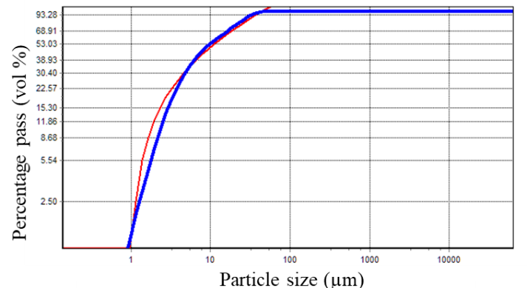
Approximate binder compositions were obtained using particle packing approach (EMMA)
(OPC + FA1) mix
Particle packing method
Optimum gradation volume ratios
Modified Andreasson model (q = 0.23)

Slide 49
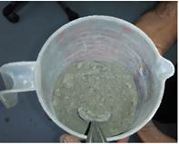
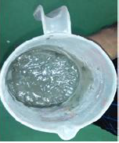
The particle packing of the designs from EMMA were confirmed using Puntke test
20 cm³ of powder
Water is added gradually until the surface becomes glossy
  due to the layer of excess water
Packing density
V_{W} = Vol. of water in cm³
V_{P} = Vol. of powder (20 cm³)
Puntke test

Slide 50
Puntke test results for the (OPC + FA1) mix
(OPC + FA1) mix
OPC (Vol %)
% Volume proportions | Packing density
50:50 | 0.600
55:45 | 0.614
58:42 | 0.618
60:40 | 0.611
65:35 | 0.608
70:30 | 0.604

Slide 51
w/b, SP dosage, and VMA dosage were determined
Normal consistency test (Vicat apparatus) - w/b
Wick-induced bleed test - VMA dosage
Flow cone test – SP dosage
VMA (%) SP (%) | 0 | 0.02 | 0.03 | 0.04 | 0.05
0 | 1.9 ml | 0 | 0 | 0 | 0
0.07 | 2.0 ml | 0 | 0 | 0 | 0
0.08 | 2.1 ml | 0 | 0 | 0 | 0
0.09 | 2.2 ml | 0 | 0 | 0 | 0
0.10 | 2.5 ml | 0 | 0 | 0 | 0
0.11 | 3.8 ml | 0 | 0 | 0 | 0
0.12 | 4.9 ml | 1 ml | 0.5 ml | 0 | 0
VMA (%) SP (%) | 0 | 0.02 | 0.03 | 0.04 | 0.05
0 | 58 | 62 | 78 | 81 | 97
0.07 | 37 | 51 | 65 | 71 | 82
0.08 | 25 | 37 | 57 | 62 | 71
0.09 | 20 | 28 | 48 | 59 | 64
0.10 | 18 | 23 | 31 | 41 | 48
0.11 | 10 | 12 | 17 | 22 | 25
0.12 | 10 | 12 | 16 | 21 | 23
Effect of superplasticizer and VMA on bleed
Effect of Superplastizer and VMA on flow time

Slide 52
SP dosage, and VMA dosage were determined
- graphical representation
Effect of superplasticizer and VMA on bleed
Effect of Superplastizer and VMA on flow time

Slide 53
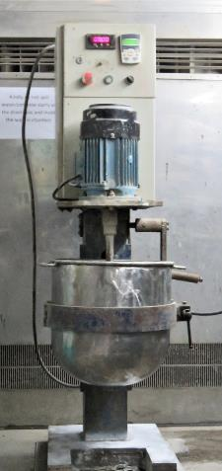
Mixing procedure and sequence adopted
Sequence
Duration(s)
Dry blending of cement and mineral admixture in Hobart mixer
Control panel
120
3 HP motor
Add water to high shear mixer
15
Add the pre-blended grout material to the mixing water at 300 rpm
Mixing bowl
60
Increase speed to 1500 rpm and continue mixing
300
Kamalakannan et al. 2018; Bras et al. 2010

Slide 54
Yield per bag and material cost were calculated
Grout | PPG1 | PPG2 | PPG3 | PPG4 | PPG5 | PPG6 | TF
Yield per 25 kg bag (l) | 15.28 | 15.48 | 15.84 | 15.60 | 16.11 | 15.74 | 15.84
No. of 25 kg bags for 1m³ grout | 63 | 63 | 64 | 63 | 64 | 63 | 64
Material cost per 25 kg bag (INR) | 193 | 208 | 200 | 237 | 225 | 217 | 200
Material cost for 1m³ of grout (INR) | 12631 | 13437 | 12706 | 14457 | 14175 | 13720 | 12706

