Slide 1
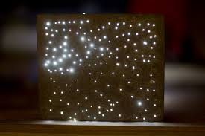
DEVELOPMENT OF LIGHT TRANSMITTING CONCRETE FOR ENERGY EFFICIENT BUILDING
Dr. R. Malathy
Dean R&D
Civil Engineering,
Sona College of Technology
Salem
Tamilnadu, India
21.09.2018
Notes:
Light Transmittance concrete is also known as Translucent Concrete or See through concrete or LITRACON

Slide 2
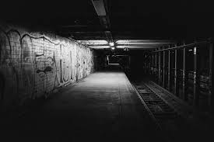

OBJECTIVE
To reduce the usage of electrical power consumption in closed buildings.
To produce aesthetically pleasing concrete structures
To produce concrete which is eco-friendly and environmentally accepted.
Notes:
Building now-a-days must be Energy efficient and aesthetically pleasing.
Hence a new innovative material must be derived from the conventional concrete which is eco-friendly.
LTC not only helps to save electrical energy but also helps in increasing privacy at places where window openings aren’t possible.

Slide 3

SCOPE OF THE PROJECT
To test our Light Transmitting Concrete specimens inorder to understand the properties of the material and the suitability of the material for implementation in the construction field.
Notes:
Testing of the specimen is necessary to study its characteristics
Results of the tests helps in comparing it’s efficiency with conventional concrete

Slide 4
METHODOLOGY
Collection of Materials
Cement, Sand Steel Slag, Jelly
Optical Fibers
Fabrication of Special Moulds
Inserting Optical Fibres
Casting
Casting of Specimens
Testing of Specimens
1m x 1m x 0.05m Slab
cubes
Light Transmittance
Compressive Strength
Permeability
Notes:
43 Grade Cement was used.
Slag sand and slag chips were used, since it reduces permeability and is more durable.
The LTC has to be made more impermeable, since a new material called POFs is added which increases the degree of heterogeneity.
POFs of superior quality were purchased from Japan
Special moulds were used to keep POFs in position
Material requirements were calculated to make suitable purchases
Casting based on Mix Proportions and by Proper Curing
3 Tests were performed

Slide 5
MATERIALS USED
Plastic Optical Fibres (POFs)
Cement – Ordinary Portland Cement (43 Grade)
Slag Sand
Slag Chips – Passing through 10mm IS Sieve
10mm Fe500 Steel bars
Notes:
To avoid more air voids, Slag chips passing through 10mm sieve were used.

Slide 6
MIX PROPORTION
M20 Grade Concrete
Cement : Slag Sand : Slag Chips
= 1 : 1.96 : 2.11 as per IS 10262 (2009)
W/C Ratio : 0.45
POFs = 25 nos x 200mm (25mm projection on either side)
= 5 m/cube
Notes:
M20 = 1:1.5:3
w/c ratio of 0.45 is an assumed value. Adopted since many previous journals applied the same ratio and as Guide consented the same.

Slide 7
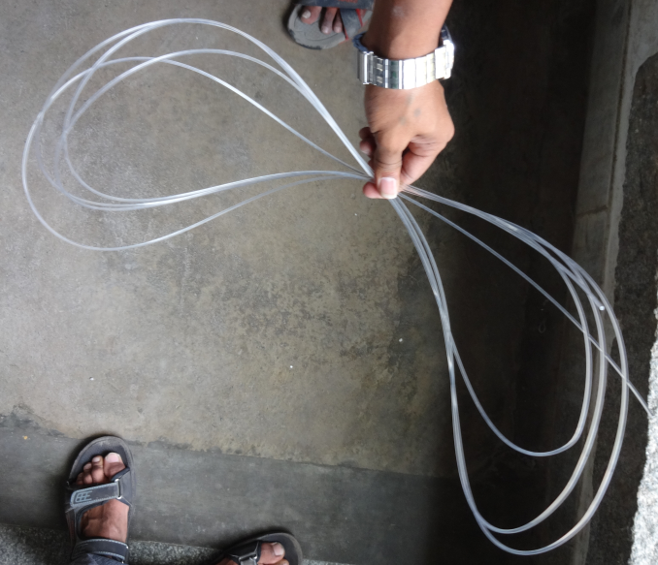
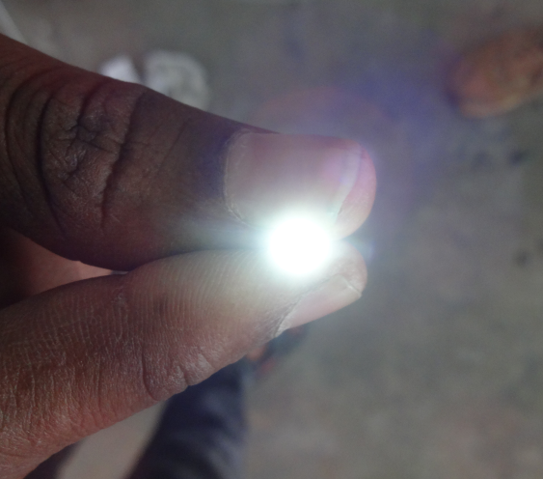
PROPERTIES OF POF
Fibre Diameter : 2mm
External Diameter : 2000μm
Core Diameter : 1960μm
Refractive Index : 1.49
Numerical Aperture : 0.5
Operating Temperature Max : 70°C
Operating Temperature Min : 55°C
Notes:
Light travels only within the core.
Cladding reflects light back inside core.
Refractive Index :
a dimensionless number that describes how light, or any other radiation, propagates through that medium.
the refractive index of water is 1.33, meaning that light travels 1.33 times faster in a vacuum than it does in water.
determines how much light is bent, or refracted, when entering a material.
n = 1.00 for air, 1.33 for pure water
Numerical aperture :
dimensionless number that characterizes the range of angles over which the system can accept or emit light.
describes the range of angles within which light that is incident on the fiber will be transmitted along it.
= n x sin θ

Slide 8
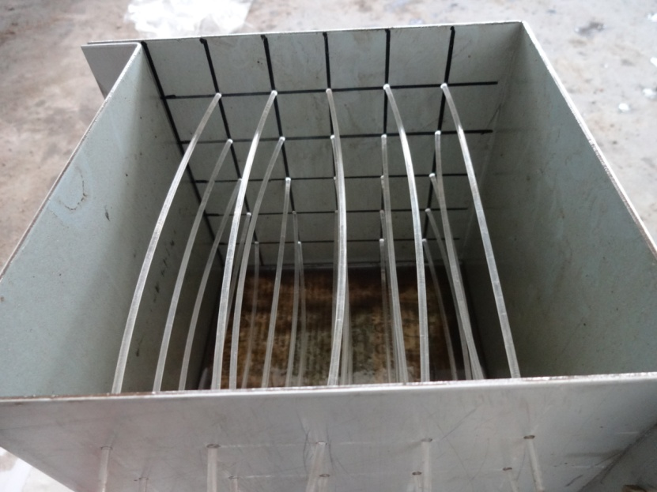
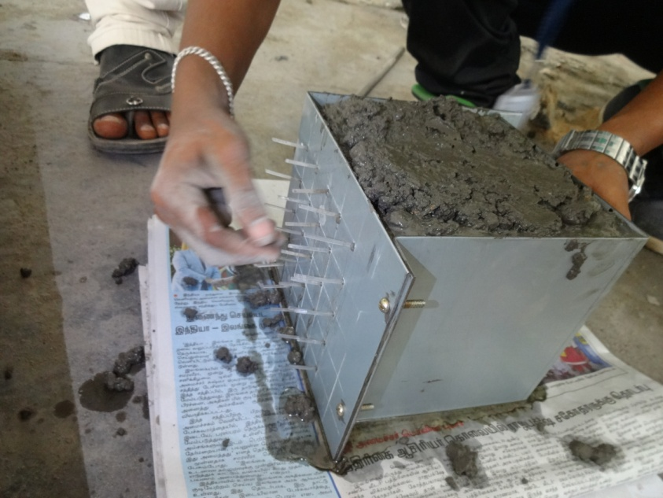
CASTING OF CUBE
Cube : 150mm x 150mm x 150mm
Special mould with holes of 2.1mm dia on 2 opposite sides to insert the 2mm POFs
Notes:
Special mould to hold the fibres at exact positions since the spacing of fibres must be uniform
Total no. of holes = 25
c/c distance = 25mm

Slide 9
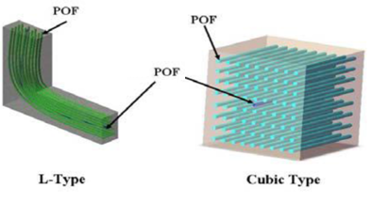
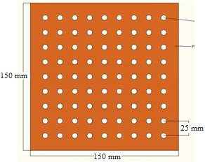
PLACEMENT OF POFS
Spacing = 25 mm
Orientation of Fibres : Perpendicular to the direction of application of concrete
Notes:
POFs are arranged horizontally

Slide 10
MATERIAL REQUIREMENTS FOR SLAB
Cement = 22.2 kg
Slag Sand = 43.6 kg
Slag Chips = 47.05 kg
Water = 9.99 litres
POFs = 19² nos x 100mm (25mm projection on either side)
= 36.1 m
Steel Reinforcement : 10mm diameter, Fe500 (6rods x 1m each);
(Effective Cover = 5mm)
Notes:
19² = 19 rows x 19 columns of POFs in 1m x 1m section

Slide 11
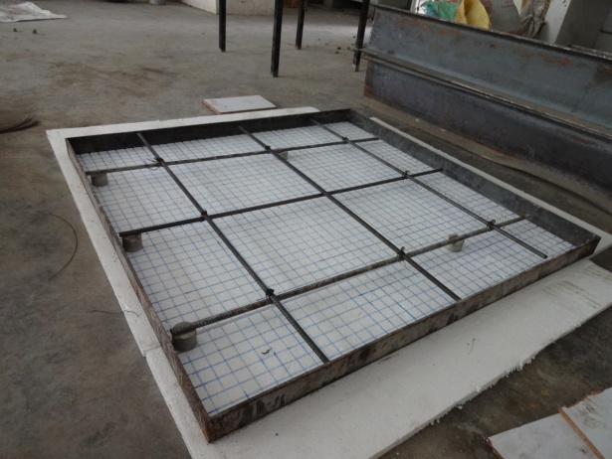
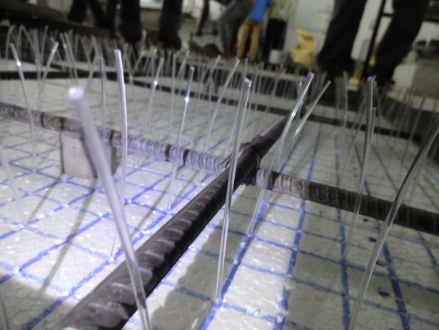
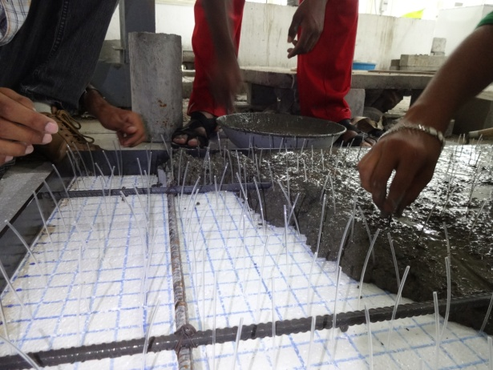
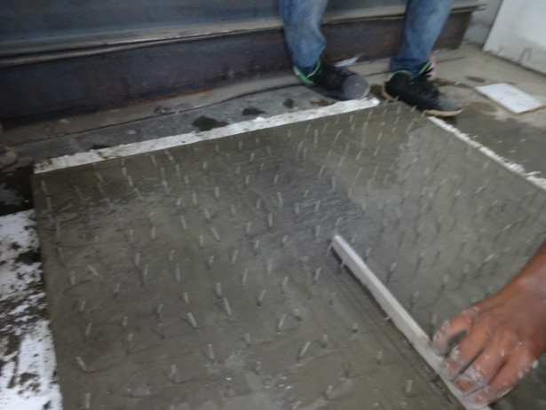
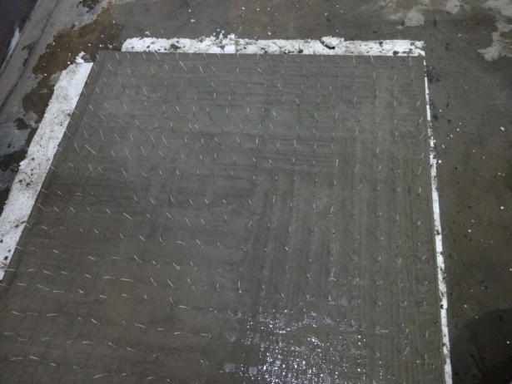
CASTING OF PREINSTALLED LTC SLAB
1m x 1m x 0.05m
Spacing of POFs = 50 mm
Notes:
Thermocol sheets were used as the base surface since the POFs can be conveniently placed at required location while the casting was done.
The POFs were pinned at the marked points on the thermocol sheet to maintain uniform spacing between the POFs and to prevent the dislocation of the POFs while pouring the concrete.
The slab is a RCC-LTC slab and the steel reinforcement were placed with suitable cover before the placement of the POFs.
The top surface of the slab is made as a smooth surface and the extra projections of the POFs were cut once the concrete is completely set.

Slide 12
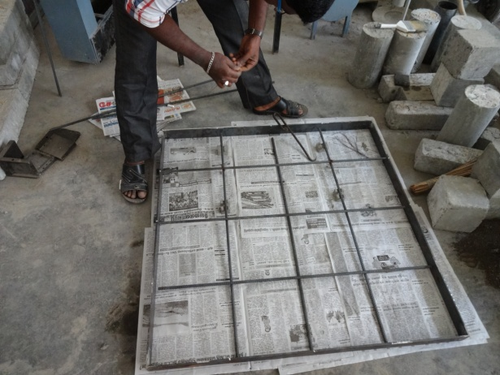
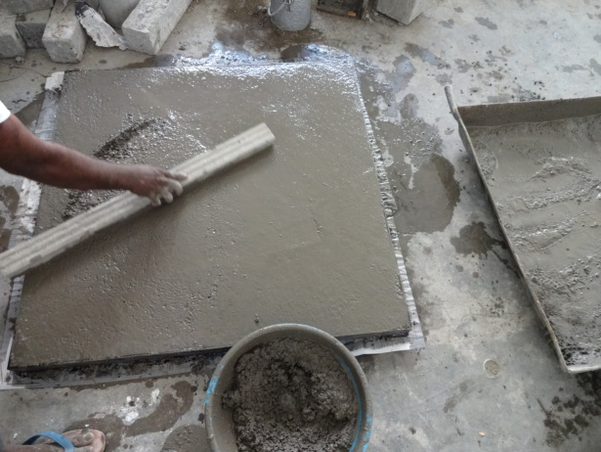
CASTING OF POST-FABRICATION POF INSTALLED RCC SLAB
    Stress Analysis done using Ansys Design Software
    Holes of 1 inch diameter were drilled at points of low stress level;
Notes:
Normal RC Slab is casted

Slide 13
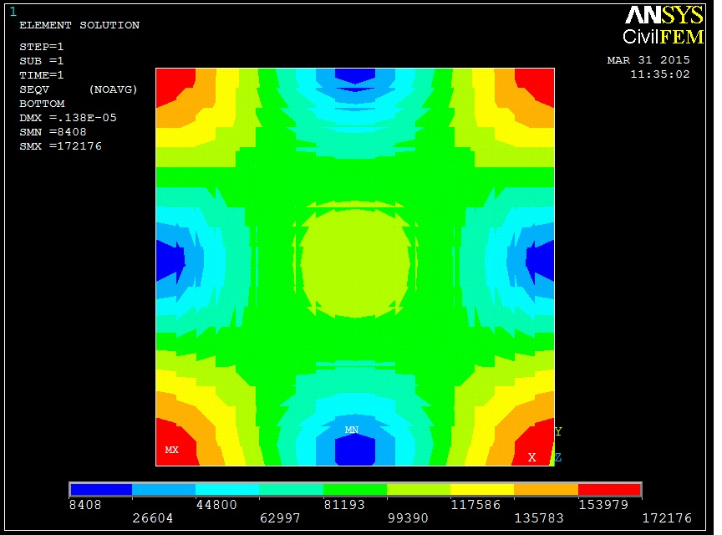
Notes:
Red – High stress zone
Blue – Low stress zone
Green – Safety zone

Slide 14
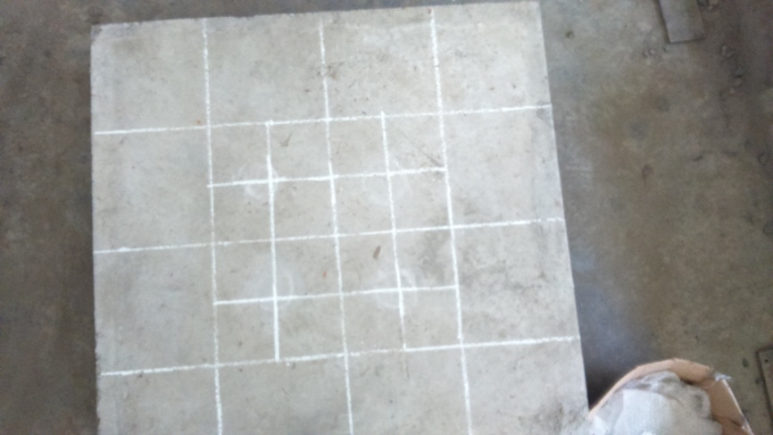
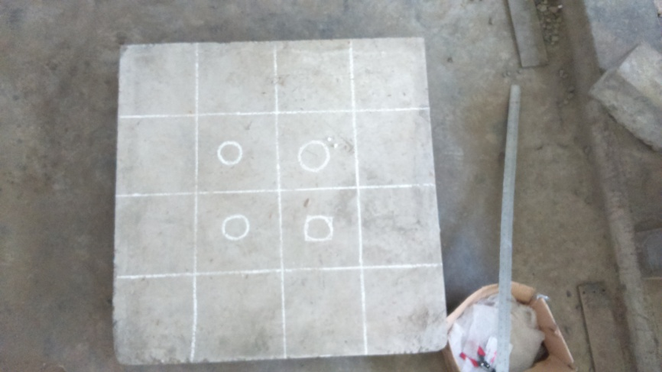
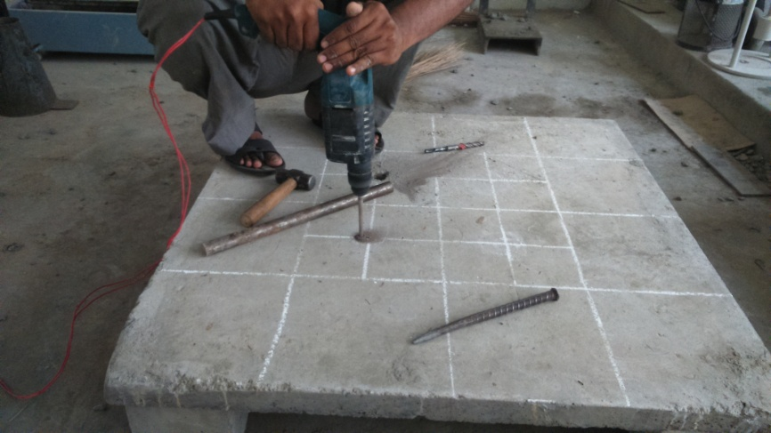
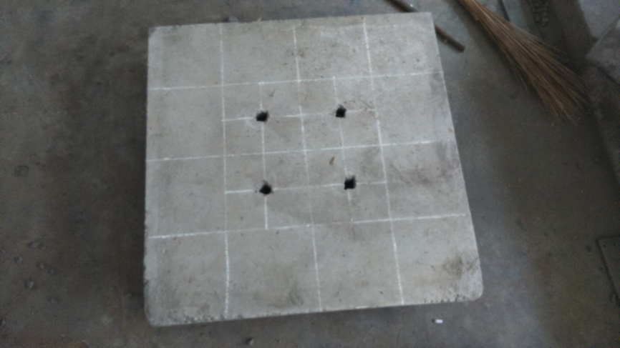
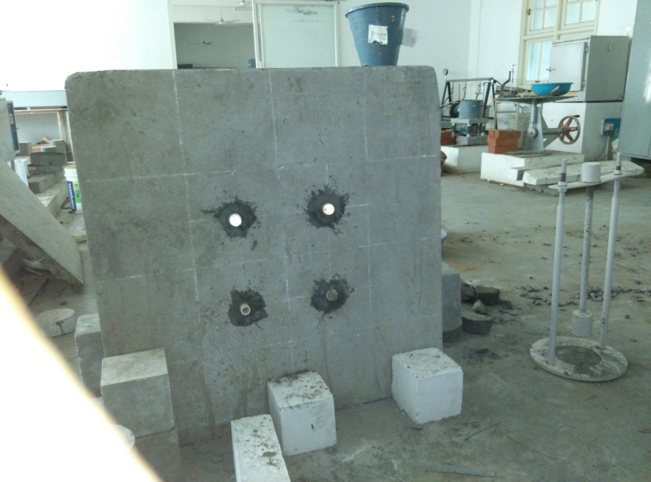
Notes:
PVC Adhesive solution were used to fill the voids between the POFs
Holes drilled at near the centre increases the illumination of the room to a greater extent.

Slide 15
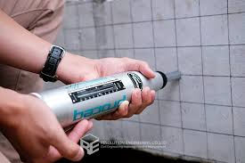
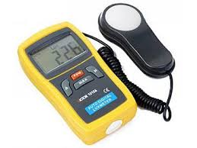
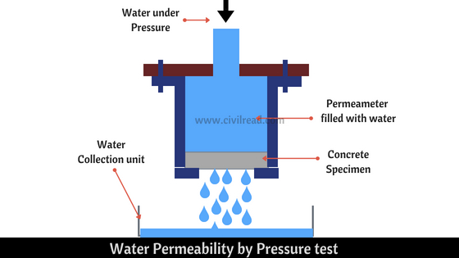
TESTS ON LTC
Compressive Strength Test
Water Permeability Test
Light Transmittance Test
Notes:
Compressive Strength test was carried out to make sure the LTC specimen satisfies the minimum standards.
Since it is sufficient, as there are no L.L expected.
Light Transmittance Test was carried out to find out the amount of transparency of concrete.
Water Permeability Test to make sure that the concrete doesn’t become more permeable due to increased level of homogeneity.

Slide 16
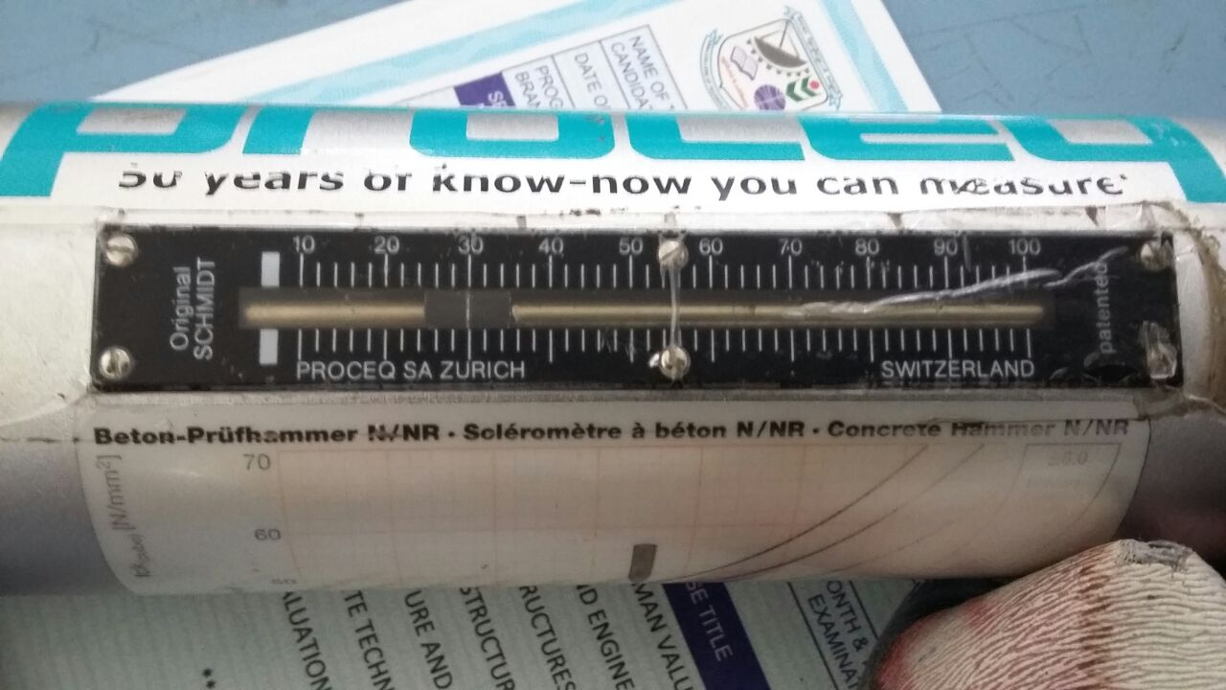
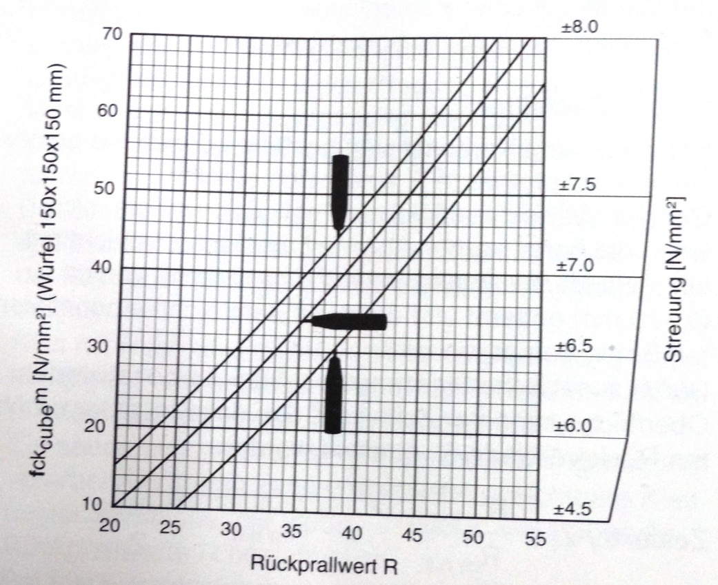
COMPRESSIVE STRENGTH TEST
Using Schmidt’s Rebound Hammer (Non-Destructive Testing Method)
Rebound Value R = 26 (On Top surface, Vertically Downwards – Parallel to direction of POFs)
f_{ck} = 27 N/mm²
Notes:
Non-destructive testing, since the POFs are costly and isn’t affordable to be wasted in testing
f_{ck} = 27 N/mm² is greater than the expected value of 20 N/mm²

Slide 17
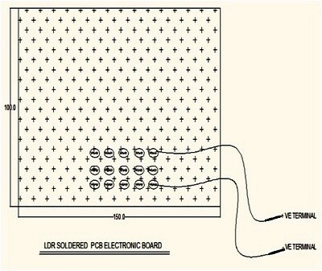
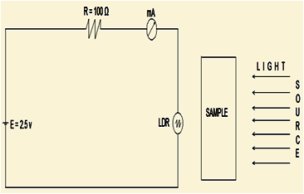
LIGHT TRANSMITTANCE TEST
Using Lux Meter
Photo diode or a Light Dependent Resistors (LDR) is used.
Light Source : 100 W Incandescent bulb
Resistance applied : 100 ohm
Uniform DC Voltage : 2.5 V
Notes:
Same circuit diagram implemented as studied in journal
Photo diodes are costlier and hence LDR are used.
Light measured in amperes.

Slide 18

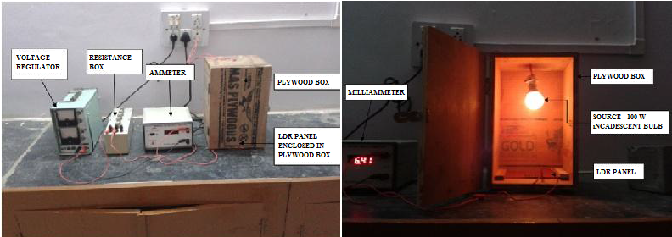
LIGHT TRANSMITTANCE TEST
LDR measures the light transmitted through the sample and converts it into the current (milli amperes)
A1 : Without sample ; A2 : With sample
Notes:
A1 – Ammeter reading when no specimen is kept inside the box
A2 – Ammeter reading when cubic specimen is kept inside the box
Light transmittance = Transparency %

Slide 19
LIGHT TRANSMITTANCE TEST
Content inside the plywood box | Ammeter Reading (mA)
Without Sample (A₁) | 13.42
With Sample cube (150mm x 150mm x 150mm) (A₂) | 1.19
Light Transmittance = 100 – 100(A₁₋ A₂)/A₁ | 8.867%
Light Transmittance refers to the Transparency of the concrete.
Hence the transparency of 9% is achieved on the concrete without affecting the Strength of the concrete
Notes:
Transparency can be increased by increasing the diameter of POFs and decreasing the spacing between the POFs but the Strength must be taken into consideration when this is done.

Slide 20
WATER PERMEABILITY TEST
In accordance to IS 3085 - 1965
Co-efficient of Permeability k = QL / ATH (cm/sec)
where
Q = quantity of water in millilitres percolating over the entire period of test after the steady state has been reached;
A = area of the specimen face in cm²;
T = time in seconds over which Q is measured;
H/L = ratio of the pressure head to thickness of specimen, both expressed in the same units.

Slide 21
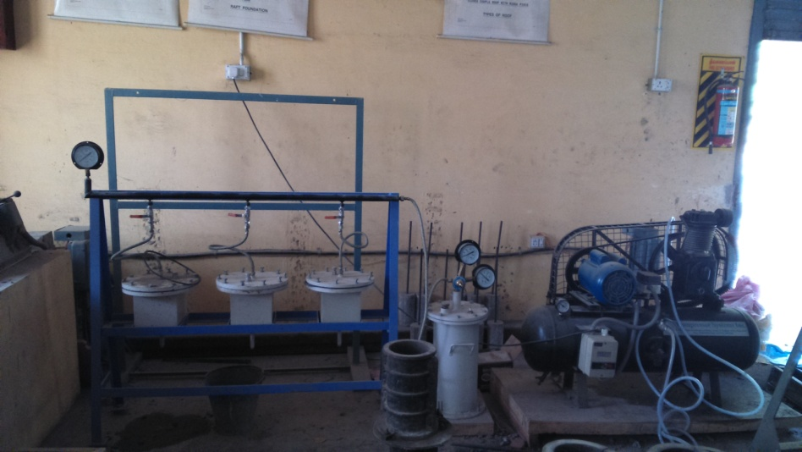
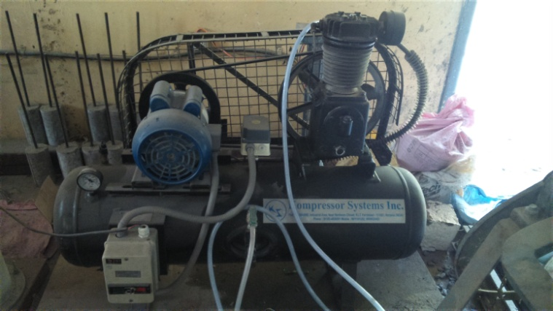
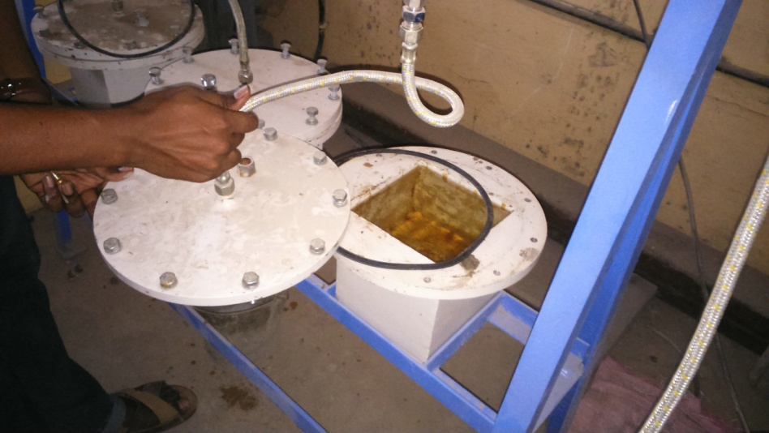
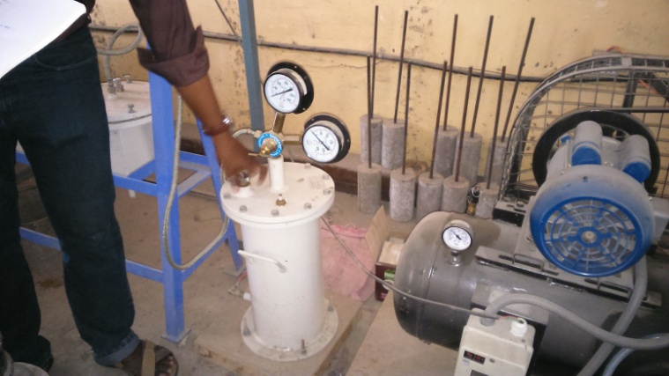
WATER PERMEABILITY TEST
H (cm) | Q (ml) | T (sec) | k (cm/sec)
10 | 10.4 | 24 hrs | 8.02 x 10⁻⁷
k = QL / ATH
= 10.4 x 15 / (15² x 24 x 60 x 60 x 10)
k = 8.02 x 10⁻⁷ cm/sec
Notes:
Testing done for 24 hrs
For conventional concrete k value of upto 8.5 x 10⁻⁷ cm/sec is acceptable.

Slide 22
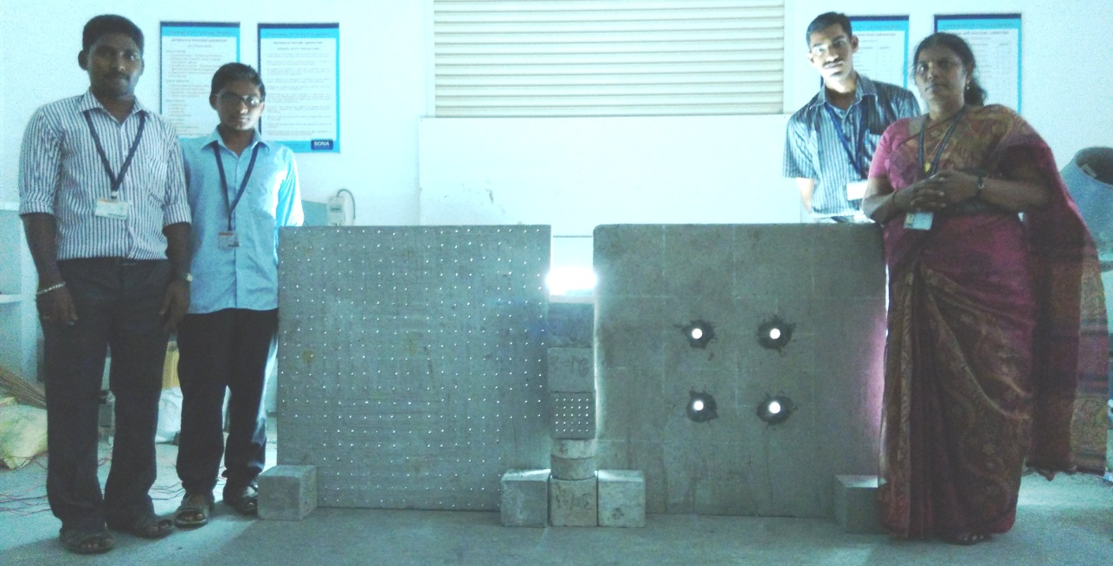
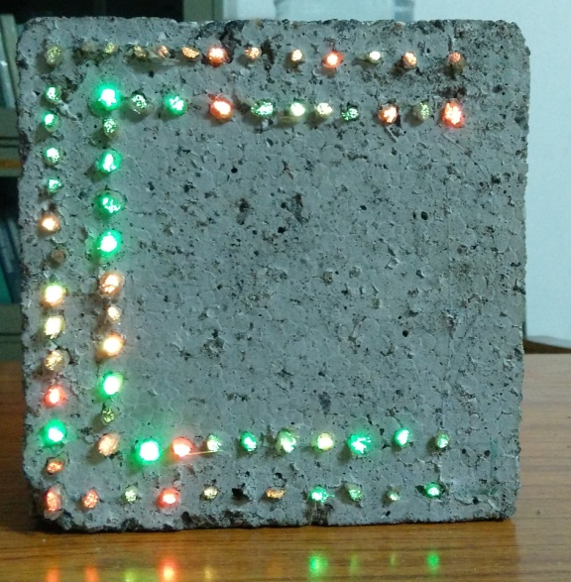
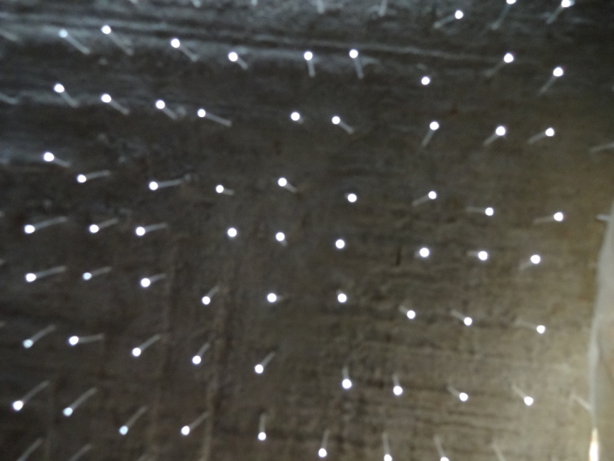
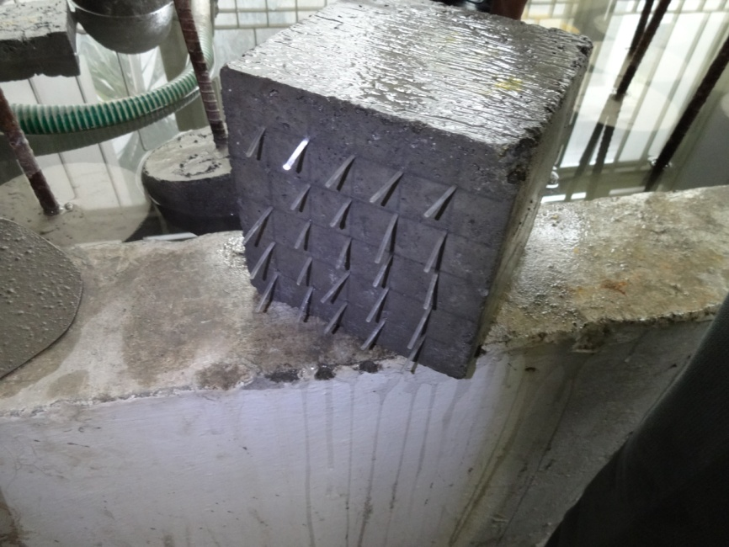
Light Transmitting Concrete Specimens

Slide 23

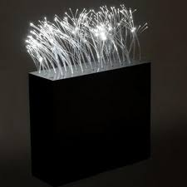
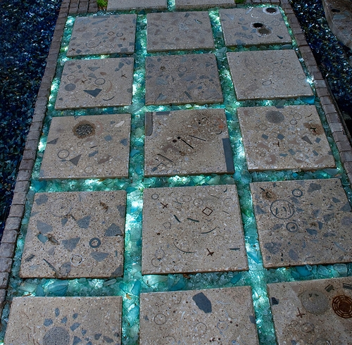
SUMMARY
Light transmittance for the samples was found to be about 9.0% for optical fibre specimen.
The transparency of light is possible in concrete without affecting its compressive strength, as the optical fibres act as fibre reinforcement thereby enhancing the strength and also enhances appearance.
This new kind of building material can integrate the concept of green energy saving the electrical energy usage.

Slide 24
REFERENCES
Global Advanced Research Journal of Engineering, Technology and Innovation (ISSN: 2315-5124) Vol. 2(3) pp. 076-083, March, 2013
He J, Zhou Z, Ou J (2011),Study on Smart Transparent Concrete Product and Its Performances , Dalian, China, July 26, 2011
ISSN: 2277-3754, ISO 9001:2008 Certified
International Journal of Engineering and Innovative Technology (IJEIT) Volume 2, Issue 8, February 2013
International Journal of Scientific and Research Publications, Volume 3, Issue 10, October 2013; ISSN 2250-3153
IJRET: International Journal of Research in Engineering and Technology eISSN: 2319-1163 | pISSN: 2321-7308
IOSR Journal of Mechanical and Civil Engineering (IOSR-JMCE)
e-ISSN: 2278-1684, p-ISSN: 2320-334X ; PP 67-72
www.iosrjournals.org
International Conference on Advances in Engineering & Technology – 2014 (ICAET-2014)
International Journal of Engineering Research and Applications (IJERA) ISSN: 2248-9622; www.ijera.com Vol. 3, Issue 3, May-Jun 2013, pp.013-017
International Journal of Inventive Engineering and Sciences (IJIES) ISSN: 2319–9598, Volume-3 Issue-1, December 2014
International Journal of Structural and Civil Engineering Research 2013
ISSN 2319 – 6009 www.ijscer.com, Vol. 2, No. 3, August 2013

Slide 25
Thank you !

