Slide 1

COMPARISON OF TEMPERATURE RISE PREDICTION METHODS WITH MEASURED TEMPERATURES DUE TO HYDRATION OF CEMENTITIOUS MATERIALS IN CONCRETE.
By
Dr. K.C. Tayade,
Dy. General Manager and Head Quality Control, Maharashtra Metro Rail Corporation Ltd., Nagpur.
Er. J.P.Gupta,
Manager (Reach-1), Maharashtra Metro Rail Corporation Ltd., Nagpur.
Er. Kunwar Sushil kumar,
Addl. General Manager (Reach-1), Maharashtra Metro Rail Corporation Ltd., Nagpur.
Er. Devendra Ramtekkar,
Executive Director, Maharashtra Metro Rail Corporation Ltd., Nagpur

Slide 2
CONTENTS OF THE PAPER
The paper deals with the experimental studies of temperature rise in concrete of a prototype structure.
Actual temperature rise measured by embedding Thermo Couples (TC’s) in the structures during concreting.
The monitoring of temperature recorded by thermocouples was done by digital recorder manually on hourly basis up to 13 days and then once in 3 hrs. up to next 21 days and beyond but restricted to 14 days in this reporting.
Contd. …

Slide 3
CONTENTS OF THE PAPER
The temperature at the time of insertion, maximum temperature reached, the time to reach peak temperatures was recorded.
The plot of time-temperature demonstrated the actual temperature rise, its trend both increasing and decreasing.
The comparison of the actual measured temperatures made with the various methods available to predict maximum concrete temperatures by empirical formulas such as PCA method, adiabatic temperature rise curves as published in ACI committee reports and ASCE method showed that the actual measured temperatures vary on plus as well as minus side over predicted.

Slide 4
STIPULATIONS
ACI 116.R-05 committee defines mass concrete as :
“any volume of concrete with dimensions large enough to require that measures be taken to cope up with the generation of heat from the hydration of cement and attendant volume change to minimize cracking.”
As per ACI 301.R.05 committee :
“in general heat generation should be considered when minimum cross sectional dimensions approaches or exceeds 360mm or cement contents above 356 Kg/m3 are used.”

Slide 5
Heat Generation and its Effect
The most important characteristics of mass concrete is thermal behavior.
Hydration of Portland cement produces large amount of heat in mass concrete elements.
Since concrete has low conductivity, a great portion of generated heat is trapped inside the mass concrete and is dissipated slowly.
This situation leads to a temperature increase inside and a temperature difference between the center and outer part of mass concrete element.
Temperature difference is a cause for tensile stresses which form thermal cracks.
Thermal cracking may cause loss of integrity and shortening of service life of the concrete element.

Slide 6
Factors most relevant to cracking in massive structures are thermal stresses induced by thermal gradients.
. . . Mehta, P.K and Monterio, P.J.M,
The thermal stress is given by the formula
σt = Kr * (E/1 + φ) * α * ∆T
where : σt = tensile stress ;
Kr = degree of restraint ;
E = elastic modulus ;
φ = creep coefficient ;
α = coefficient of thermal expansion;
∆T = temperature change

Slide 7
Temperature Evolution in Concrete

Slide 8
Criteria for assessment of hydration heat induced cracks
    Temperature based assessment.
    Stress based assessment.
Temperature based assessment frequently adopted : -
    As temperatures can be readily assessed by field measurements and numerical analysis
    AND
    The reliability of temperature measurement is significantly higher than that of stress measurements.

Slide 9
Research significance of present study
The temperature prediction methods are over 50 years old.
With time there is change in construction methodology, form types, cement chemistry, cement fines and types/grades, SCM’s and chemical admixtures, SO these methods may not be appropriate or needs updation.
The use of mass concrete elements have also increased.
Hence a need to accurately predict the temperatures.
In this study, an effort has been made to assess the ability of these methods by checking their accuracy to predict the maximum temperatures by comparing with the actual maximum temperatures measured in a prototype structure.

Slide 10
Maximum temperature and Maximum temperature difference
Measurements of temperatures inside concrete is an important tool to know the pattern of rise of temperature.
The prediction of maximum temperature and rise of temperature is important in controlling heat of hydration. The maximum in place temperature reached in concrete members affects the long term performance of structure during its service life.
Large temperature difference occur when the concrete core is hot and the ambient temperatures are low OR when the forms are removed when the concrete underneath is hot, typically referred to as “thermal shock”

Slide 11
The 3 methods considered for comparison in this paper for the measured maximum temperatures
PCA METHOD : Empirical formulas.
GRAPHICAL METHOD OF ACI 207.2R : Adiabatic temperature rise curves as published in ACI committee.
THE ASCE METHOD :
. . . . to have comparative Assessment of the maximum concrete temperatures with that of theoretical Ones.
Current state of practice is to perform adiabatic calorimetry testing on concrete mixtures and use FEM analysis to predict temperature distribution over time. - - - Riding K.A.

Slide 12
PCA METHOD
The Portland Cement Association’s (PCA) Design and control of concrete mixtures 14th edition, 2003, gives a quick method to estimate the maximum temperature developed in mass concrete members.
Postulates that the maximum temperature rise of concrete above the placement temperatures will be at 12⁰C (21.6⁰F) for every 100 kg of cement used in concrete.
Method is approximate for concrete containing 300 to 600 kg of cement per cubic meter of concrete, also assumes that the least dimension of concrete member is at least 1.8 m (6 ft).
PCA method does not provide any information on time of maximum temperature; treats all cements the same and gives no guidelines on how to account for slag cements.

Slide 13
PCA METHOD (Contd ..)
ACI 207.1R-05 suggests that the modification to account for supplementary cementitious materials (SCM’s) can be made by presuming that they liberate approximately half the amount of heat of cement for a given mass.
The PCA calculations for maximum concrete temperature Tmax when altered to account for the initial temperature and SCM’s are Expressed by : -
Tmax = Ti + (12xWc/100) + (6xWscm/100)
where, Ti = concrete placement temperature in º C
Wc = weight of cement in kg/m3
Wscm = weight of SCM in kg/m3

Slide 14
GRAPHICAL METHOD OF ACI 207.2R
ACI 207.2R contains several charts and equations based on empirical data to estimate the maximum temperature in mass concrete.
Adjustments can be made for member size; cement type; exposure condition, use of slag and /or fly ash and the placement temperature.
This graphical method gives adiabatic temperature rise by :
Tr = TI * ( Tf / T1800 )
where Tr = Cement turbidimeter (ASTM C115) fineness adjusted adiabatic
temperature for 171 kg (377lb) of cement in º C
TI = adiabatic temperature rise for Type I cement from ACI 207
Tf = Heat generation in percent of 28 days heat generation for the measured
cement fineness from ACI 207.2R
T1800 = Heat generation in percent of 28 day heat generation for cement
fineness of 1800 cm2/gm from ACI 207.2R

Slide 15
THE ASCE METHOD
The adiabatic temperature rise resulting from the heat of hydration can be calculated using the expression developed and presented by Tanabe et al in seminar proceedings for FEA of reinforced structures, Tokyo, Japan in 1985 and published by the American Society of civil engineers (ASCE) in 1986.
The temperature rise is given by the expression : -
T(t) = K( 1-e^{-αt} )
where T = Temperature in ⁰C
t = time in days.
K & α are constants based on casting temperature (⁰C)
The values of K & α can be obtained from the plots developed.

Slide 16
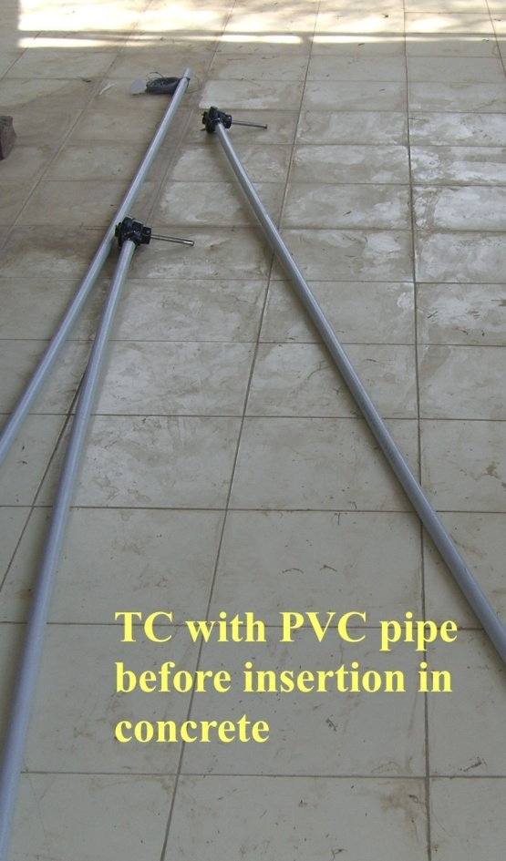

THE EXPERIMENTAL PROGRAM AND SCHEME OF STUDY
Aim of experimental study was to measure and monitor the temperature rise in A concrete prototype structures, this was done by inserting an array of thermo couples at different locations and levels.
The thermo couples used were PT100.
Thermo Couple – Type – PT 100
( Type K : chromel–alumel )

Slide 17
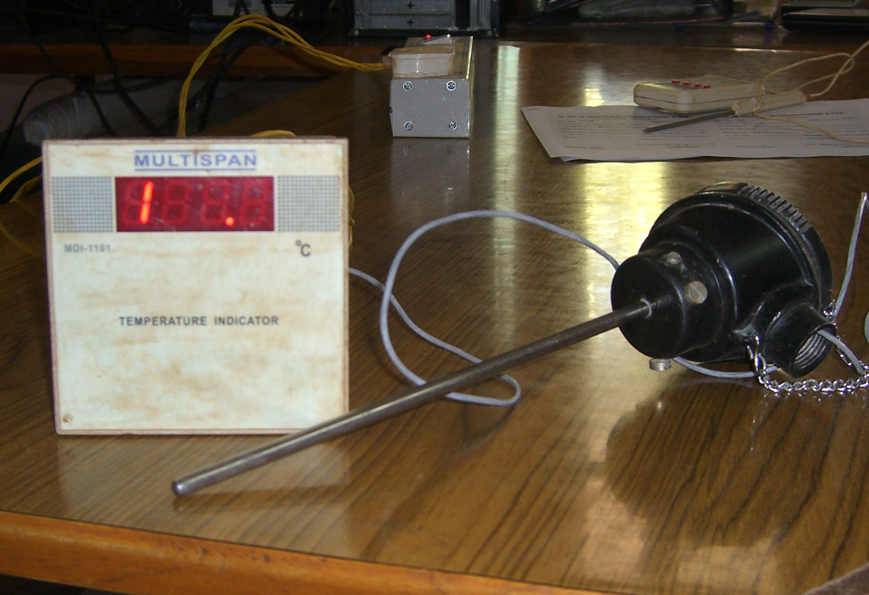
Electronic Temperature recording meter

Slide 18
Scheme of study
The scheme of study was to insert the thermo couples at five locations in pier cap namely location X, Y, P, Q, on sides and location C at centre.
At a particular location, in cross section total three thermo couples were embedded in three layers.
The thermo couples at the top and bottom were inserted 0.20m inside to accommodate the reinforcements. The thermo couples at the location on sides namely X,Y,P,Q were inserted 0.50 m from face of concrete inside the concrete structure, so that the effect of surface cooling is minimized.
One TC protected from direct sunlight to measure the ambient temperature and was kept outside the structure.

Slide 19
Scheme of study
Sr.No. | Location | Number of T.C’s | Notation**
1 | C | 3 | C’, C2, C3
2 | X | 3 | X2, X3
3 | Y | 3 | Y1, Y3
4 | P | 3 | P3
5 | Q | 3 | Q2, Q3
** The Thermo Couples at Location X1; Y2; P1; P2 and Q1 had malfunctioned and so are not considered in this study. The Thermocouple at location C1 malfunctioned during embedment and was replaced with another TC with notation as C’.
Hence, out of 15 thermo couples, 10 were available for this study.
The formwork used was of steel shuttering and it was removed after 3 days.

Slide 20
STRUCTURE – Pile Cap
Layout Plan and Plan of Pile cap showing Locations of Thermo Couples.
W
S
N-S Corridor
E-W Corridor

Slide 21
Cross Section of Pile Cap
Locations of Thermo Couples.

Slide 22
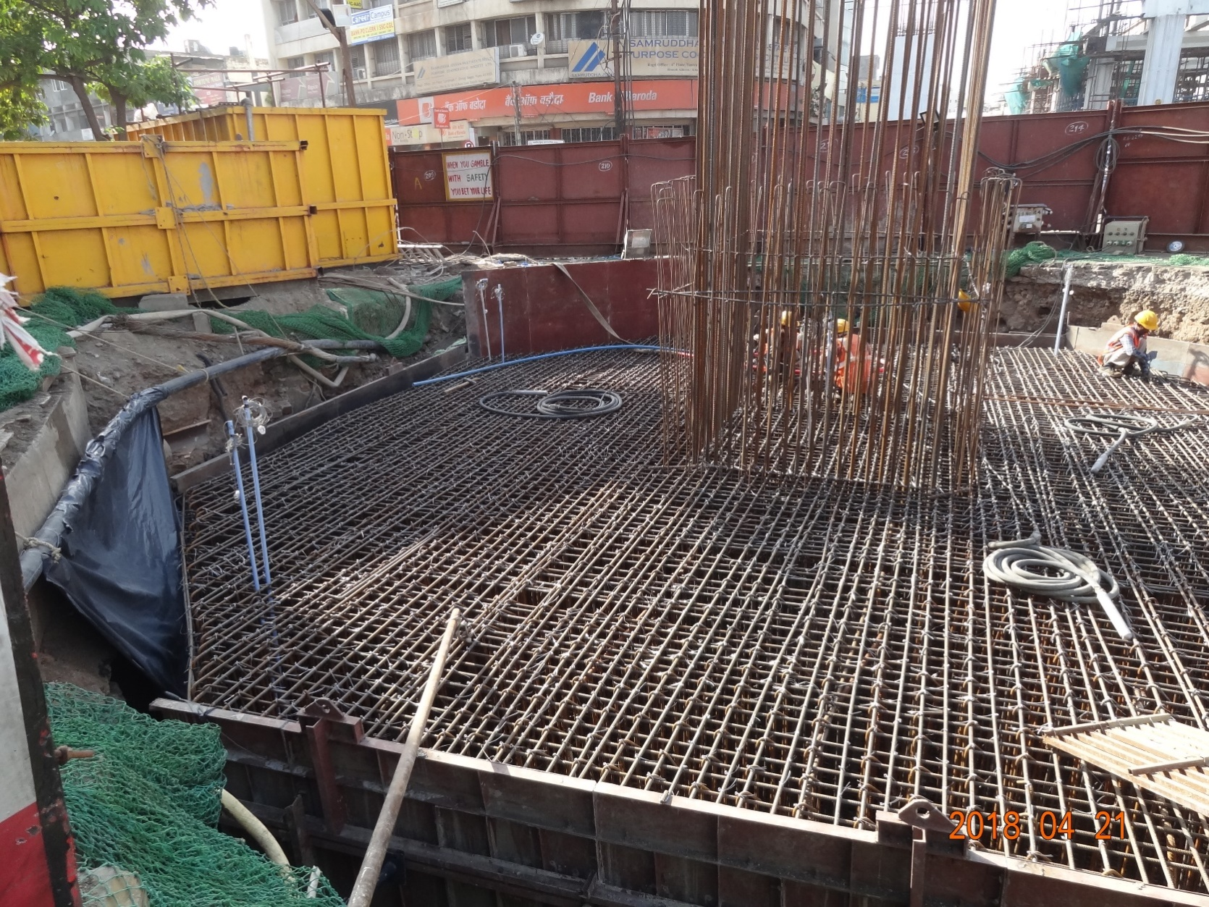
Video of thermocouple insertion before concreting.
(48 sec.)
Locations of Thermo Couples

Slide 23
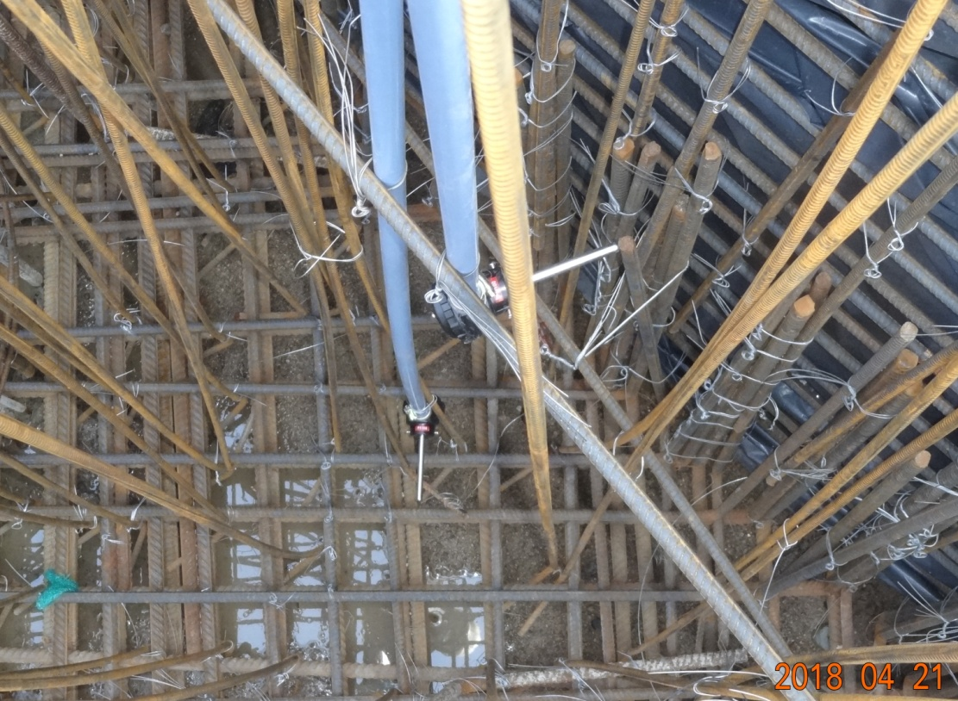
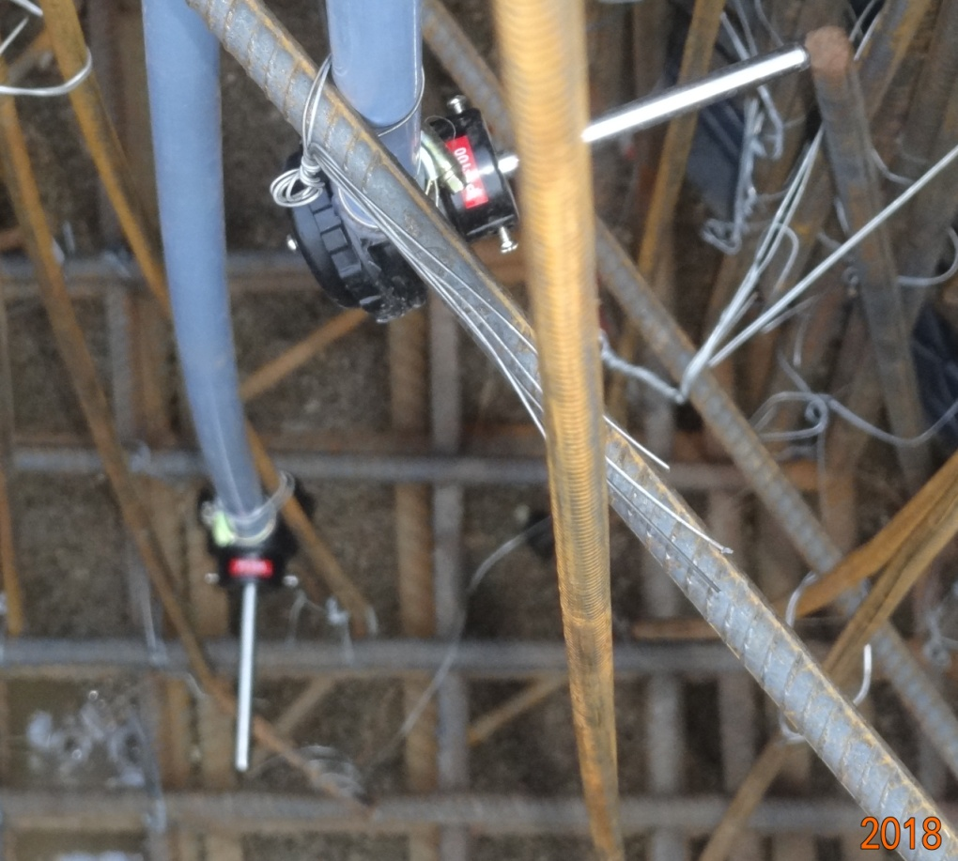
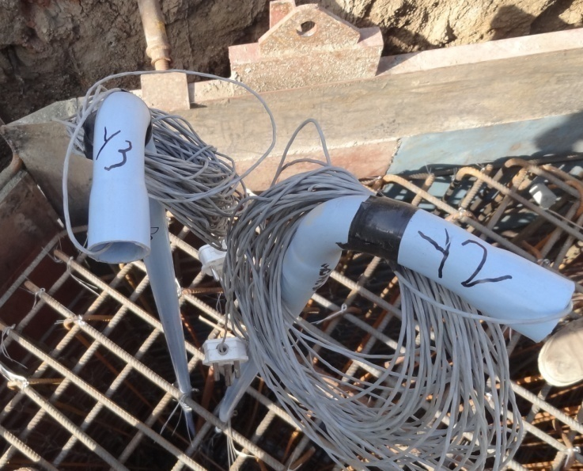
Thermo Couples
PVC Casing Pipes
Lead Wires
Actual photos of structure with Thermo couples Fixed

Slide 24
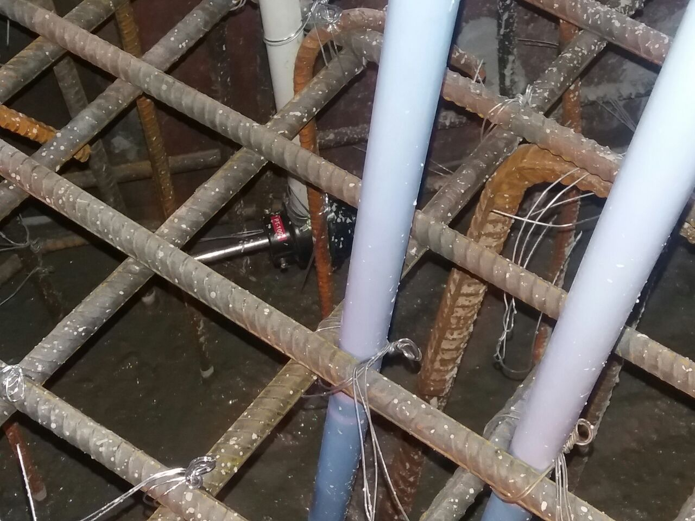
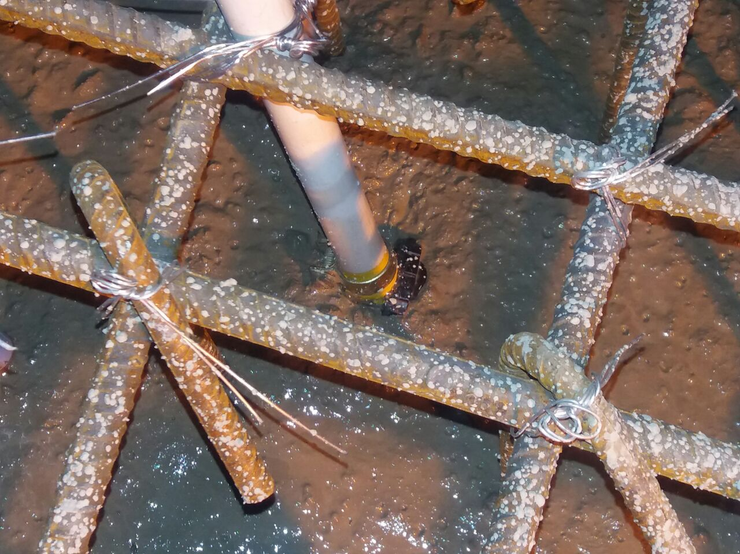
Thermo couple
Thermo couple
Photographs showing the Thermo Couples being embedded in concrete.

Slide 25
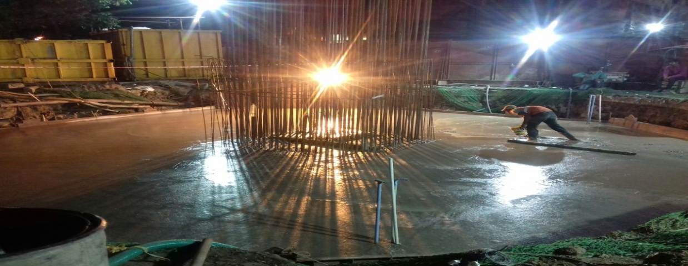
Pile Cap after completion of Concreting
Total Qty. of Concrete –
384 Cum.
PVC Pipes as Casing for embedded TC’s - Clearly seen.

Slide 26
Table showing the mix proportion
for the Concrete used in Pile Cap.
Concrete Grade M-40 (20MSA)
Cement (Kg.) |  | Water (Kg.) | Sand (Kg.) |  | Coarse aggregate (Kg) |  | Plasticiser (kg)
 |  |  |  |  | 20mm | 10mm
Cement OPC 53 grade | GGBS | 143 | River sand | Crushed sand | 626 | 512 | 3.28
246 | 164 (40 %) |  | 600 | 257 (30%)
The F.M. of R/sand was 2.9 and Crushed Sand was 3.15 which was very coarse sand and categorized as Zone-II and Zone-I as per IS 383

Slide 27
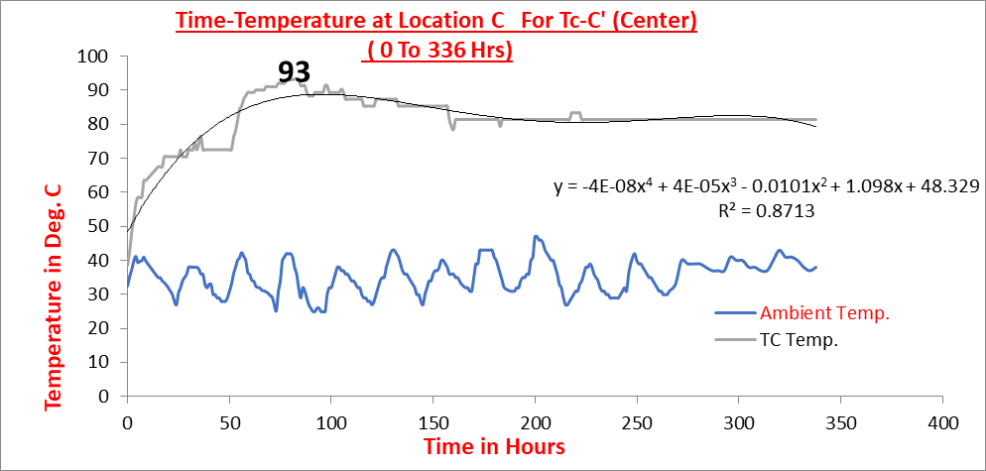
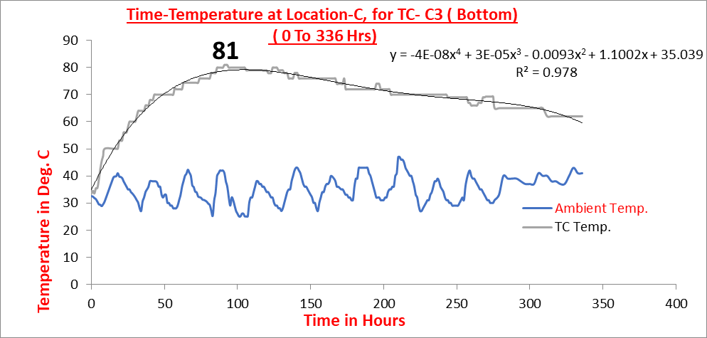
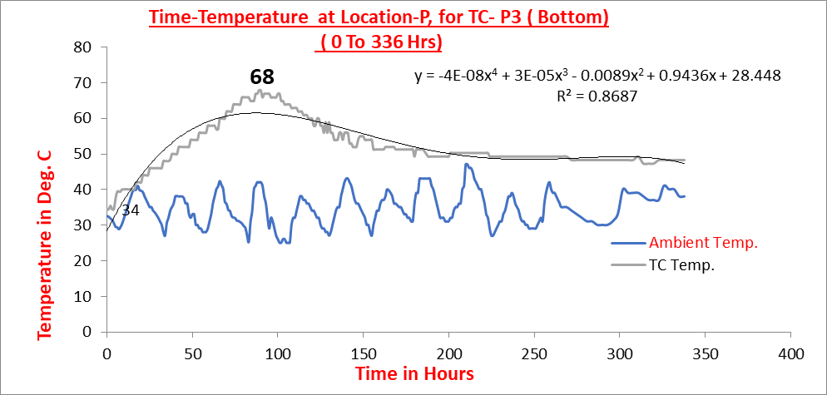
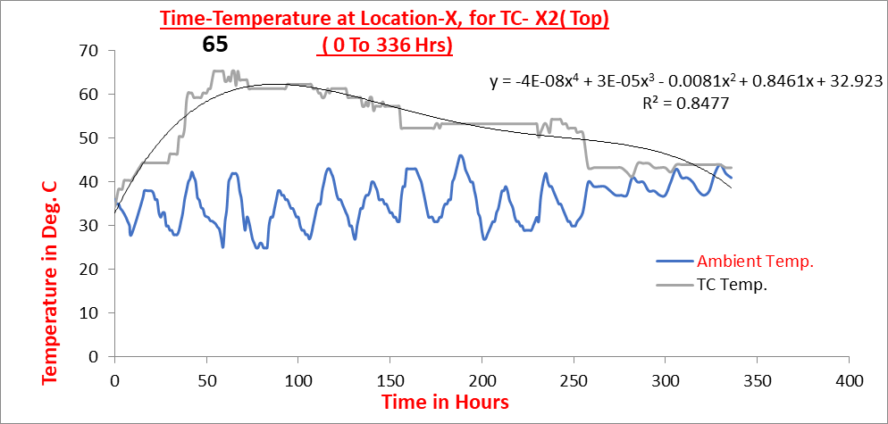
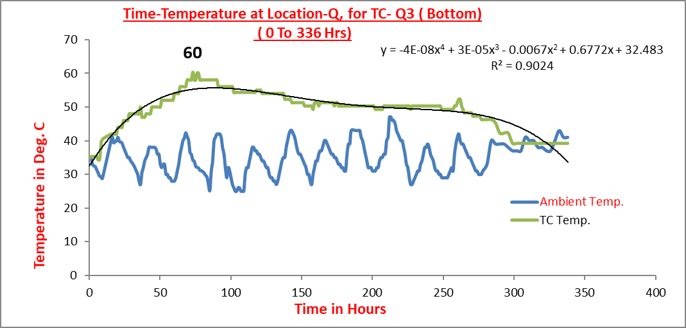
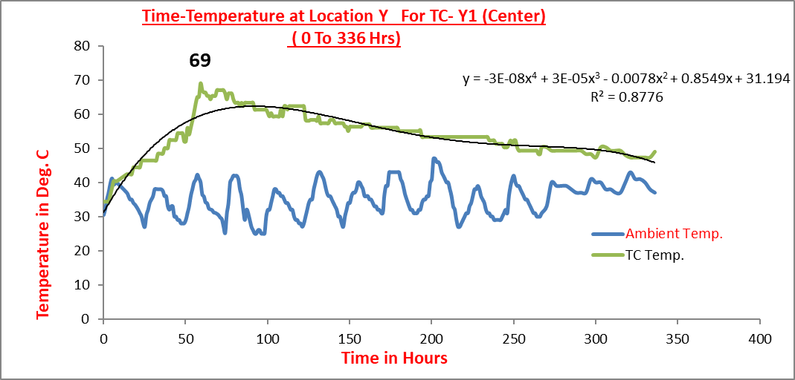
Time – Temperature record for TC for 14 days (336 Hrs.)
for TC – C’
for TC - C3
for TC - P3
for TC - X2
for TC -Q3
for TC - Y1

Slide 28
The Table showing the maximum (peak) temperatures recorded by thermo couples, the period to reach the maximum (peak) temperature, the ambient temperatures at that time.
Location | C |  |  | X |  | Y |  | P | Q
Thermo Couple | C’ | C2 | C3 | X2 | X3 | Y1 | Y3 | P3 | Q2 | Q3
Placement Temperatures ⁰C | 31.5 | 31.5 | 31.5 | 31.5 | 31.5 | 31.5 | 31.5 | 31.5 | 31.5 | 31.5
Max.Temp. Recorded. (Tmax) ⁰C | 93 | 87 | 81 | 65 | 85 | 69 | 60 | 68 | 68 | 60
Period to reach Max. Temp. (Hrs) | 80 | 87 | 91 | 67 | 76 | 59 | 57 | 89 | 56 | 73
Ambient Temp. (Tam) ⁰C | 42 | 30 | 41 | 41 | 32 | 40 | 29 | 42 | 31 | 34
Diff.of Temp.at peak Δ Tp = (Tmax–Tam) ⁰C | 51 | 57 | 40 | 24 | 53 | 29 | 31 | 26 | 38 | 26

Slide 29
Table showing the derived equations for Different Locations of Thermo couples for 14 Days ( 336hrs)
Sr No | TC | Derived Polynomial Equation | r² | r
1 | C’ | y = -4E-08x⁴ + 4E-05x³ - 0.0101x² + 1.098x + 48.329 | 0.871 | 0.933
2 | C2 | y = 9E-10x⁴ + 9E-06x³ - 0.0055x² + 0.9923x + 22.634 | 0.804 | 0.897
3 | C3 | y = -4E-08x⁴ + 3E-05x³ - 0.0093x² + 1.1002x + 35.039 | 0.973 | 0.986
4 | X2 | y = -4E-08x⁴ + 3E-05x³ - 0.0081x² + 0.8461x + 32.923 | 0.847 | 0.920
5 | X3 | y = -7E-08x⁴ + 6E-05x³ - 0.0149x² + 1.4373x + 28.579 | 0.880 | 0.938
6 | Y1 | y = -3E-08x⁴ + 3E-05x³ - 0.0078x² + 0.8549x + 31.194 | 0.877 | 0.936
7 | Y3 | y = -4E-08x⁴ + 3E-05x³ - 0.0078x² + 0.696x + 38.568 | 0.787 | 0.887
8 | P3 | y = -4E-08x⁴ + 3E-05x³ - 0.0089x² + 0.9436x + 28.448 | 0.868 | 0.932
9 | Q2 | y = -4E-08x⁴ + 3E-05x³ - 0.0078x² + 0.696x + 38.568 | 0.952 | 0.976
10 | Q3 | y = -4E-08x⁴ + 3E-05x³ - 0.0067x² + 0.6772x + 32.483 | 0.902 | 0.950
y = Temp. in ^{O} C
X = Time in Hrs.

Slide 30
TEMPERATURE PREDICTION BY 3 METHODS
PCA METHOD –
The maximum temperatures were calculated by this method for all the TEN TC’s.
Cement used was OPC with 40% GGBS;
The contribution of this SCM’s was assumed to be 70% of cement as per recommendation of - -
L Zheng, K A Paine and R K Dhir
AND
Tang, Millard and Beattie, Jiao tong

Slide 31
2) GRAPHICAL METHOD OF ACI 207.2R –
As Wagner Turbidimeter values are not available, equivalent fineness values to the Wagner Turbidimeter method (ASTM C115) were estimated from the Blaine’s fineness values using equation :
Sw = 0.56*Sb
Where Sw = Wagner Specific surface in m2/kg
Sb = Blaine’s Specific surface in m2/kg
The cement used was having Blaine’s fineness of 293 m2/kg , so that the Wagner specific surface works out to 164.08 m2/kg.
Maximum placement temperatures were calculated with and without adjustments for cement fineness.
Values used in the calculations were manually extracted from the charts within ACI 207.2R (Charts 2.1; 2.2)

Slide 32
3) ASCE METHOD –
The maximum placement temperature (adiabatic) for all the TC’s location were calculated.
From the plots developed, for our case with the temperature of casting near to 30⁰C and unit cement content of 246 kg/m3 the values of constants works out to K = 51 and α = 1.40.
The time (t) is taken as the time when measured temperature have reached maximum i.e. the time of T(max).

Slide 33
Table showing the Maximum recorded and calculated Temperatures in Concrete
Thermo Couple | Maximum Concrete Temperatures ⁰C
 | Measured | PCA Method using Eq. ( 2 ) | ACI 207.2R Method Not Corrected for Fineness | ACI 207.2R Method Corrected for Fineness | The ASCE Method using Eq. ( 4 )
C’ | 93 | 74.8 (Since placement temperatures are the same, calculated Maximum Concrete Temperatures are same for all TC's) | 70.3 (Since placement temperatures are the same, calculated Maximum Concrete Temperatures are same for all TC's) | 73.3 (Since placement temperatures are the same, calculated Maximum Concrete Temperatures are same for all TC's) | 82.0
C2 | 87 |  |  |  | 82.2
C3 | 81 |  |  |  | 82.2
X2 | 65 |  |  |  | 81.5
X3 | 85 |  |  |  | 81.9
Y1 | 69 |  |  |  | 80.9
Y3 | 60 |  |  |  | 80.7
P3 | 68 |  |  |  | 82.2
Q2 | 68 |  |  |  | 80.6
Q3 | 60 |  |  |  | 81.8
Av. of all TC‘s in ºC | 73.6 | 74.8 | 70.3 | 73.3 | 81.6
% deviation from measured average maximum temperatures | 0.0 | (+) 1.6 | (-) 4.5 | (-) 0.4 | (+) 10.8

Slide 34
RESULTS AND DISCUSSIONS
Actual measured temperatures vary on plus as well as minus side over predicted by the empirical methods
The average difference in measured and predicted maximum temperature by 3 methods :
      PCA method - Deviation of (+) 1.60%
      ACI graphical method - Deviation of (-) 4.5% and Deviation of (-) 0.40% for without and with correction for fineness respectively.
      ASCE method - Deviation of (+) 10.80%
The developed polynomial equations to predict the temperature with strong correlation coefficient (r) of 0.88 to 0.98 can be used to calculate the temperature at any time after concreting but has restrictions.

Slide 35
RESULTS AND DISCUSSIONS
The results demonstrates that PCA method is not accurate to be a reliable predictor of maximum temperature for mass concrete structures. It can be a useful tool for quick estimates to show the effect of cement content on heat development.
The reliability of ACI graphical method is poor because cements have changed significantly since the charts in ACI were developed.
The ASCE method predicts relatively better when time (t) is less but here time being more the predicted values vary to large extent and hence is a time dependent method.

Slide 36
CONCLUSIONS
The actual recorded temperatures were found to be varying w.r.t. calculated values from 3 methods. This could be attributed to the combined effects of thermal properties of concrete, environmental and weather conditions and curing and form removal.
In prototype structure the formwork was removed 3 days after concreting the layers, and the concrete water cured continuously, due to which the surface concrete got cooled down which affected the heat balance and flow of heat.
Hence, these methods have limited usefulness and can be a tool to roughly and quickly estimate the maximum temperature rise.

Slide 37
CONCLUSIONS
The maximum temperature; the time to maximum temperature and the time spent at elevated temperatures were observed to be critical parameters in predicting thermal shock susceptibility. This suggests that the time of removal of formwork must be delayed beyond the point of occurrence of peak.
Present study the average of the time of peak temperatures reached is about 66 Hrs. while the Form was removed later i.e. 72 Hrs.
The temperature measurement by inserting Thermo Couples has limited adoptability as such studies could not be done in every structure.

Slide 38
CONCLUSIONS
The use of micro fibers like fibrillated polypropylene can be very useful in arresting the temperature induced micro cracking of the matrix of concrete due to high temperatures or large temperature differential.
However, the results obtained from such experimental studies could be used to validate the results from mathematical models which could be generalized prediction tools for accurate prediction of temperature profiles in concrete structures.

Slide 39
Acknowledgement
The authors are thankful to
Hon. Director Project
and
Hon. Managing Director,
Maharashtra Metro Rail Corporation Ltd. Nagpur for their motivational inputs and support.

Slide 40

Thank You

