Slide 1

A CASE STUDY ON MEASUREMENT OF TEMPERATURE RISE IN CONCRETE AND ASSESSMENT OF PROBABILITY OF CRACKING DUE TO HEAT OF HYDRATION.
By - -
Dr. K.C.Tayade, Dy. General Manager and Head Quality Control, Maharashtra Metro Rail Corporation Ltd., Nagpur.
Er. Sandip Sonule, Sect. Engg. Quality, Reach-1, General Consultants, Maha Metro, Nagpur.
Er.Sushil Kumar , Addl.General Manager, Reach-1, Maharashtra Metro Rail Corporation Ltd., Nagpur.
Er. Mahesh kumar , Director Project, Maharashtra Metro Rail Corporation Ltd., Nagpur.

Slide 2
Contents of the Paper
The paper deals with the experimental studies of temperature rise in concrete of a prototype structure.
Actual temperature rise measured by embedding Thermo Couples (TC’s) in the structures during concreting.
The monitoring of temperature recorded by thermocouples was done by digital recorder manually on hourly basis up to 13 days and then once in 3 hrs. up to next 21 days and beyond but restricted to 14 days in this reporting.
Contd. …

Slide 3
Contents of the Paper
The plot of time-temperature demonstrated the actual temperature rise, its trend both increasing and decreasing.
Another purpose of this study was to find the crack index for internally restraint cases both the elastic; hypoelastic models and to know the probability of cracking based on the existing cracking assessment based on Korean methods as Indian specifications are non-existent.

Slide 4
Heat Generation and its Effect
Hydration of Portland cement
Exothermic reaction
Large amount of heat generated in mass concrete elements
Concrete has low thermal conductivity
Great portion of generated heat is trapped inside and dissipated slowly
So temperature increases inside
Temperature difference between the center and outer part is created
Cause for tensile stresses
Gives rise to thermal cracks in concrete structure.

Slide 5
Temperature Evolution in concrete
∆T = Temperature Rise – Needs to be assessed

Slide 6
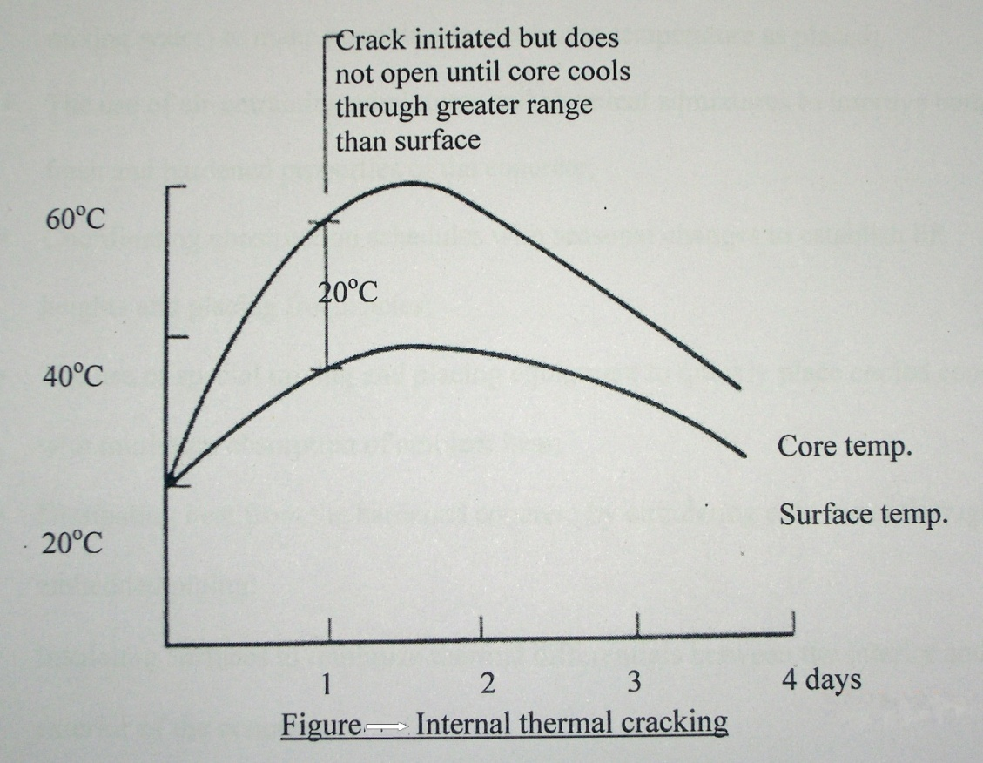
In massive concrete structures, internal restraint occurs from the inability of the heat to dissipate quickly from the core of the member due to the low thermal diffusivity of the concrete. A temperature differential is set up between the core of the concrete and the surface – Leads to Cracking.
The critical 20⁰C (36⁰F) temperature difference occurs during Heating - - i.e. when temperature is increasing.
Figure shows a pattern of temperature change, which causes internal cracking of a large concrete mass.

Slide 7
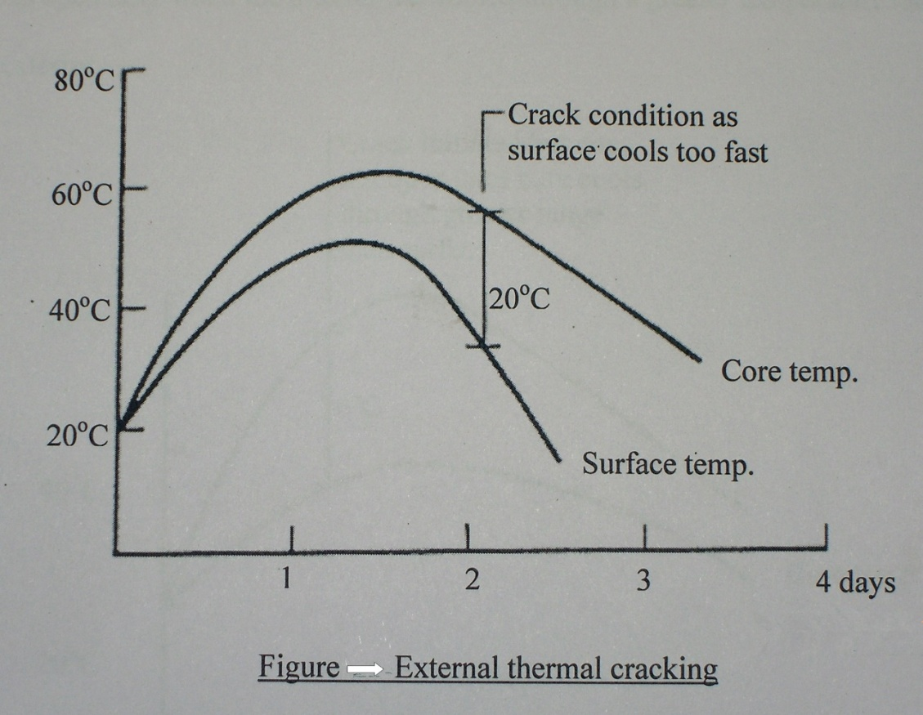
The non uniform expansion and contraction will result in thermal stresses within the concrete element, and due to restraint results in external cracking of concrete.
The critical 20⁰C (36⁰F) temperature difference occurs during Cooling - - . i.e. when temperature is decreasing.
Figure shows pattern of temperature change which causes external thermal cracking of large concrete mass.

Slide 8
Criteria for assessment of hydration heat induced cracks :-
    Temperature based assessment.
    Stress based assessment.
Temperature based assessment frequently adopted : -
    as temperatures can be readily assessed by field measurements and numerical analysis
    AND
    the reliability of temperature measurement is significantly higher than stress measurements.

Slide 9
LITERATURE REVIEW
The literature shows that the factors most relevant to cracking in massive structures are thermal stresses induced by thermal gradients - ACI 207, 2007.
The critical 20⁰C (36⁰F) temperature difference occurs during cooling – FitzGibbon.
According to Neville, restraint exists in all but the smallest of concrete members.
According to FitzGibbon, the cracking strain of concrete is reached when an internal thermal differential of 20⁰C (36⁰F) is exceeded.
European standard ENV 206:1992 suggests the limit on the maximum temperature difference between the centre and the surface is 20⁰ C (36⁰ F) to avoid concrete surface cracking caused by heat generated.

Slide 10
ACI Committee 207.1R & RILEM Tech. Committee give useful guidance in respect of thermal control plan and cracking in mass concrete.
ACI Committee 224.R contains recommendations regarding crack control in mass concrete.
Panarese postulated that when dimensions of concrete structures are more than 1 m, temperature rise shall be considered.
As per ACI 301 heat generation should be considered when minimum c/s dimensions approaches or exceeds 760 mm or when cement contents above 356 Kg/m3 are used.
The exact temperature required for the formation of DEF is extensively debated; but the majority of available research reports 70⁰C (158⁰F) as the minimum temperature necessary for the formation of DEF- Gajda.

Slide 11
REVIEW OF PROVISIONS REGARDING CRACKING ASSESSMENT
There are many criteria for assessment of the hydration heat induced cracks. Such as temperature based assessment as well as stress based assessment.
Temperature based assessment has been frequently employed in practice as temperatures can be readily assessed by field measurements as well as analysis and the reliability of temperature measurement is significantly higher than that of stress measurements.
In the US the ACI guides namely ACI 207.2R-2007 and ACI 305 R do not provide any specific criteria for cracking induced by the heat of hydration.
In Europe, as per CEB–FIB 1993 crack risk criteria and various temperature difference criteria have been employed together in some large projects.

Slide 12
Japan Concrete Institute 1986 adopts the crack index based on the splitting tensile strength of concrete and the tensile strength which are time dependant and can be obtained by thermal stress analysis.
Korean Standard Specification 2003 for Concrete present simplified form of crack index as a function of temperature and for internally restrained case is given by : - -
Icr = 15 / ∆Ti
Where ∆Ti = maximum temperature difference across the section º C
The following criteria could be specified:
Criteria | I_{cr} Value
to prevent cracks | Icr > 1.5
to limit cracks | 1.2 > I_{cr} < 1.5
to limit harmful cracks | 0.7 > I_{cr} < 1.2
Based on crack index the probability of crack occurrence is as shown in Figure; which can be used to assess cracking.
Contd. …

Slide 13
So, the temperature difference across the section is the primary information required for the evaluation of the tendency of cracking.
As derived and reported by Jeon, 2008 the crack index for internally restraint cases for elastic model is given by : - -
Icr(e) = 15.4 / ∆Ti
Is valid near the peak temperatures when the maximum temperature difference occurs within 3 days after placing. However, the elastic crack index depends only on the maximum temperature difference and does not take into account the development of heat of hydration, the member size, curing conditions, the form removal, the hardening properties of concrete etc.
A more realistic hypo - elastic model is also developed by Jeon, 2008 and is given by : - -
Icr(h) = 25 / ∆Ti

Slide 14
RESEARCH SIGNIFICANCE OF PRESENT STUDY
A large amount of research has been carried out aimed at controlling and minimizing early age cracks in concrete. The heat of hydration of concrete has been one of the most important issues investigated. There are many criteria for assessment of the hydration heat induced cracks.
The purpose of this study is to know the probability of cracking based on the existing cracking assessment based on Korean methods and also on the crack index for internally restraint cases both for the elastic and hypoelastic models from practical consideration developed by Se-Jim Jeon and reported in ACI materials journal 2008{12}.

Slide 15
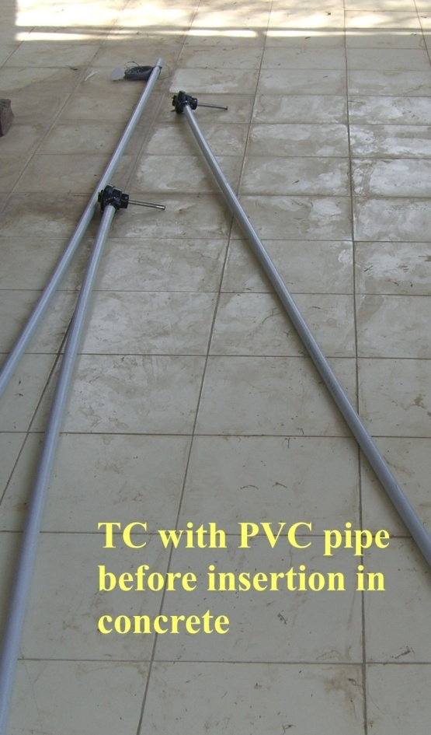
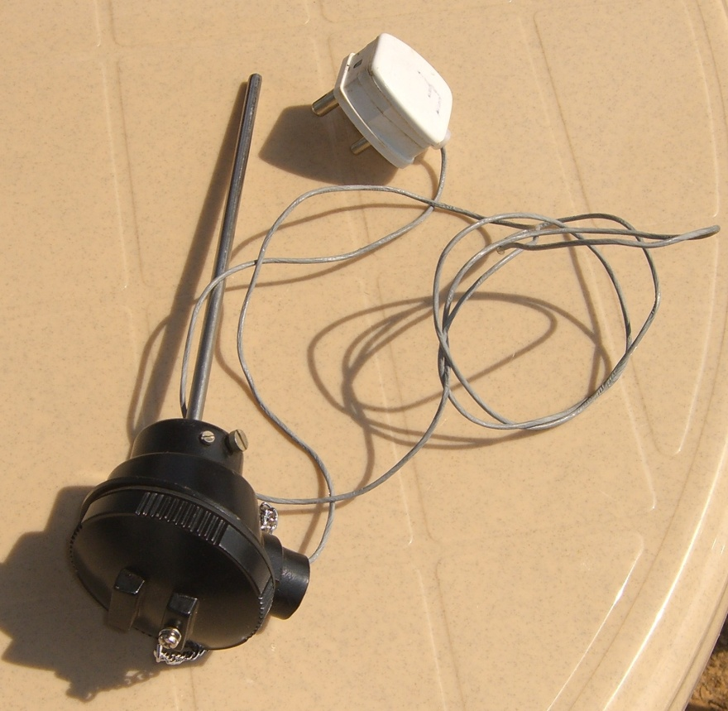
THE EXPERIMENTAL PROGRAM AND SCHEME OF STUDY
Aim of experimental study was to measure and monitor the temperature rise in A concrete prototype structures, this was done by inserting an array of thermo couples at different locations and levels.
The thermo couples used were PT100.
Thermo Couple – Type – PT 100
( Type K : chromel–alumel )

Slide 16
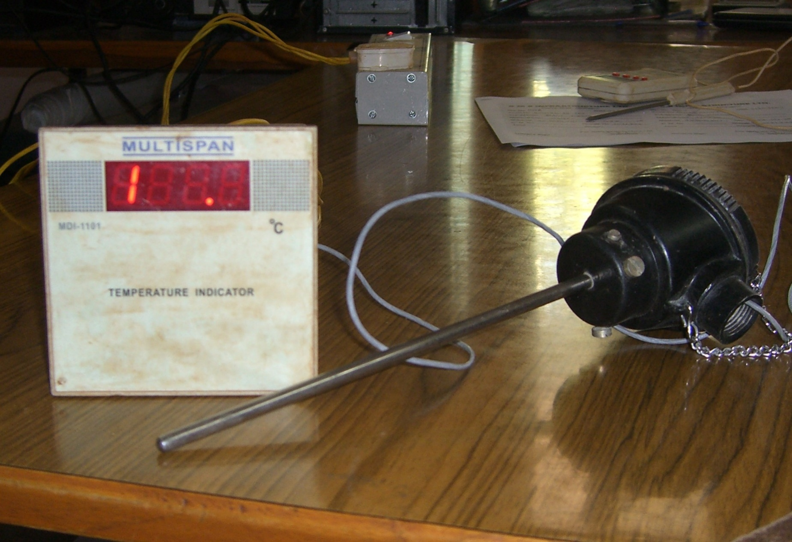
Electronic Temperature recording meter

Slide 17
Scheme of study
The scheme of study was to insert the thermo couples at five locations in pier cap namely location X, Y, P, Q, on sides and location C at centre.
At a particular location, in cross section total three thermo couples were embedded in three layers.
The thermo couples at the top and bottom were inserted 0.20m inside to accommodate the reinforcements. The thermo couples at the location on sides namely X,Y,P,Q were inserted 0.50 m from face of concrete inside the concrete structure, so that the effect of surface cooling is minimized.
One TC protected from direct sunlight to measure the ambient temperature and was kept outside the structure.

Slide 18
Scheme of study
Sr.No. | Location | Number of T.C’s | Notation**
1 | C | 3 | C’, C2, C3
2 | X | 3 | X2, X3
3 | Y | 3 | Y1, Y3
4 | P | 3 | P3
5 | Q | 3 | Q2, Q3
** The Thermo Couples at Location X1; Y2; P1; P2 and Q1 had malfunctioned and so are not considered in this study. The Thermocouple at location C1 malfunctioned during embedment and was replaced with another TC with notation as C’.
Hence, out of 15 thermo couples, 10 were available for this study.
The formwork used was of steel shuttering and it was removed after 3 days.

Slide 19
STRUCTURE – Pile Cap
Layout Plan and Plan of Pile cap showing Locations of Thermo Couples.
W
S
N-S Corridor
E-W Corridor
19

Slide 20
Cross Section of Pile Cap
Locations of Thermo Couples.

Slide 21
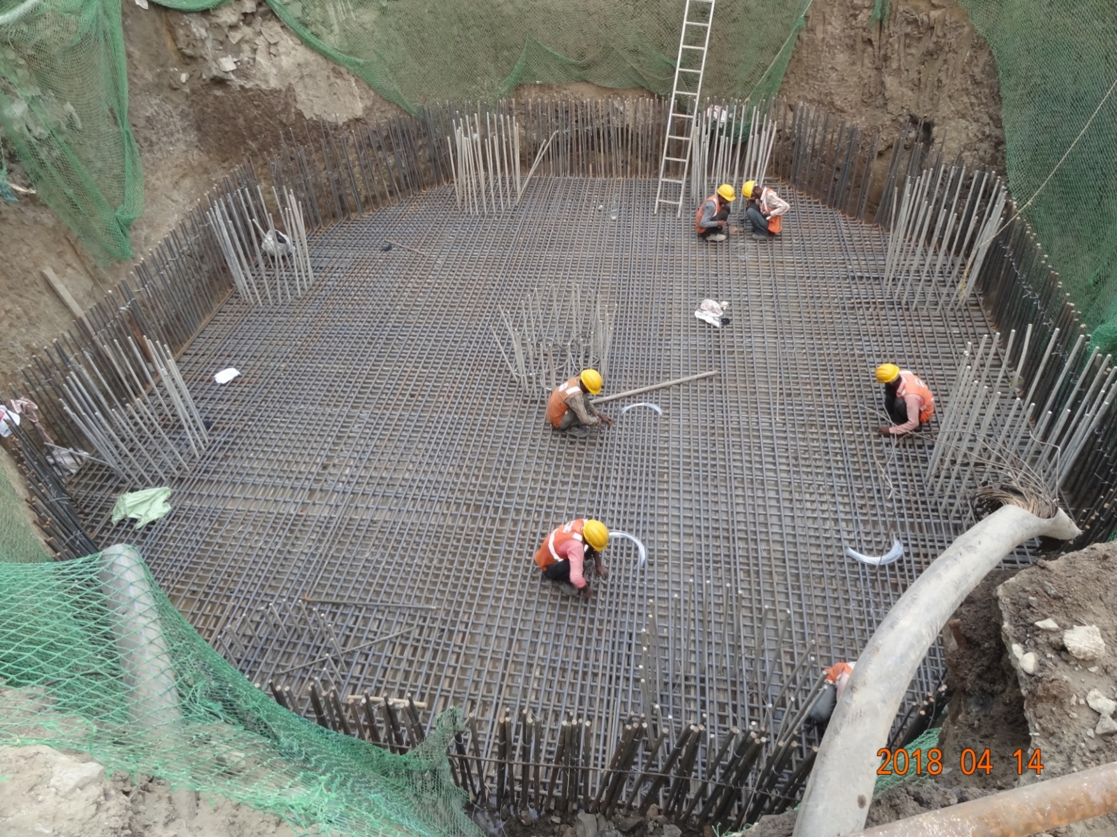
Pile Cap – Reinforcement work
Pile Head Reinforcement Anchors

Slide 22
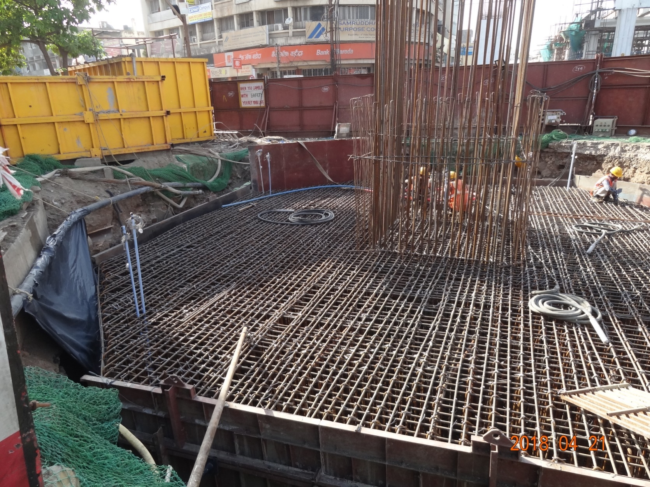
Play Video of thermocouple insertion before concreting.
(48 sec.)
Locations of Thermo Couples

Slide 23
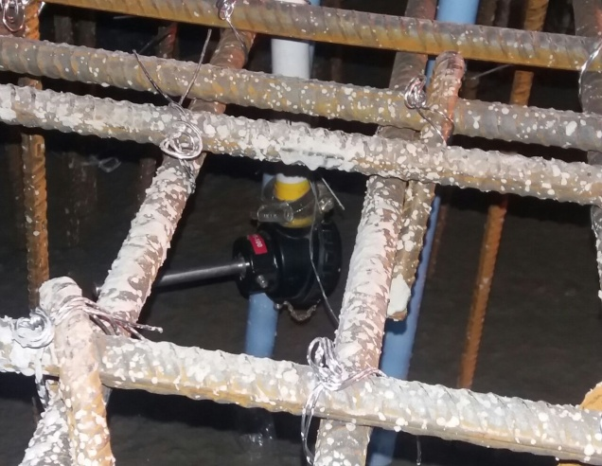
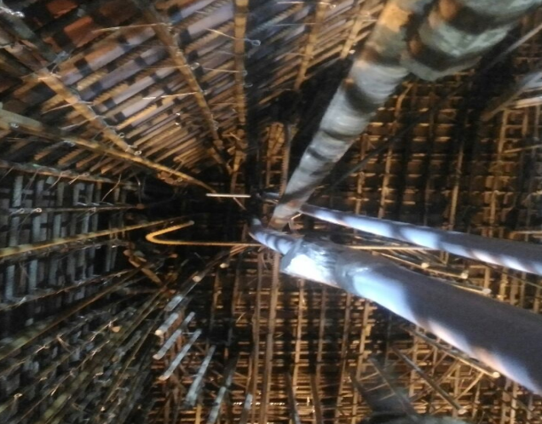
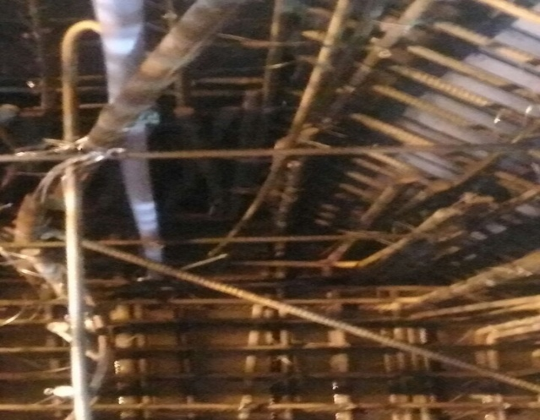
Actual photos of structure with Thermo couples
TC – Bottom layer
TC – Top layer
TC – Middle layer
23

Slide 24
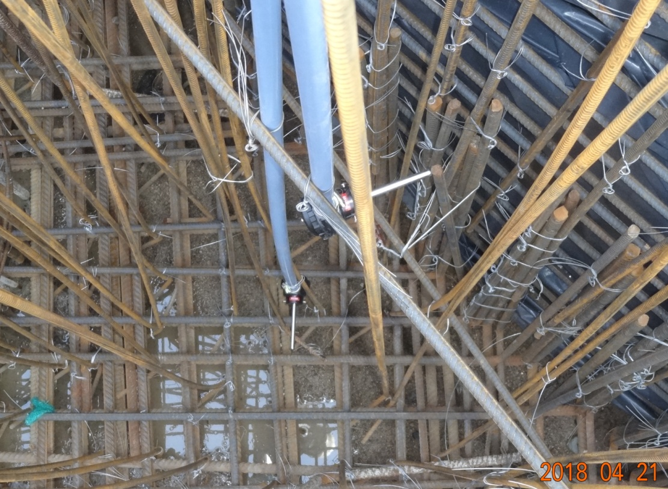
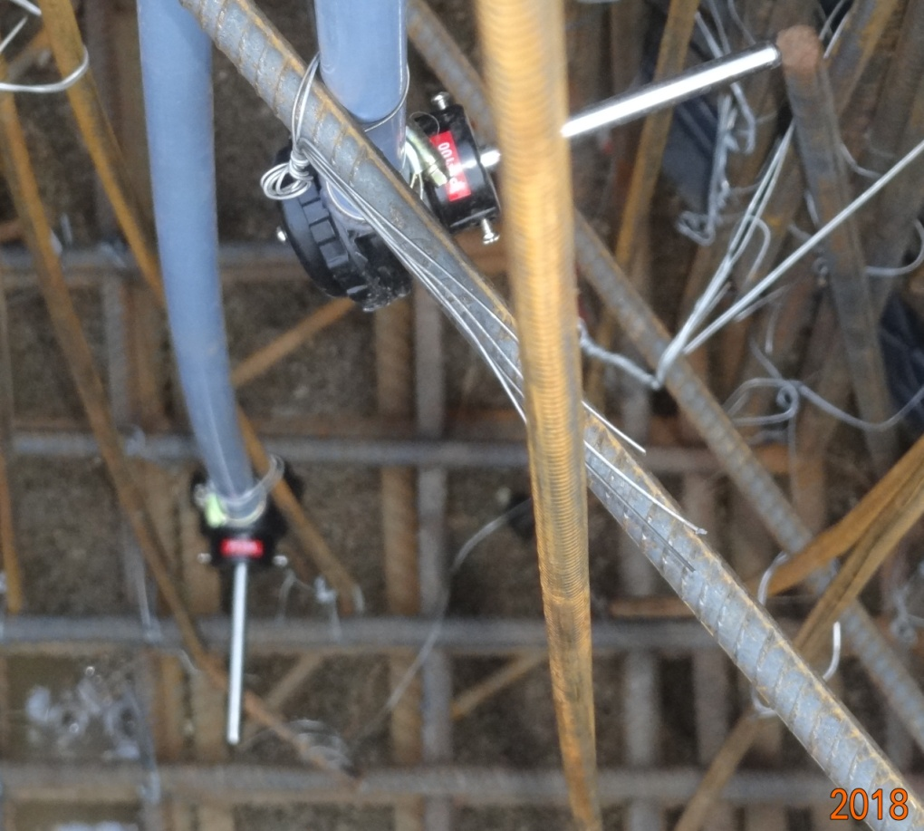
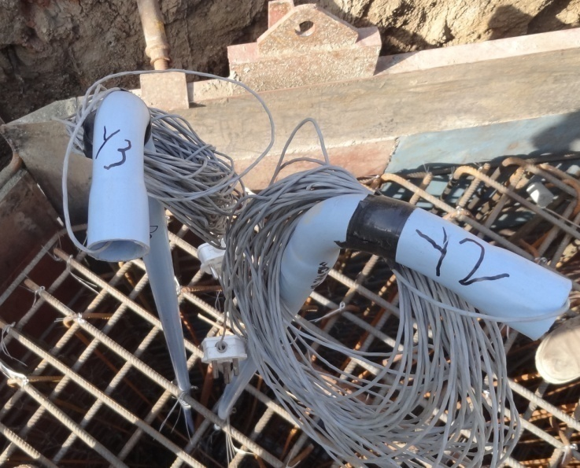
Thermo Couples
PVC Casing Pipes
Lead Wires
Actual photos of structure with Thermo couples Fixed

Slide 25
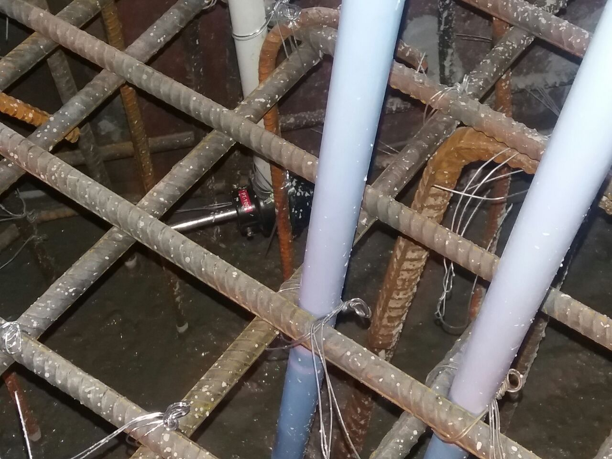
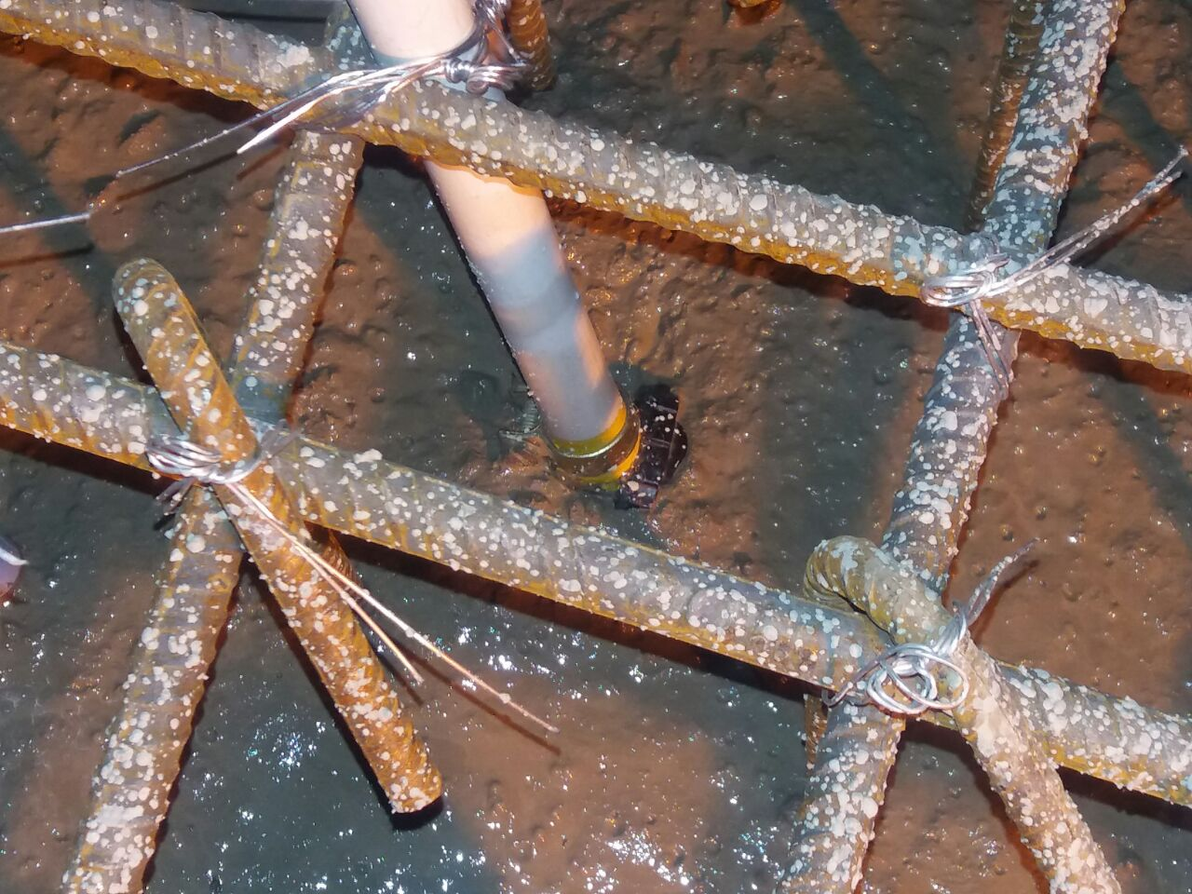
Thermo couple
Thermo couple
Photographs showing the Thermo Couples being embedded in concrete.
25

Slide 26
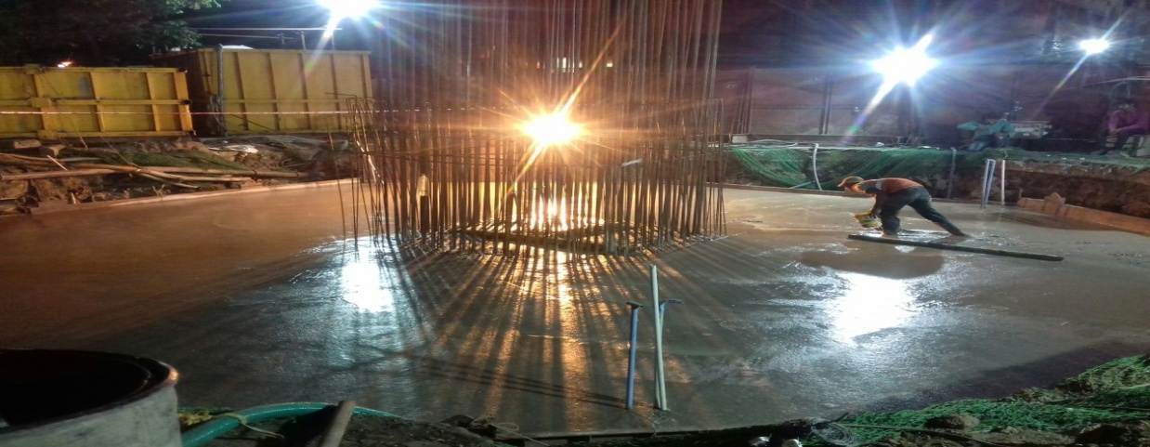
Pile Cap after completion of Concreting
Total Qty. of Concrete –
384 Cum.
PVC Pipes as Casing for embedded TC’s - Clearly seen.

Slide 27
Table showing the mix proportion
for the Concrete used in Pile Cap.
Concrete Grade M-40 (20MSA)
Cement (Kg.) |  | Water (Kg.) | Sand (Kg.) |  | Coarse aggregate (Kg) |  | Plasticiser (kg)
 |  |  |  |  | 20mm | 10mm
Cement OPC 53 grade | GGBS | 143 | River sand | Crushed sand | 626 | 512 | 3.28
246 | 164 (40 %) |  | 600 | 257 (30%)
The F.M. of R/sand was 2.9 and Crushed Sand was 3.15 which was very coarse sand and categorized as Zone-II and Zone-I as per IS 383

Slide 28
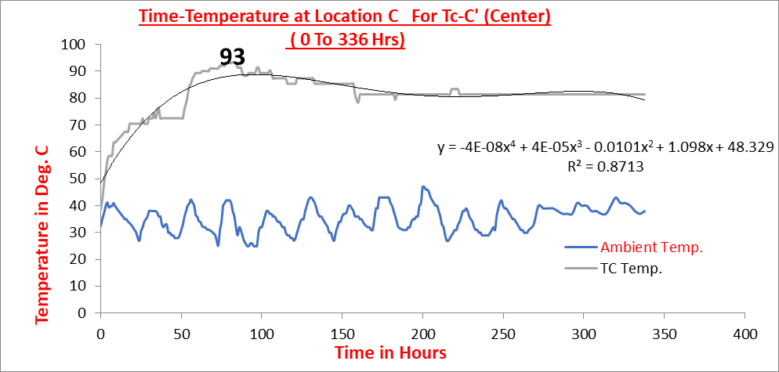
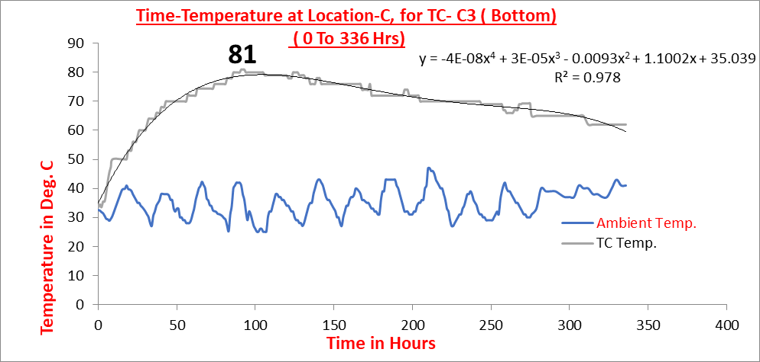
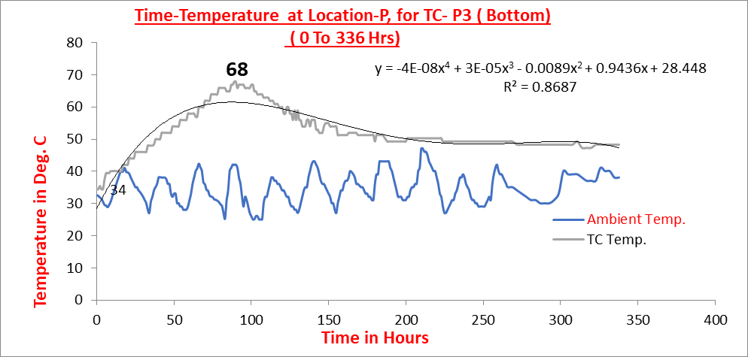
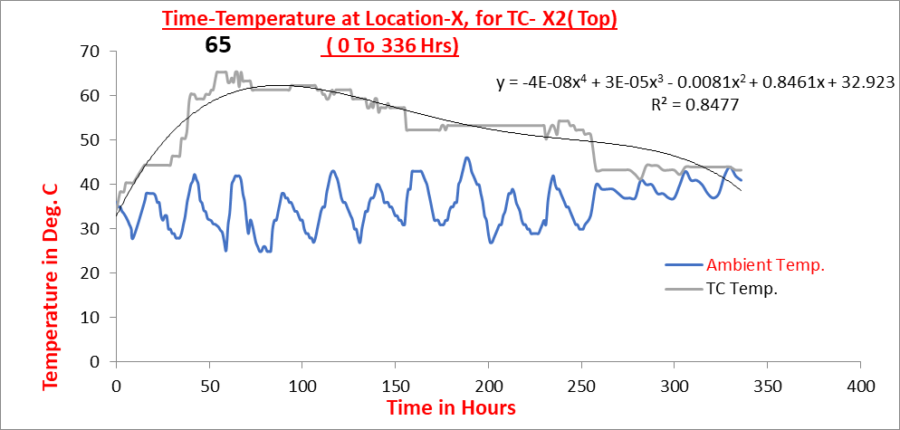
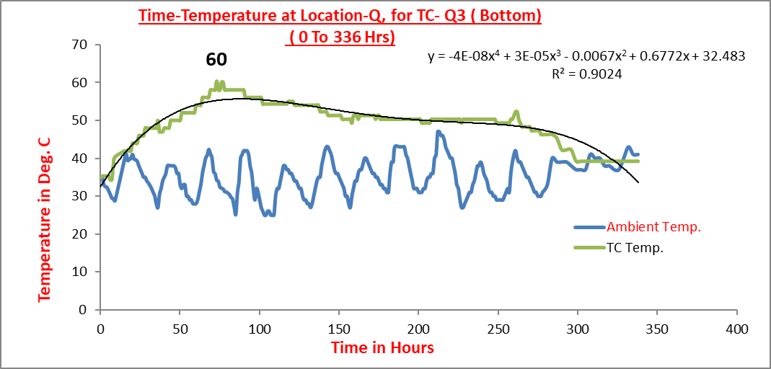
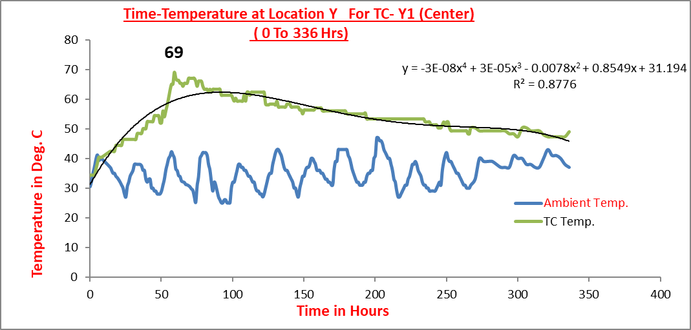
Time – Temperature record for TC for 14 days (336 Hrs.)
for TC – C’
for TC - C3
for TC - P3
for TC - X2
for TC -Q3
for TC - Y1

Slide 29
The Table showing the maximum (peak) temperatures recorded by thermo couples, the period to reach the maximum (peak) temperature, the ambient temperatures at that time.
Location | C |  |  | X |  | Y |  | P | Q
Thermo Couple | C’ | C2 | C3 | X2 | X3 | Y1 | Y3 | P3 | Q2 | Q3
Placement Temperatures ⁰C | 31.5 | 31.5 | 31.5 | 31.5 | 31.5 | 31.5 | 31.5 | 31.5 | 31.5 | 31.5
Max.Temp. Recorded. (Tmax) ⁰C | 93 | 87 | 81 | 65 | 85 | 69 | 60 | 68 | 68 | 60
Period to reach Max. Temp. (Hrs) | 80 | 87 | 91 | 67 | 76 | 59 | 57 | 89 | 56 | 73
Ambient Temp. (Tam) ⁰C | 42 | 30 | 41 | 41 | 32 | 40 | 29 | 42 | 31 | 34
Diff.of Temp.at peak Δ Tp = (Tmax–Tam) ⁰C | 51 | 57 | 40 | 24 | 53 | 29 | 31 | 26 | 38 | 26

Slide 30
Table showing the derived equations for Different Locations of Thermo couples for 14 Days ( 336hrs)
Sr No | TC | Derived Polynomial Equation | r² | r
1 | C’ | y = -4E-08x⁴ + 4E-05x³ - 0.0101x² + 1.098x + 48.329 | 0.871 | 0.933
2 | C2 | y = 9E-10x⁴ + 9E-06x³ - 0.0055x² + 0.9923x + 22.634 | 0.804 | 0.897
3 | C3 | y = -4E-08x⁴ + 3E-05x³ - 0.0093x² + 1.1002x + 35.039 | 0.973 | 0.986
4 | X2 | y = -4E-08x⁴ + 3E-05x³ - 0.0081x² + 0.8461x + 32.923 | 0.847 | 0.920
5 | X3 | y = -7E-08x⁴ + 6E-05x³ - 0.0149x² + 1.4373x + 28.579 | 0.880 | 0.938
6 | Y1 | y = -3E-08x⁴ + 3E-05x³ - 0.0078x² + 0.8549x + 31.194 | 0.877 | 0.936
7 | Y3 | y = -4E-08x⁴ + 3E-05x³ - 0.0078x² + 0.696x + 38.568 | 0.787 | 0.887
8 | P3 | y = -4E-08x⁴ + 3E-05x³ - 0.0089x² + 0.9436x + 28.448 | 0.868 | 0.932
9 | Q2 | y = -4E-08x⁴ + 3E-05x³ - 0.0078x² + 0.696x + 38.568 | 0.952 | 0.976
10 | Q3 | y = -4E-08x⁴ + 3E-05x³ - 0.0067x² + 0.6772x + 32.483 | 0.902 | 0.950
y = Temp. in ^{O} C
X = Time in Hrs.

Slide 31
EXPERIMENTAL OBSERVATIONS AND DISCUSSIONS
The difference* between peak temperatures and the ambient temperatures ∆Tp was calculated, having known the peak temperatures.
Applying this temperature difference (∆Tp) the crack index as per Korean specifications, for elastic and hypo-elastic models were computed as per corresponding equations and tabulated.
The probability of crack occurrence was worked out from graph and tabulated.
*Note: The difference is calculated w.r.t. the ambient temperatures since it is difficult to measure temperatures just inside the concrete surface or of the outer surface of concrete.
Contd. …

Slide 32
Table showing the details of temperature recorded by Thermocouples in concrete layer and the Crack index and probability of cracking for ∆Tp*
Location | C |  |  | X |  | Y |  | P | Q
Thermo Couple | C’ | C2 | C3 | X2 | X3 | Y1 | Y3 | P3 | Q2 | Q3
Diff.of Temp.at peak Δ Tp = (Tmx–Tam) | 51 | 57 | 40 | 24 | 53 | 29 | 31 | 26 | 38 | 26
Crack Index - - korean spcs. I_{CR(K)} /15/Δ Tp | 0.29 | 0.26 | 0.38 | 0.63 | 0.28 | 0.52 | 0.48 | 0.58 | 0.39 | 0.58
Probability of crack occurance.% | 95 | 96 | 94 | 84 | 95 | 91 | 92 | 88 | 94 | 88
Crack Index - - elastic analysis I_{CR(e)}= 15.4/Δ Tp | 0.3 | 0.27 | 0.39 | 0.64 | 0.29 | 0.53 | 0.5 | 0.59 | 0.41 | 0.59
Probability of crack occurance.% | 95 | 95 | 93 | 84 | 95 | 91 | 92 | 88 | 94 | 88
Crack Index - - Hypoelstic analysis.I_{CR(h)}= 25/Δ Tp | 0.49 | 0.44 | 0.63 | 1.04 | 0.47 | 0.86 | 0.81 | 0.96 | 0.66 | 0.96
Probability of crack occurance.% | 92 | 94 | 84 | 50 | 92 | 58 | 76 | 54 | 83 | 54
* ∆Tp is w.r.t. ambient temperatures

Slide 33
DISCUSSIONS OF RESULTS
The temperature rise could be used to assess the thermal gradients and the effects such as cracking index when the internal restraint is dominant in the early ages to 3 days.
The maximum temperatures recorded in concrete were in the wide range of 60⁰C-90⁰C correspondingly, the average probability of cracking reduces from - -
96% to 84% - for crack indices as per the Korean formula.
95% to 84% - for crack indices as per the elastic models.
94% to 54% - for crack indices as per the hypoelastic models.
Contd. …

Slide 34
DISCUSSIONS OF RESULTS
The temperature difference in the structure is more crucial than the Maximum Temperatures reached.
For example : for a temperature difference of 20⁰C the elastic and hypoelastic model gives a crack index as 0.77 & 1.25 and accordingly this falls into the category of limiting harmful cracks under elastic model whereas the hypoelastic model indicates that it falls into category of limiting the cracks. The effect of these different results on the overall construction scheme and its economics could be significant.
It can be seen the peak temperatures are reached well within 3 days and the temperatures were getting stabilized in 14 days with the rate of cooling being very low.
Contd. …

Slide 35
CONCLUSIONS
The time-temperature equations with a strong correlation (r) values in the range of 0.88 – 0.98 could be used to predict the temperature rise for structures with similar geometry, cement contents, mix proportions, ambient temperatures, curing conditions etc.
The practical formula of crack index based on hypoelastic model gave better assessment of the probability of crack occurrence.
The temperature based assessment of cracking which is based on crack index is a good and handy tool to quickly assess the probability of cracking, but should be used with caution and restraint since it is too conservative
Contd. …

Slide 36
CONCLUSIONS
Contd. …
In the present study even though the probability of crack occurrence is more than 50%, actually no cracks were observed, this could be due to heavy reinforcement and the use of vertical pins and peripheral (temperature) reinforcement in the structure.
Another explanation can be, that, the tensile strength of concrete is a function of concrete’s maturity and the thermal gradient (which leads to cracking) is also a function of concrete’s maturity, which means that the a concrete element could in some circumstances have a low risk of cracking even though has a high temperature difference, if this large temperature difference occurs at a late age.

Slide 37
CONCLUSIONS
Contd. …
The use of micro fibers like fibrillated polypropylene can be very useful in arresting the temperature induced micro cracking of the matrix of concrete.
The more realistic equation of crack index based on hypoelastic model can be used which nearly matches with the existing limiting temperature difference namely 15⁰C - 20⁰C for the elimination of cracking that has been adopted the world over.

Slide 38
Acknowledgement
The authors are thankful to Hon. Managing Director, Maharashtra Metro Rail Corporation Ltd. Nagpur for his motivational inputs and support.

Slide 39

Thank you
keshavtayade@yahoo.com

