Slide 1

Evaluation Of Strength And Durability Of Concrete Made From Recycled Aggregates For Sustainable Construction
By
Smt B. Suguna Rao
Asst.Prof.CED
RIT(Affliated to VTU)
Bangalore-54
Guide:
Dr.Srikanth.M.Naik
Professor,CED
RIT,Bangalore-54

Slide 2
INTRODUCTION
Total %of annual waste arising by sector
Quantity of C AND D-International
Demolition waste in Europe (RILEM)
Member State | C and D Waste | % Recycled | % Incinerated Landfilled
France | 24 | 15 | 85
Italy | 20 | 9 | 91
India | 14 | <5 | >95
Spain | 13 | <5 | >95
Belgium | 7 | 87 | 13
Portugal | 3 | <5 | >95
Denmark | 3 | 81 | 19
Greece | 2 | <5 | >95
Sweden | 2 | 21 | 79
Finland | 1 | 45 | 55
Ireland | 1 | <5 | >95
Quantity of C AND D-India
Constituents | Quantity C&D MillionTons Per Annum
Soil, Sand, Gravel | 4.2 - 5.14
Brick and Masonry | 3.6 - 4.4
Concrete | 2.4 - 3.67
Metals | 0.6 - 0.73
Bitumen | 0.25 - 0.3
Wood | 0.25 - 0.30

Slide 3
EXPERIMENTAL INVESTIGATION
A. MATERIAL AND PROPERTIES
Cementitious materials used in this study consist of 90% Portland cement of 43 grade and 10% silica fume with specific gravities of 3.09, and 2.22. Crushed stone particles down size 12mm was obtained from local crushing units are used as natural coarse aggregates with a specific gravity of 2.657.Recycled aggregates used for replacement of natural coarse aggregates was obtained from demolition site inside the campus of M.S.R.I.T . A recycled aggregate of 12.5 mm down size was obtained by crushing and sieving with a specific gravity of 2.59. Manufactured sand was used as fine aggregate with a specific gravity of 2.492. Portable water was used for mixing the ingredients of concrete. CONPLAST was used to obtain required workability of concrete.

Slide 4
Siveve Analysis
Figure 1 Particle Size Distribution curve of Recycled Coarse Aggregate

Slide 5
Characterization Of Materials
Test | Fine Aggregate | Natural Coarse Aggregate | Recycled Coarse Aggregate
Fineness Modulus | 2.35 | 5.25 | 5.45
Specific gravity | 2.492 | 2.657 | 2.59
Crushing Value | - | 27.56% | 28.10%
Impact Value | - | 21.18% | 29.86%
Water Absorption | - | 0.31% | 1.87%
Moisture Content | 0.61% | - | -

Slide 6
MIX DESIGN
Mix design calculations are done based on perumal’s method. Portland cement was 10% replaced by silica fume. It was observed by one of the Author that adding silica fume improves the strength of concrete compared to normal strength concrete. Portland cement was replaced by 10% silica fume. Four water /cement ratios are considered for mix design of five different replacement ratios.

Slide 7
Mix proportion for natural aggregate concrete
:M60
Perumal’s method:
Size of Coarse aggregate(CA) = 12.5 mm
Water content = 150 kg/m³
SP dosage, d =2.5%
Entrapped air content, V_{EA} = 2 %
Water binder ratio = 0.33
Calculation of binder content, b would then be done as follows: 454.54 kg/m³
Considering 10 % replacement of cement by silica fume
Cement content =409.09 kg/m³
Silica fume content = 45.45 kg/m³
fine aggregate content(FA) = 750.07 kg/m³
Total solid content of SP was 33% (S) and its specific gravity was 1.1 (S_{S}) and computation of super plasticizer is 10.23 kg/m³ (2.5%).
Considering the specific gravity of CA as 2.65,FA as 2.492 and silica fume as 2.22 and cement as 3.09.

Slide 8
MIX PROPORTIONS
Mix no | % Replacement | w/c | cement (kg/m³) | Fine aggregate (kg/m³) | Silica fume | NCA (kg/m³) | RCA (kg/m³) | Water (kg/m³) | S.P in (kg/m3)
 |  |  |  |  | (kg/m³)
1 | 0% | 0.27 | 500 | 665.535 | 55.55 | 1000 | 0 | 150 | 12.5
2 | 30% | 0.27 | 500 | 644.11 | 55.55 | 700 | 300 | 150 | 12.5
3 | 35% | 0.27 | 500 | 640.54 | 55.55 | 650 | 350 | 150 | 12.5
4 | 40% | 0.27 | 500 | 636.97 | 55.55 | 600 | 400 | 150 | 12.5
5 | 45% | 0.27 | 500 | 633.4 | 55.55 | 550 | 450 | 150 | 12.5
6 | 50% | 0.27 | 500 | 629.83 | 55.55 | 500 | 500 | 150 | 12.5
7 | 0% | 0.3 | 450 | 712.03 | 50 | 1000 | 0 | 150 | 11.25
8 | 30% | 0.3 | 450 | 690.6 | 50 | 700 | 300 | 150 | 11.25
9 | 35% | 0.3 | 450 | 687.03 | 50 | 650 | 350 | 150 | 11.25
10 | 40% | 0.3 | 450 | 683.46 | 50 | 600 | 400 | 150 | 11.25

Slide 9
MIX PROPORTIONS
Mix no | % Replacement | w/c | cement (kg/m³) | Fine aggregate (kg/m³) | Silica fume | NCA (kg/m³) | RCA (kg/m³) | Water (kg/m³) | S.P in (kg/m3)
12 | 50% | 0.3 | 450 | 676.32 | 50 | 500 | 500 | 150 | 11.25
13 | 0% | 0.33 | 409.09 | 750.07 | 45.45 | 1000 | 0 | 150 | 10.23
14 | 30% | 0.33 | 409.09 | 728.64 | 45.45 | 700 | 300 | 150 | 10.23
15 | 35% | 0.33 | 409.09 | 725.07 | 45.45 | 650 | 350 | 150 | 10.23
16 | 40% | 0.33 | 409.09 | 721.50 | 45.45 | 600 | 400 | 150 | 10.23
17 | 45% | 0.33 | 409.09 | 717.93 | 45.45 | 550 | 450 | 150 | 10.23
18 | 50% | 0.33 | 409.09 | 714.36 | 45.45 | 500 | 500 | 150 | 10.23
19 | 0% | 0.36 | 375 | 781.77 | 41.67 | 1000 | 0 | 150 | 9.375
20 | 30% | 0.36 | 375 | 760.34 | 41.67 | 700 | 300 | 150 | 9.375
21 | 35% | 0.36 | 375 | 756.77 | 41.67 | 650 | 350 | 150 | 9.375
22 | 40% | 0.36 | 375 | 753.2 | 41.67 | 600 | 400 | 150 | 9.375
23 | 45% | 0.36 | 375 | 749.63 | 41.67 | 550 | 450 | 150 | 9.375
24 | 50% | 0.36 | 375 | 746.06 | 41.67 | 500 | 500 | 150 | 9.375

Slide 10
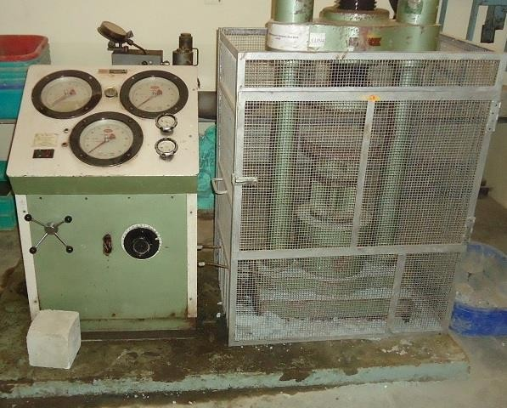
TEST SPECIMENS AND TESTING
A.COMPRESSIVE STRENGTH
% Replacement | Compressive Strength MPa
 | 0.27 w/c | 0.30 w/c | 0.33 w/c | 0.36 w/c
0% | 73.03 | 67.43 | 65.31 | 63.34
25% | 71.8 | 67.14 | 64.38 | 62.14
30% | 69.97 | 67 | 63.92 | 61.8
35% | 68.61 | 66.9 | 63.34 | 60.23
40% | 67.8 | 66.72 | 62.68 | 59.1
45% | 66 | 60.17 | 54.72 | 53.68
50% | 65.43 | 58.08 | 53.91 | 53.02

Slide 11
SPLIT TENSILE STRENGTH
% Replacement | Split Tensile Strength MPa
 | 0.27 w/c | 0.30 w/c | 0.33 w/c | 0.36 w/c
0% | 10.12 | 9.98 | 9.95 | 9.92
25% | 9.89 | 9.77 | 9.67 | 9.56
30% | 9.63 | 9.61 | 9.57 | 9.43
35% | 9.3 | 9.29 | 9.44 | 9.35
40% | 9.26 | 8.99 | 7.99 | 7.69
45% | 7.41 | 7.33 | 7.00 | 6.86
50% | 6.94 | 6.88 | 6.88 | 6.7

Slide 12
FLEXURAL TEST
% Replacement | Flexural Strength MPa
 | 0.27 w/c | 0.30 w/c | 0.33 w/c | 0.36 w/c
0% | 7.23 | 6.88 | 6.78 | 6.23
25% | 6.5 | 6.35 | 6.08 | 6.01
30% | 6.43 | 5.91 | 5.90 | 5.46
35% | 6.14 | 5.88 | 5.73 | 5.65
40% | 6.11 | 5.81 | 5.55 | 5.44
45% | 5.96 | 5.68 | 5.46 | 5.45
50% | 5.7 | 5.58 | 5.35 | 5.33

Slide 13
D. OPTIMIZATION USING TAGUCHI’SMETHOD
Identification of Main Function and its side effects
Main function: Compressive strength.
Side effects: Cement content, FA, CA, w/c ratio, % replacement, Silica Fume, Super plasticizer, Natural aggregate, recycled aggregate.
Identifying the Testing Conditions and Quality Characteristics
Here w/c ratio 0.27, 0.30, 0.33 and 0.36 with replacement of 0%, 30%, 35%, 40%, 45% and 50% of Natural aggregates by Recycled aggregates are taken into consideration along with super plasticizer and silica fume content.

Slide 14
DURABILITY STUDIES
Durability of the concrete deals with the sustenance of concrete when exposed to environmental conditions. Though in controlled lab conditions the concrete specimens may exhibit good strength, in actual field, the conditions are different. The concrete building may be exposed to severe weathering and environmental conditions which may increase its degradation and cause a reduction in strength. Hence the concrete may not be able to perform as it is supposed to be.In this investigation; the durability tests conducted are acid attack resistance, sulphate attack resistance, chloride attack resistance and water absorption. The tests have been conducted on concrete cubes of 100mm size. They have been cured for 28 days after casting and then kept immersed in the respective solutions for a period of 28 days for durability check. Weights of the immersed specimens have been taken weekly to calculate percentage weight loss of specimens.

Slide 15
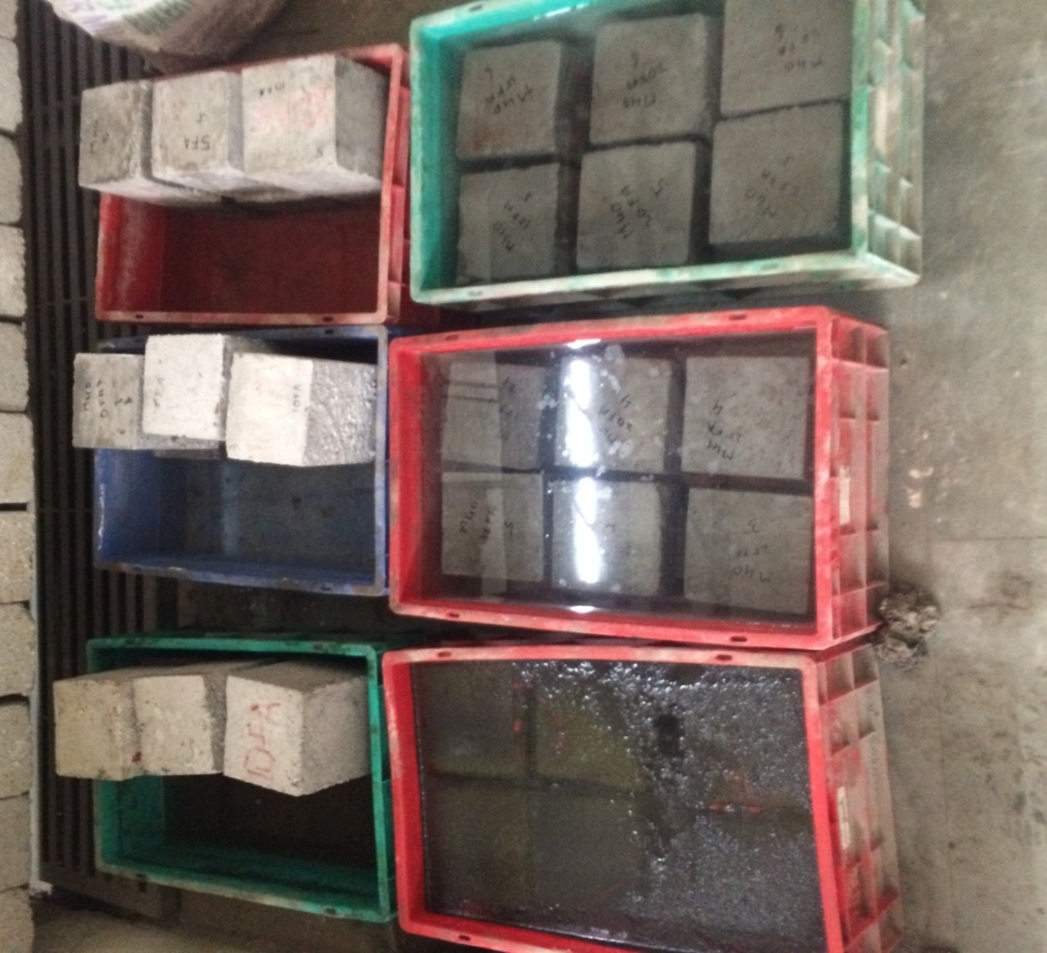
Acid Resistance Test
Figure2: Concrete cubes immersed in HCl
Figure3: % weight loss of R-0and R-45
Sl.no | Specimen Mm-R-0 | Days of testing | Initial weight in kg | Final weight in kg | Weight loss in kg | % weight loss
1 | 100x100x100 | 28 | 8.278 | 8.098 | 0.18 | 2.17
2 | 100x100x100 | 56 | 8.278 | 8.018 | 0.26 | 3.14
Sl.no | Specimen Mm-R-45 | Days of testing | Initial weight in kg | Final weight in kg | Weight loss in kg | % weight loss
1 | 100x100x100 | 28 | 8.262 | 8.016 | 0.246 | 2.98
2 | 100x100x100 | 56 | 8.262 | 7.98 | 0.282 | 3.413

Slide 16
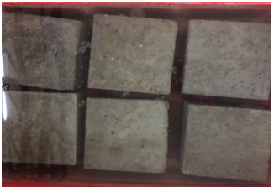
B. Chloride Resistance Test
Figure4: specimen immersed in chloride solution Figure5: % weight loss R-0 and R-45
Sl. no | Specimen-R-0 Mm | Days of testing | Initial weight in kg | Final weight in kg | Weight loss in kg | % weight loss
1 | 100x100x100 | 28 | 8.280 | 8.305 | -0.025 | -0.302
2 | 100x100x100 | 56 | 8.280 | 8.308 | -0.028 | -0.338
Sl.no | Specimen-R-45 Mm | Days of testing | Initial weight in kg | Final weight in kg | Weight loss in kg | % weight loss
1 | 100x100x100 | 28 | 8.264 | 8.298 | -0.034 | -0.41
2 | 100x100x100 | 56 | 8.264 | 8.3 | -0.036 | -0.43

Slide 17
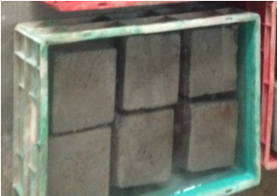
Sulphate Resistance Test
Figure6: specimen immersed in MgSO₄ solution Figure7: % weight loss of R-0 and R-45
Sl. no | Specimen-R-0 mm | Days of testing | Initial weight in kg | Final weight in kg | Weight loss in kg | % weight loss
1 | 100x100x100 | 28 | 8.283 | 8.358 | -0.075 | -0.905
2 | 100x100x100 | 56 | 8.283 | 8.168 | 0.115 | 1.388
Sl. no | Specimen-R-45 mm | Days of testing | Initial weight in kg | Final weight in kg | Weight loss in kg | % weight loss
1 | 100x100x100 | 28 | 8.265 | 8.370 | -0.105 | -1.27
2 | 100x100x100 | 56 | 8.265 | 8.288 | -0.023 | -0.278

Slide 18
Compressive Strength of Concrete after Acid, Sulphate and Chloride Attack
Specimen | Compressive Strength at 28 days- N/mm² | Comparative Reduction in strength | Compressive Strength at 56 days- N/mm² | Comparative Reduction in strength
Acid attack-R-0 | 50.14 | 25.64% | 38.36 | 43.11%
Acid attack-R-45 | 41.8 | 30.53% | 30.52 | 49.3%
Sulphate attack-R-0 | 70.2 | 3.9% | 67.58 | 0.22%
Sulphate attack-R-45 | 65.4 | 7.9% | 61.9 | 2.79%.
Chloride attack-R-0 | 68.9 | 2.13% | 58.86 | 5.48%
Chloride attack-R-45 | 63.66 | 12.7% | 52.32 | 13.05%

Slide 19
Compressive strength of concrete after acid attack

Slide 20
Compressive strength of concrete after sulphate attack

Slide 21
Compressive strength of concrete after Chloride attack

Slide 22
SATURATED WATER ABSORPTION TEST
Concrete specimens R-0 and R-45 subjected to water absorption test
Specimen | Time in minute | Dry weight in kg | Wet weight in kg
R-0 | 180 | 0.994 | 1.01
R-45 | 180 | 0.978 | 1
% of water absorption R-0 = 1.584%
% of water absorption R-45 = 3.2%

Slide 23
RESULTS AND DISCUSSION
By observing Table.3, the compressive strength for 0% replacement ratio for w/c 0.36 is less than that for w/c of 0.27. The percentage reduction of compressive strength after 28 days is 13.27% indicating that with increasing w/c the compressive strength decreases. The compressive strength achieved for w/c ratio of 0.27 at 45% replacement ratio is 66 MPa, which is closer to the target mean strength and hence it is being considered as an optimum mix.
Table.4 gives us the inference of split tensile strength of 0% replacement ratio of w/c 0.36 is less than w/c ratio of 0.27. The percentage reduction of the split tensile strength after 28 days is 2% indicating that with increasing w/c the split tensile strength decreases.
Table.5 we can observe that, the reduction of strength of replacement ratio of 0% for w/c ratio of 0.36 is minimal compared to w/c ratio of 0.27.
From the optimization technique used it is observed from the S/N ratio that optimum replacement ratio is 45% for w/c ratio of 0.27.

Slide 24
RESULTS AND DISCUSSION
Durability of concrete when exposed to hydrochloric acid is that under the effect of acid attack the weight loss is rapid in both natural as well as recycled aggregate concrete. Hence the strength remained is a recycled aggregate is only 50% after the specimen is subjected to acid attack.
Specimens when immersed in chloride solution has initially increased in their weight but after 56 days there is reduction in weight .this indicates that the recycled aggregates absorbs more water due increase in the porosity and capillary pores.
In case of specimens subjected to sulphate attack, it can be observed that the results are positive as we can see a development in strength with increase in exposure to sulphate solution. This is true in both R-0 and R-45 although the strength developed in R-45 is less than that of R-0.This strength development may be due to formation of ettringite which helps in better bond and strength.
In case of water absorption, the R-45 exhibit higher water absorption values as compared to R-0. This is due to the presence of adhered mortar present in the aggregates. The greater is the adhered mortar, the more is the water absorption in the concrete.

Slide 25
CONCLUSIONS
The specific gravity and bulk density of recycled aggregates is lower than the natural aggregates, because of adhered mortar present in recycled aggregates.
Reduction in compressive strength by increase in the percentage replacement of natural aggregates by recycled aggregates in concrete. The compressive strength achieved for w/c ratio of 0.27 at 45% replacement ratio is 66 MPa, which is closer to the target mean strength, hence concluded that optimum value.
The maximum tensile strength is obtained for 0.27 w/c ratio at all replacement ratios the split tensile strength is found to be more than the 10% of its compressive strength. It can be inferred from the test results that the variation is quite less for each variation in w/c ratios. It can also be observed that the strength decreased with increase in replacement ratio.
For all replacements ratios maximum flexural strength can be obtained at w/c ratio of 0.27.
Optimum compressive strength obtained using Taguchi method is for w/c ratio of 0.27 and replacement ratio of 45%.
From the above study we can infer that we can achieve required target strength for a replacement ratio of 45% adopting w/c ratio of 0.27.
Durability of recycled aggregates needs indicates a declining trend in some cases and some cases it behaves at acceptable limit. Hence further more research is required on durability aspect of recycled aggregate concrete.

Slide 26
REFERENCES
Taguchi G, Konishi S ,Taguchi Methods, orthogonal arrays and linear graphs, tools for quality American supplier institute, American Supplier Institute; 1987,p. 8-35.
Hansen, T.C., Ed.Taylor and Francis,“Recycling of Demolished Concrete and Masonry”, Oxford shire ,UK, 1992, p. 316.
Mater. Struct RILEM Recommendation: Specifications for concrete with recycled aggregates, 1994, 27, 557-559.
W.T. Foster, Basic Taguchi design of experiments, National Association of Industrial Technology Conference, Pittsburgh, PA, 2000.
Deutsches Institute For Standardization: Aggregates for Mortar and Concrete—Part 100: Recycled Aggregates; Berlin, Germany, 2002; p. 18.
Poon, C.S.Azhar, S.Kou,S.C.,“Recycled aggregates for concrete applications”. In Proceeding of the Materials Science and Technology in Engineering Conference—Now, New and Next, Hong Kong, China, 15–17 January 2003; p. 16
Sanchez de Juan, M.Gutierrez, P.A, “Influence of recycled aggregate quality on concrete properties”. In Proceeding of the International RILEM Conference: The Use of Recycled Materials in Building and Structures, Barcelona, Spain, 8–11 November 2004; pp. 545-553.
Malešev, M.Radonjanin, V.Dimča, M, “Research of possibility of application of recycled concrete as aggregate for new concrete”—Part I. In Proceeding of 4th International Science Meeting, INDIS 2006 (Planning, Design, Construction and Renewal in the Construction Industry), Novi Sad, Serbia, 22–24 November 2006; pp. 495-504.
Concrete—Complementary British Standard to BS EN 206-1—Part 2: Specification for Constituent Materials and Concrete; British Standards Institute (BSI): London, UK, 2006; p. 38.

Slide 27
REFERENCES
[9]Evangelista.L, Brito.J, “Mechanical behavior of concrete made with fine recycled concrete aggregate” .Cem. Concr. Compos. 2007, 5, 397-401.
[11] Yang, K.H., Chung, H.S., Ashour. “A Influence of type and replacement level of recycled aggregates on concrete properties”, ACI Mater. J. 2008, 3, 289-296.
[12]Li, X. Recycling and reuse of waste concrete in China: Part I. Material behavior of recycled aggregate concrete. Resour. Conserv.Recycl. 2008, 1-2, 36-44
[13]López-Gayarre, F.; Serna, P.; Domingo-Cabo, A.; Serrano-López, M.A.; López-Colina, C. Influence of recycled aggregate quality and proportioning criteria on recycled concrete properties. Waste Manag. 2009, 12, 3022-3028.
[14]Snezana Marinkovic, Ivan Ignjatovic, Vlastimir Radonjanin, Mirjana Malesev, ACES Workshop Innovative Materials and Techniques in Concrete Construction Corfu, October 10-12, 2010.
[15]Assessment of recycled concrete-Journal of Engineering Research and Studies JERS, Vol.II, Issue I,January-March 2011.
[16]Performance Evaluation Of Recycled Aggregate Used In Concrete -International Journal of Engineering Research and Applications (IJERA) Vol. 2, Issue 4, July-August 2012.
[17]Ng Chin Fei, Nik MizamzulMehat, and ShahrulKamaruddin“Practical Applications of Taguchi Method for Optimization of Processing Parameters for Plastic Injection Moulding: A Retrospective Review”- Hindwai Publications, ISRN Industrial Engineering Volume 2013 (2013), Article ID 462174, 11 pages.
[18]Use Of Recycled Aggregate In Concrete-International Journal of Engineering Research & Technology (IJERT) Vol. 2 Issue 1, January- 2013
[19]Wengui Li, Jianzhuang Xiao, Caijun Shi and Chi Sun Poon, “Structural Behaviour of Composite Members with Recycled Aggregate Concrete” Construction and Building Materials”, 2015, Vol.31, pp. 364–383.

Slide 28
REFERENCES
[20].Suguna Rao and Anagha, S.M.Naik “Utilization of Demolished Waste Concrete Material in Structural Members” JSS Academy of Technical Education, Bangalore, National Conference on “Recent Advancements in Infrastructural Development”-RAID 2015.
[21]B. Suguna rao and B. Lakshmi sravanthi “Strength Properties of High Strength Concrete Using Recycled Concrete Aggregate” MAT journals, Journal of Industrial Engineering and Advances Volume1 Issue 3, 2016.
[22]Harinipriya M-Strength and durability of m30 concrete with various mineral and chemical admixtures- international journal of advances in engineering & technology, Aug., 2015. ©ijaet ISSN: 22311963 598 vol. 8, issue 4, pp. 598-604.
[23]Chetna M. Vyas et al-Durability properties of concrete with partial replacement of natural aggregates by recycled coarse aggregates, International Journal of Civil,Structural,Environmental and Infrastructure Engineering Research and Development (IJCSEIERD)ISSN2249-6866Vol.3,Issue 2,Jun 2013,125-134 ©TJPRC Pvt Ltd.

Slide 29
REFERENCES
[24]ArlindoGoncalves et al-Influence of recycled concrete aggregates on concrete durability, National Laboratory of Civil Engineering (LNEC), Portugal, Abstract ID Number: 279.
[25]Avinashbabu et al-Effect of Normal and High Strength Concrete Made out of Recycled Aggregate. Proceedings of International Conference on Advances in Architecture and Civil Engineering (AARCV 2012), 21st-23rd June 2012, paper id SAMI198, Vol.1.
[26]S.Gangaram-Strength and durability aspects of recycled aggregate concrete- ijret: international journal of research in engineering and technology EISSN: 2319-1163 | PISSN: 2321-7308 volume: 04 special issue: 13 | icise-2015 | dec-2015, available @ http://www.ijret.org 396.
[27]Rajesh Kumar Jain-Investigation of some Technical Properties of RecycledMaterials- Global Journal of Researches in Engineering: J General Engineering Volume 14 Issue 7 Version 1.0 Year 2014 Type: Double Blind Peer Reviewed International Research Journal Publisher: Global Journals Inc. (USA) Online ISSN: 2249-4596 & Print ISSN: 0975-5861.

