Slide 1
Experimental study on AASC using PS ball as fine aggregate at the higher concentration of sodium silicate
Avinash H.T.
Research Scholar
Department of Civil Engineering
NITK Surathkal
Mangaluru - 575025

Slide 2
Presentation outline
Introduction
Experimental program
Mix design
Results and discussion
References

Slide 3
Introduction
Concrete is produced by mixing cement with sand, coarse aggregate and water.
The OPC production is associated with emission of large amount of CO₂ into the atmosphere.
Annually the 1.6 million tons of cement used over world wide producing 12 billion tons of concrete.
The cement industry is extremely energy intensive, as it consumes 4 GJ per ton of energy.

Slide 6
Introduction
Rajamane et al. 2011 reported the gainful utility of flyash and slag as an alternative binder materials with lower carbon foot print.
Initially the study on alkali activated binder was carried by purdon in late 1940.
After that, in late 1950 Glukhovsky invented alkali activated sysytem came out with result forming C-S-H.
The application of this AASC technology offers opportunity to address a various sustainability issues.

Slide 7
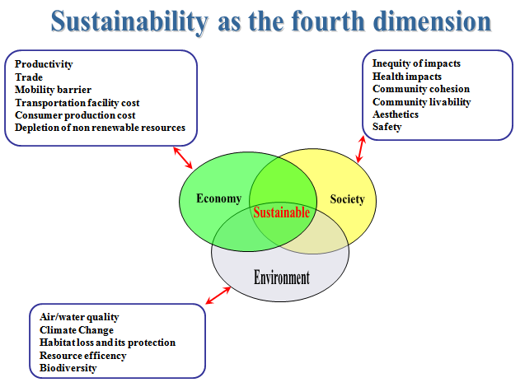

Slide 9
Introduction
Sand is critical for infrastructure development and construction, global sand reserves being depleted.
Indiscriminating extracting of sand has severe environmental, social, economic and geological inputs.
This paper centers on using the Precious Slag (PS) ball as the most viable alternative for fine aggregate in the Alkali Activated Slag Concrete (AASC).

Slide 10
Experimental Programme
Ground Granulated Blast Furnace Slag (GGBFS) procured from M/s Jindal Steel Works, Bellary.
PS ball procured from Ecomaister Beads, Bellary.
Crushed stone pieces of max nominal size of 20mm down were used as coarse aggregate.

Slide 11
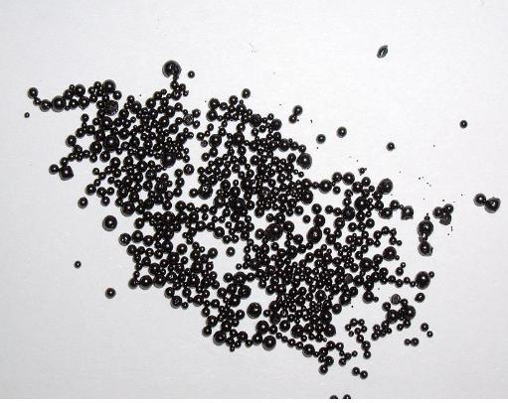
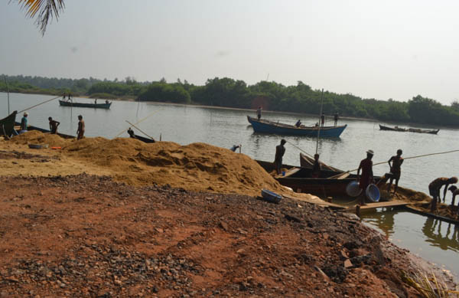
Criteria behind using PS Ball
The overuse of river sand for construction has various undesirable social and ecological consequences.
During this process free CaO and Fe₂O₃ are scattered to form a solid PS Ball.
They are environment friendly as the material is pollution free and non toxic

Slide 12
Dissociation of ions
Na⁺ OH⁻ SiO₄⁻

Slide 14
Details of mix proportion for concrete mixes
Mix ID | Binder (kg\m³) | Molarity | SS/SH ratio | Sodium silicate (kg\m³) | Sodium hydroxide (kg\m³) | Coarse Aggregate (kg\m³) | Fine Aggregate (kg\m³) | Total weight (kg\m³)
M1 M2 M3 M4 | 443 443 443 443 | 8 8 8 8 | 1 1.5 2 2.5 | 66.465 79.758 88.62 95 | 66.465 53.172 44.31 38 | 1167.36 1167.36 1167.36 1167.36 | 656.64 656.64 656.64 656.64 | 2400 2400 2400 2400
Alkaline liquid / binder = 0.3

Slide 15
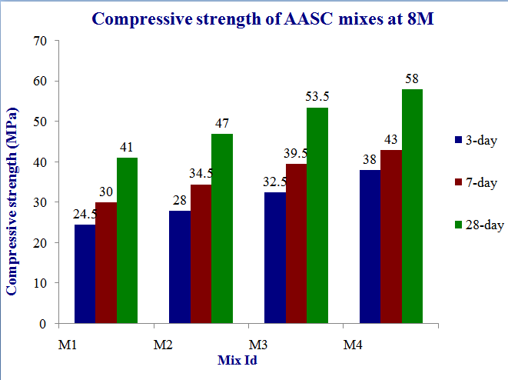

Slide 16
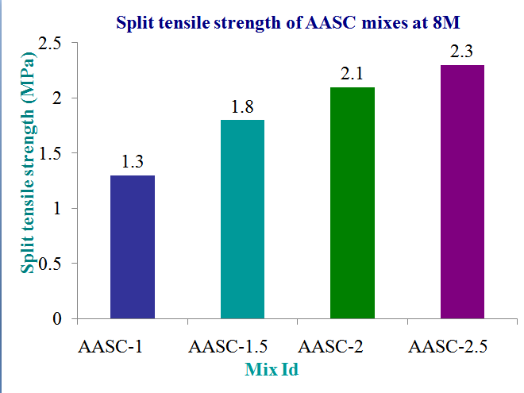

Slide 17
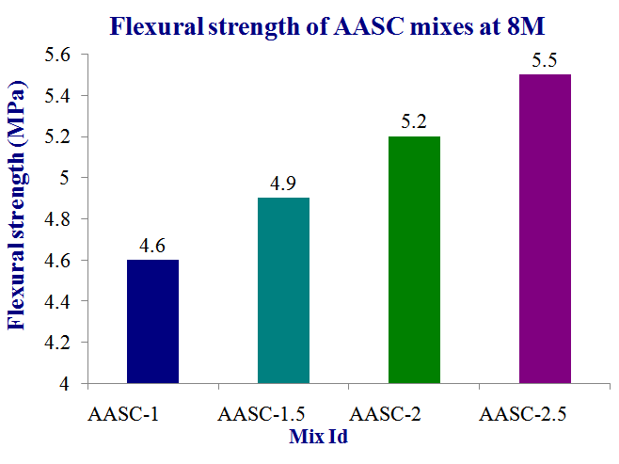

Slide 20
Conclusions
The increased sodium silicate concentration will have positive effect on compressive strength.
The compressive strength of AASC is dependent on NaOH concentration and Na₂O content in alkaline activator solution.
The AASC mix with AL/B ratio of 0.3, 8M NaOH and SS/SH ratio of 1.5 can be proposed as ideal mix.

Slide 21
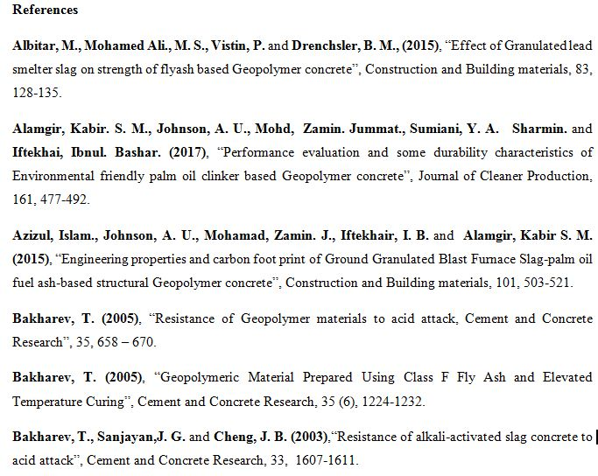

Slide 22
